Slide 1
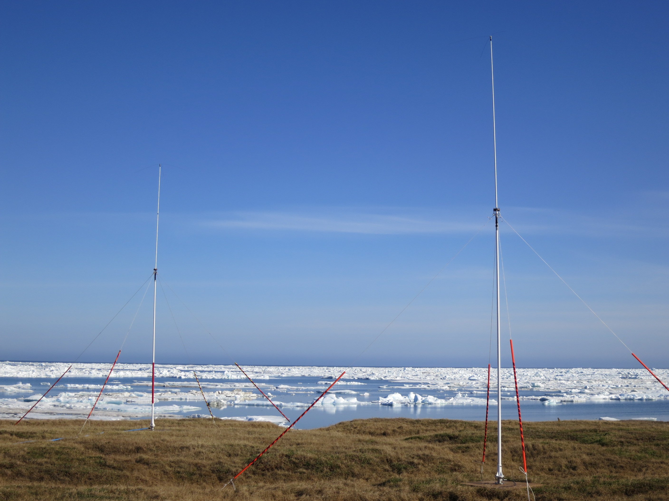
Surface Current Patterns in the Northeastern Chukchi Sea and Their Response to Wind Forcing
Ying-Chih Fang, Rachel Potter,
Hank Statscewich and Thomas Weingartner
College of Fisheries and Ocean Sciences
University of Alaska Fairbanks

Slide 2
Two major forces influencing the Chukchi Sea circulation
Pressure gradient (background state) - northward mean flow
Winds (mean winds oppose mean flow) - sheared surface layer - currents may change directions

Slide 3
Why do we care about surface currents?
Past results are based on subsurface historical measurements
Evaluate surface current responses influenced by both winds and pressure gradient - important for material transport
Notes:
Option:
Surface currents are influenced by both winds and pressure gradient - important for oil spill models

Slide 4
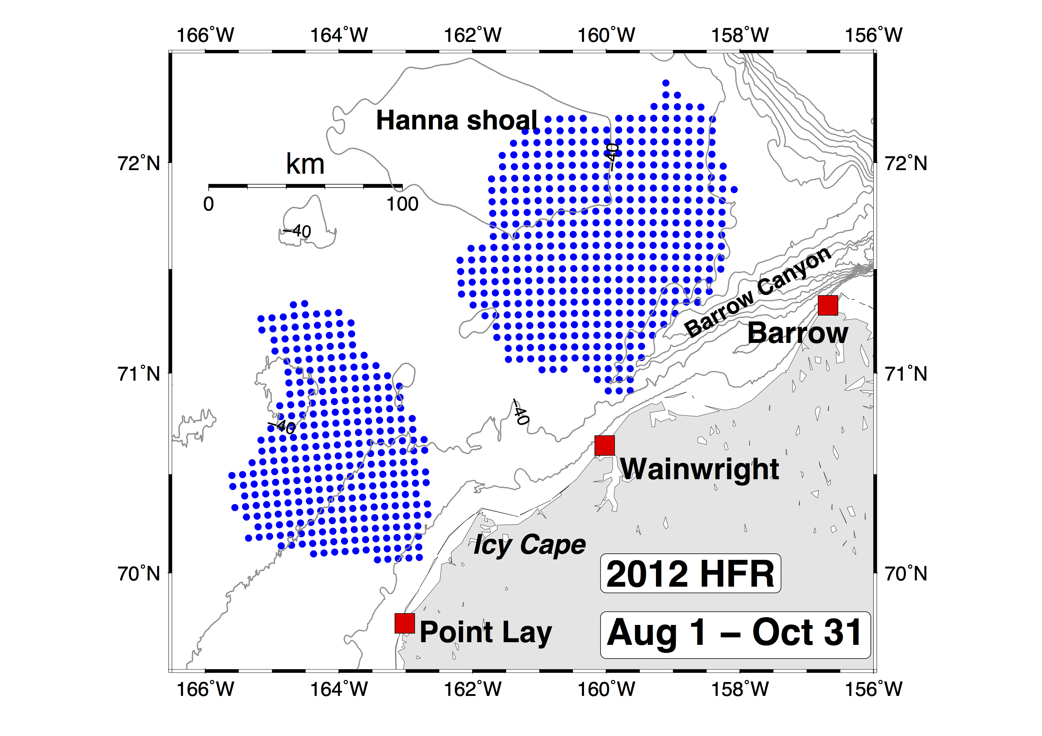
High-frequency radar (HFR)
Radar site
Data grid points

Slide 5
Data and methods
QA/QC
HFR surface currents + (< 2 m depth)
North American Regional Reanalysis (NARR) winds (10 m height)
Self-Organizing Map (SOM)
Circulation regimes + paired wind fields
Four regimes for 2012 data

Slide 6
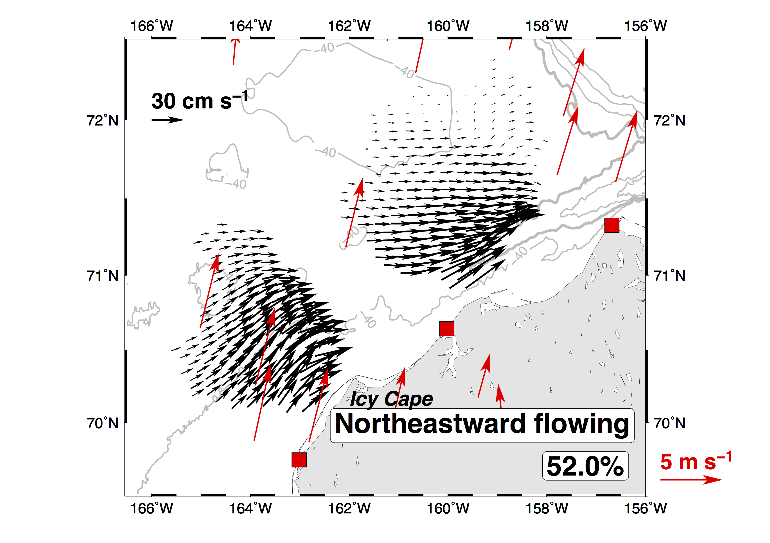
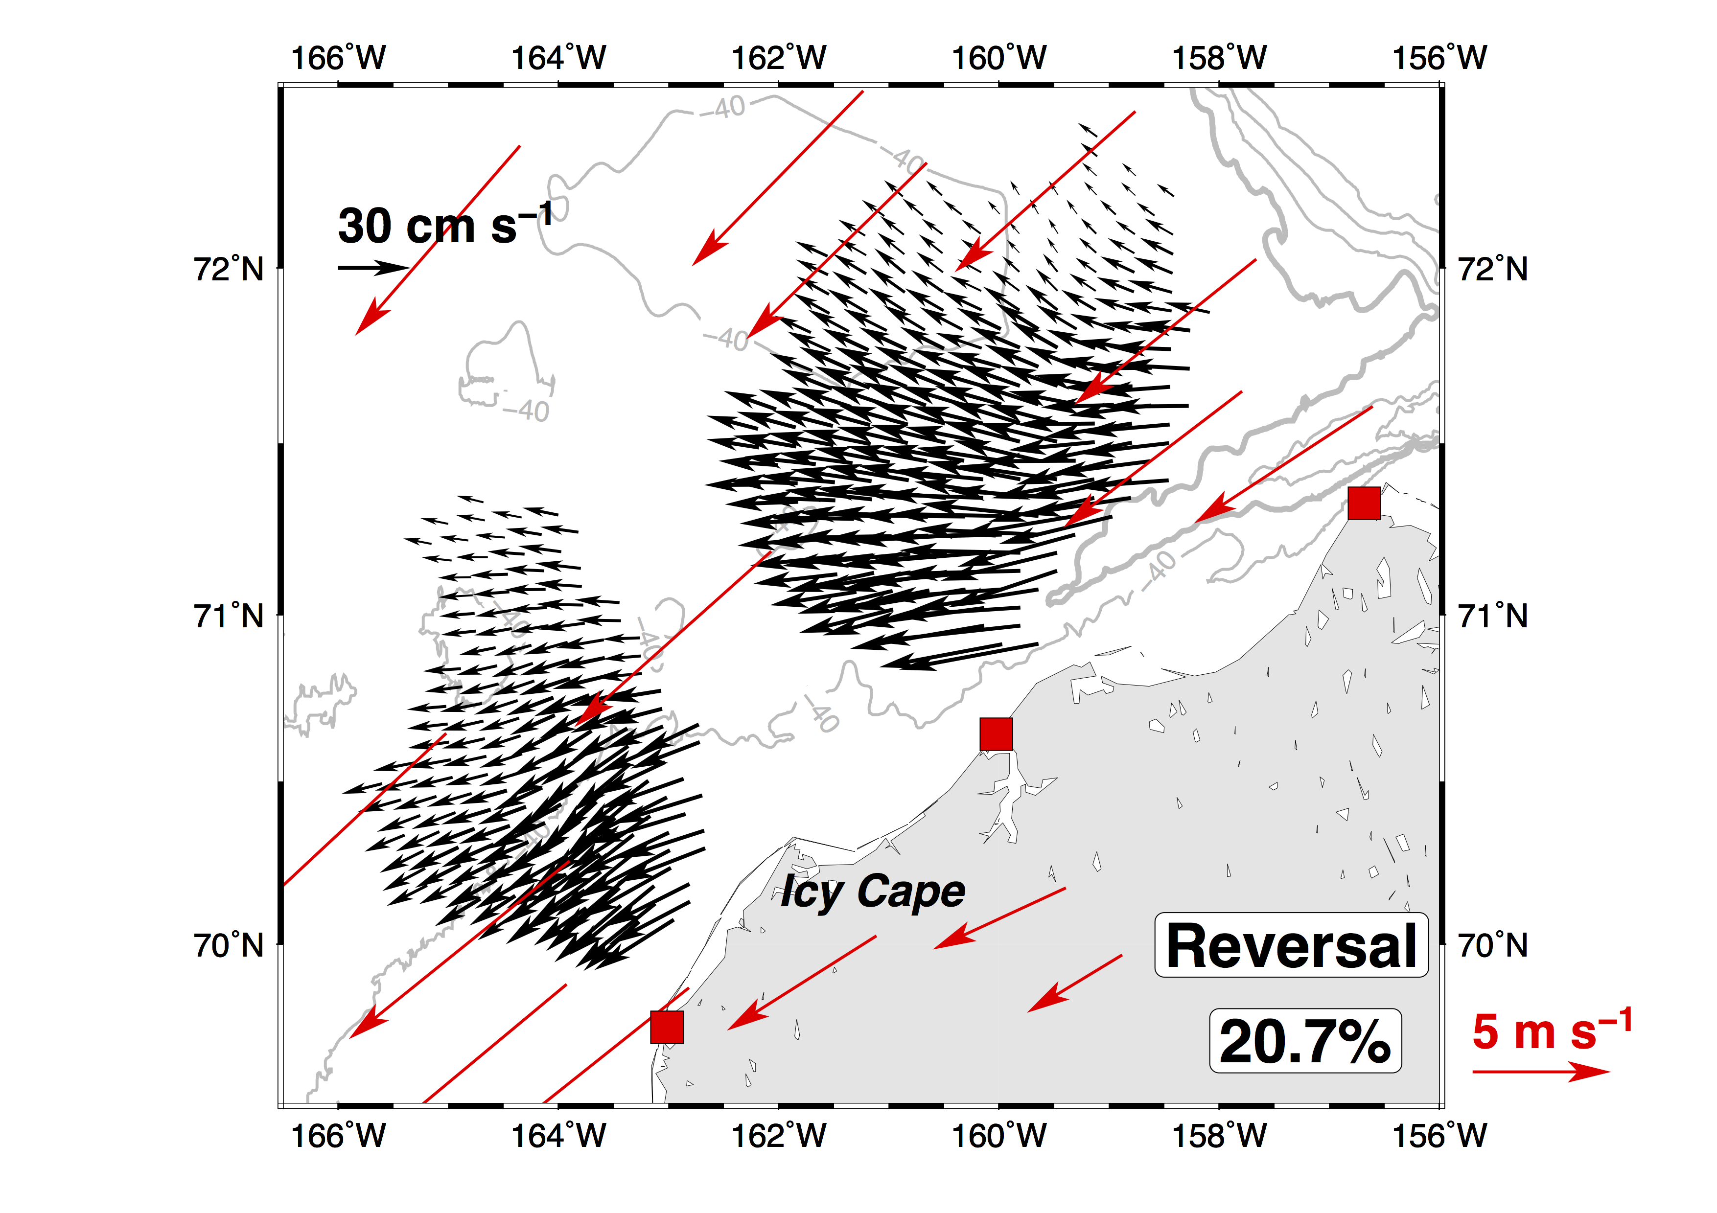
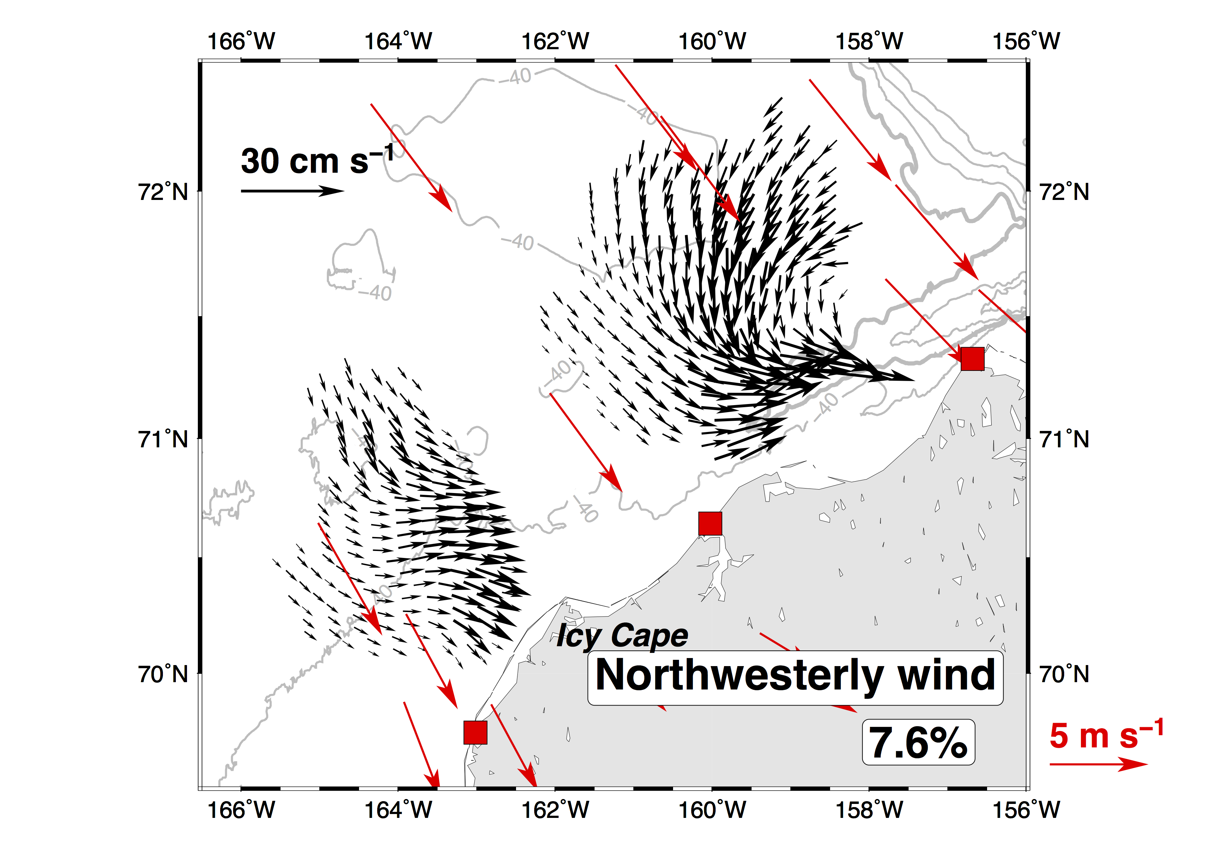
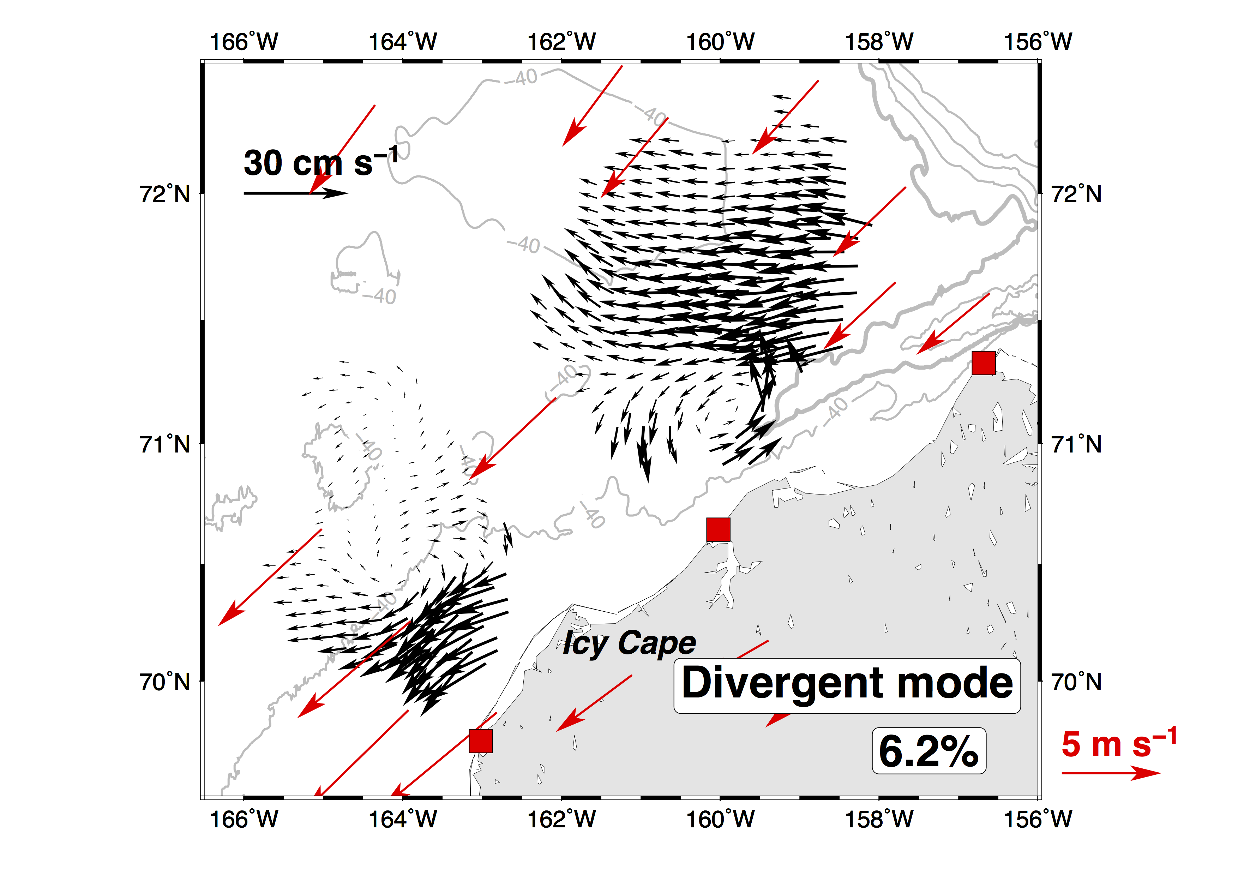
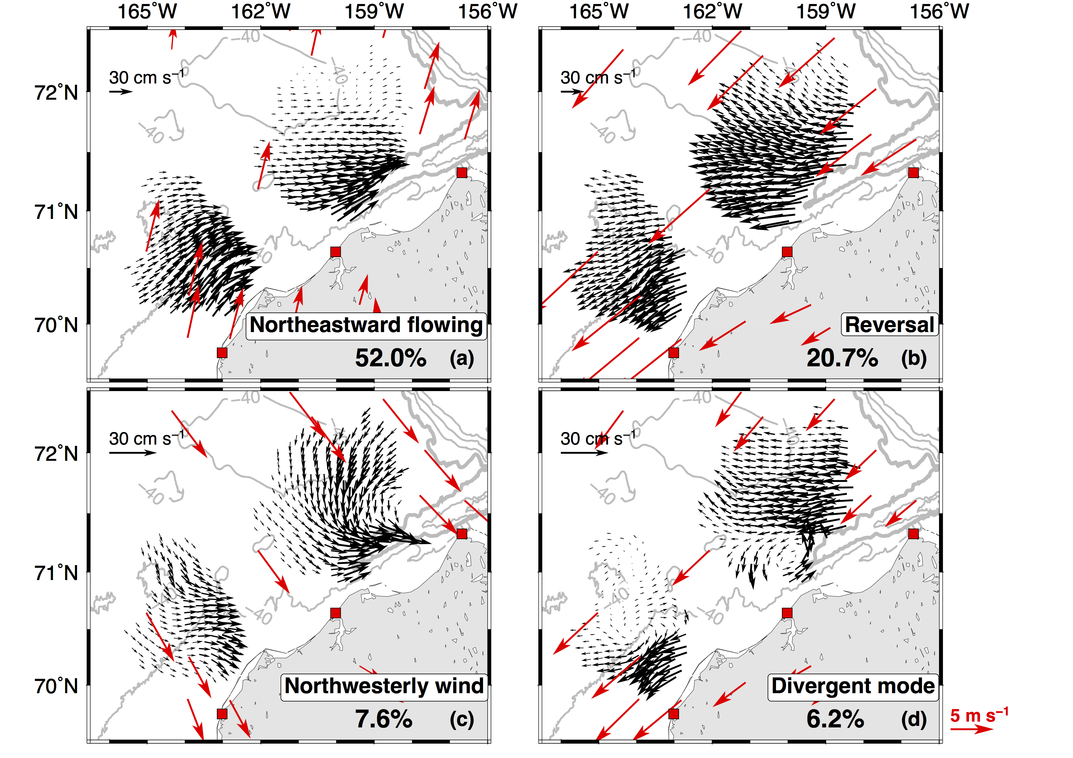
Self-Organizing Map (SOM) derived regimes
Notes:
提及有13.5%是 Data gaps

Slide 7
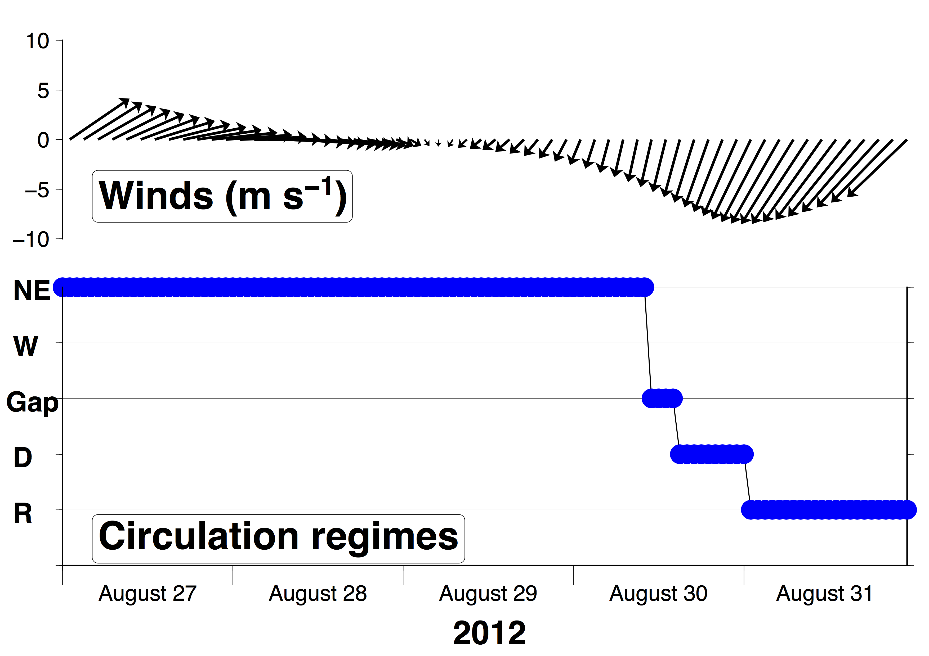
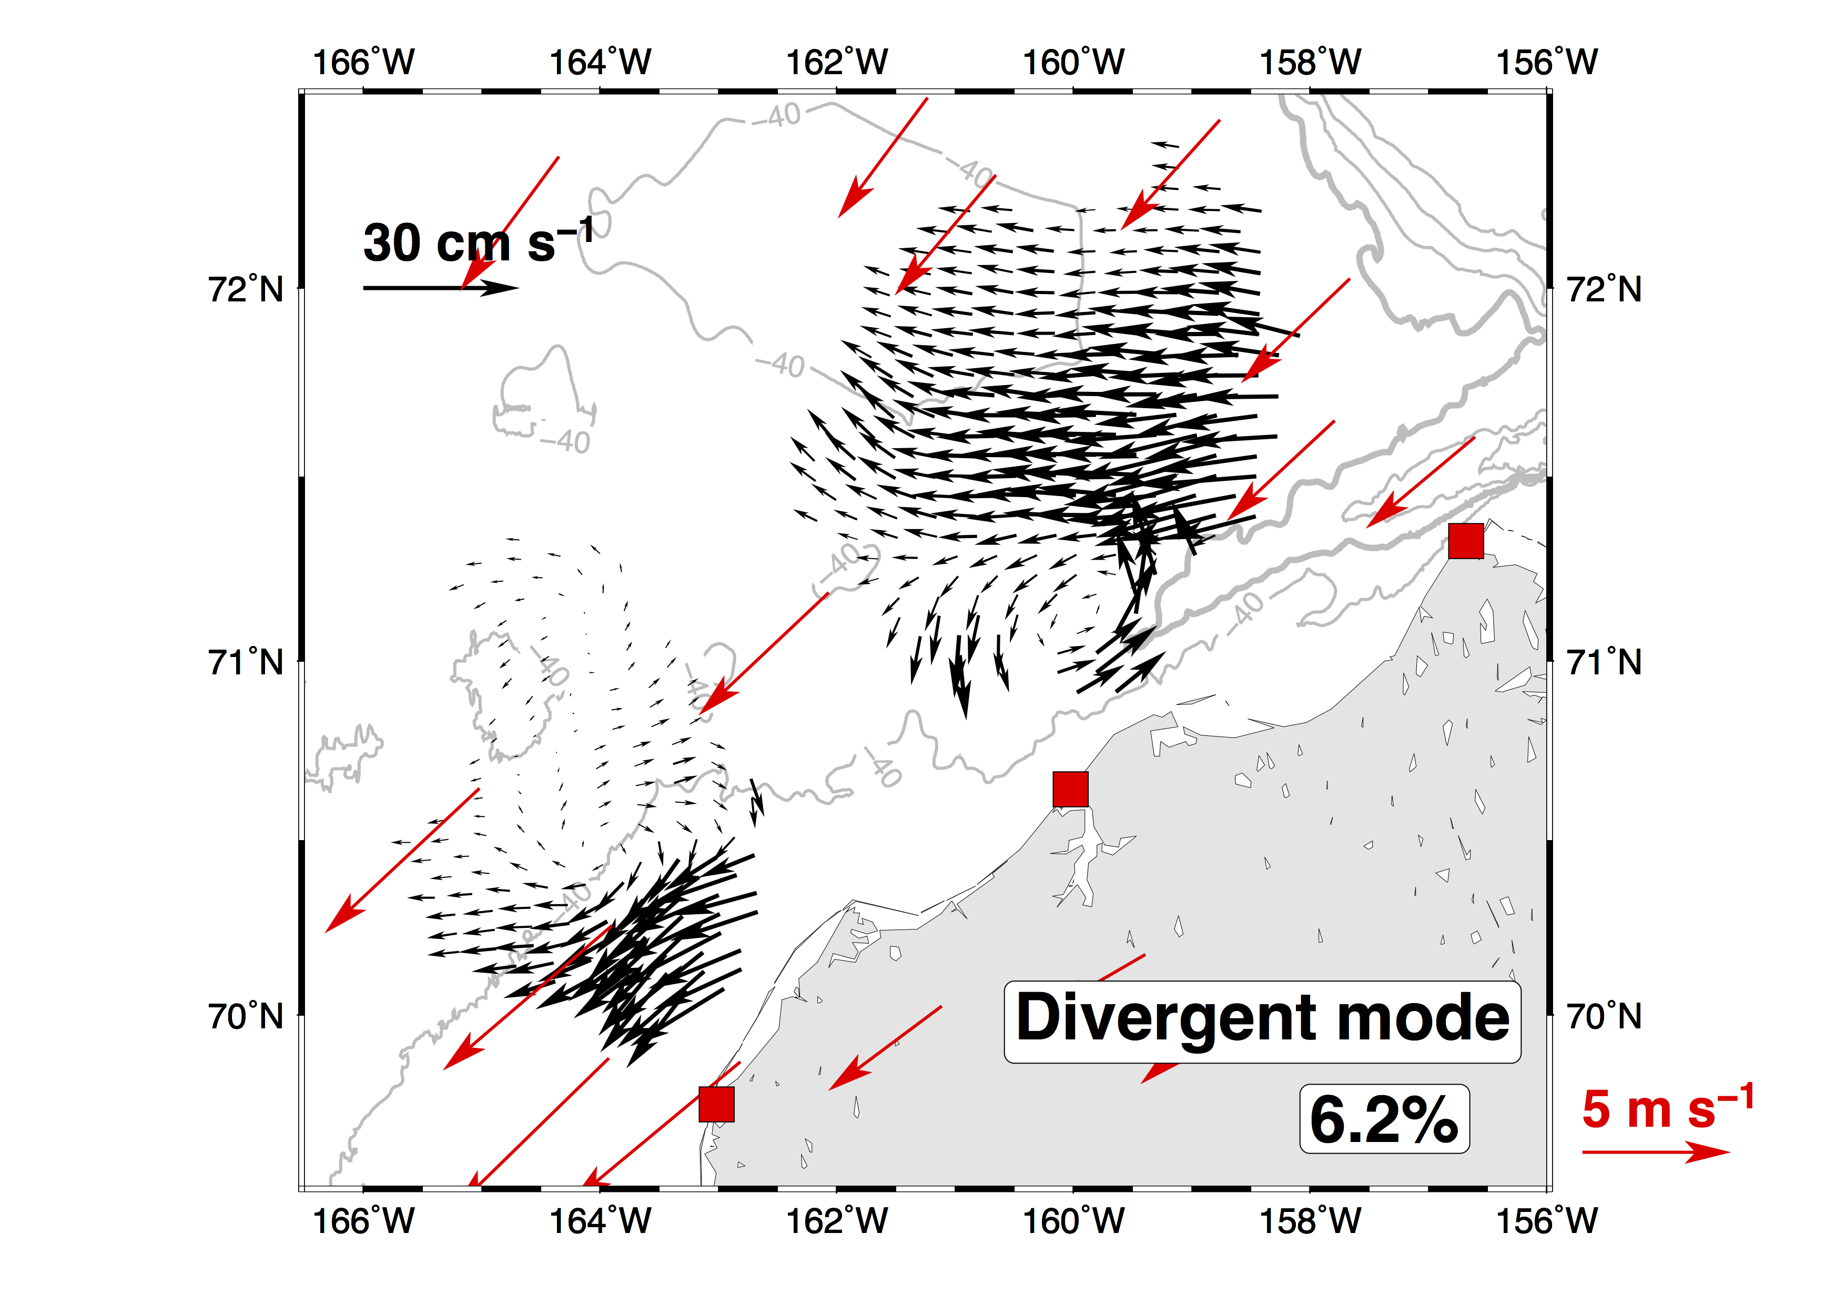
Time series analysis

Slide 8
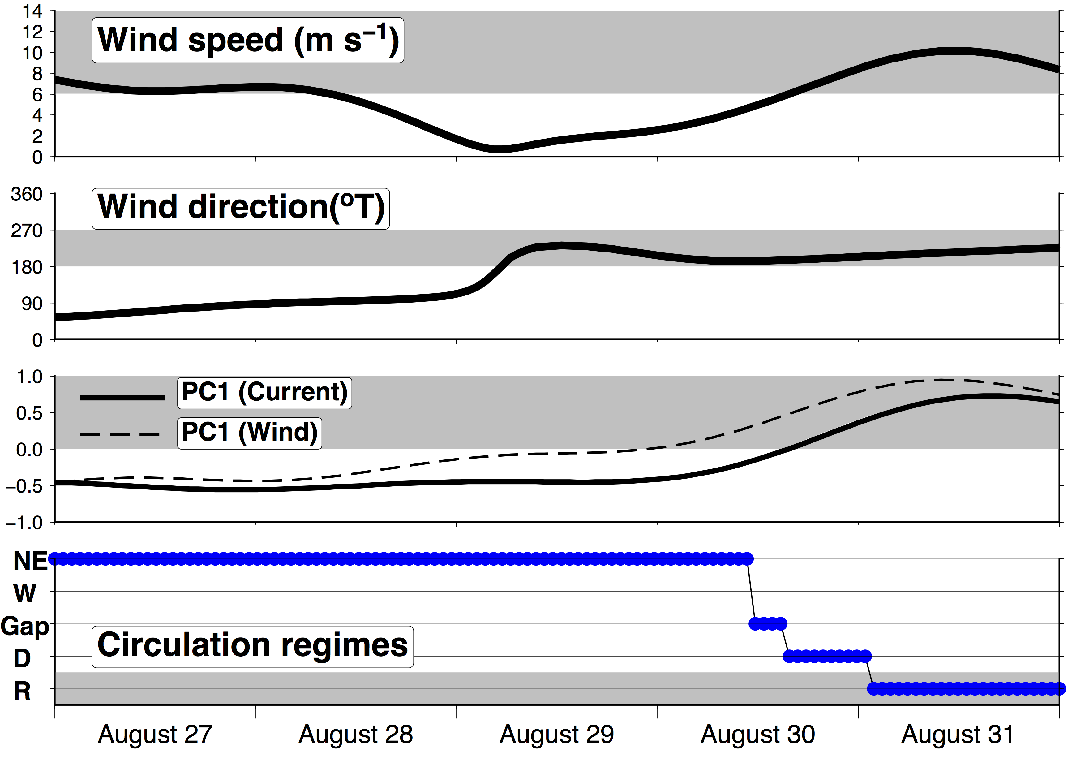
6 m s⁻¹
northeasterly
Reversal regime
Northeasterly winds
16 h
Divergent mode
Reversal
2012

Slide 9
Circulation regimes are related to winds.
Current reversal occurs when northeasterly winds > 6 m s⁻¹
Divergent mode is a transitional state before currents fully reverse

Slide 10
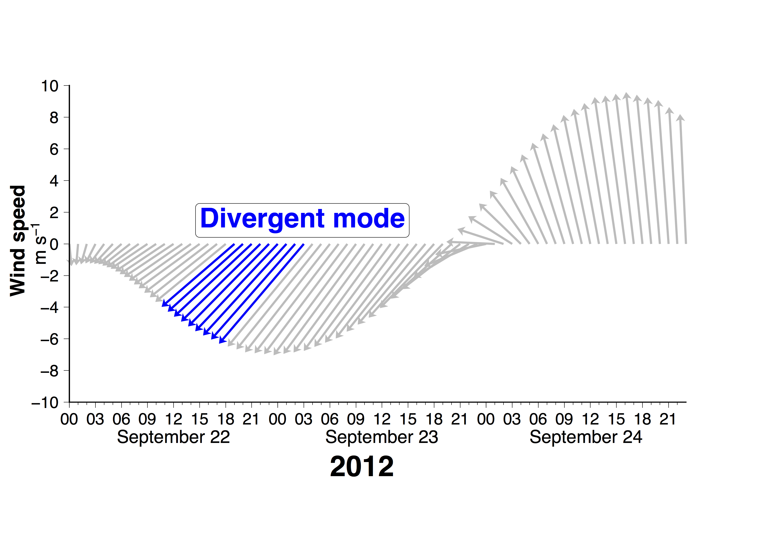
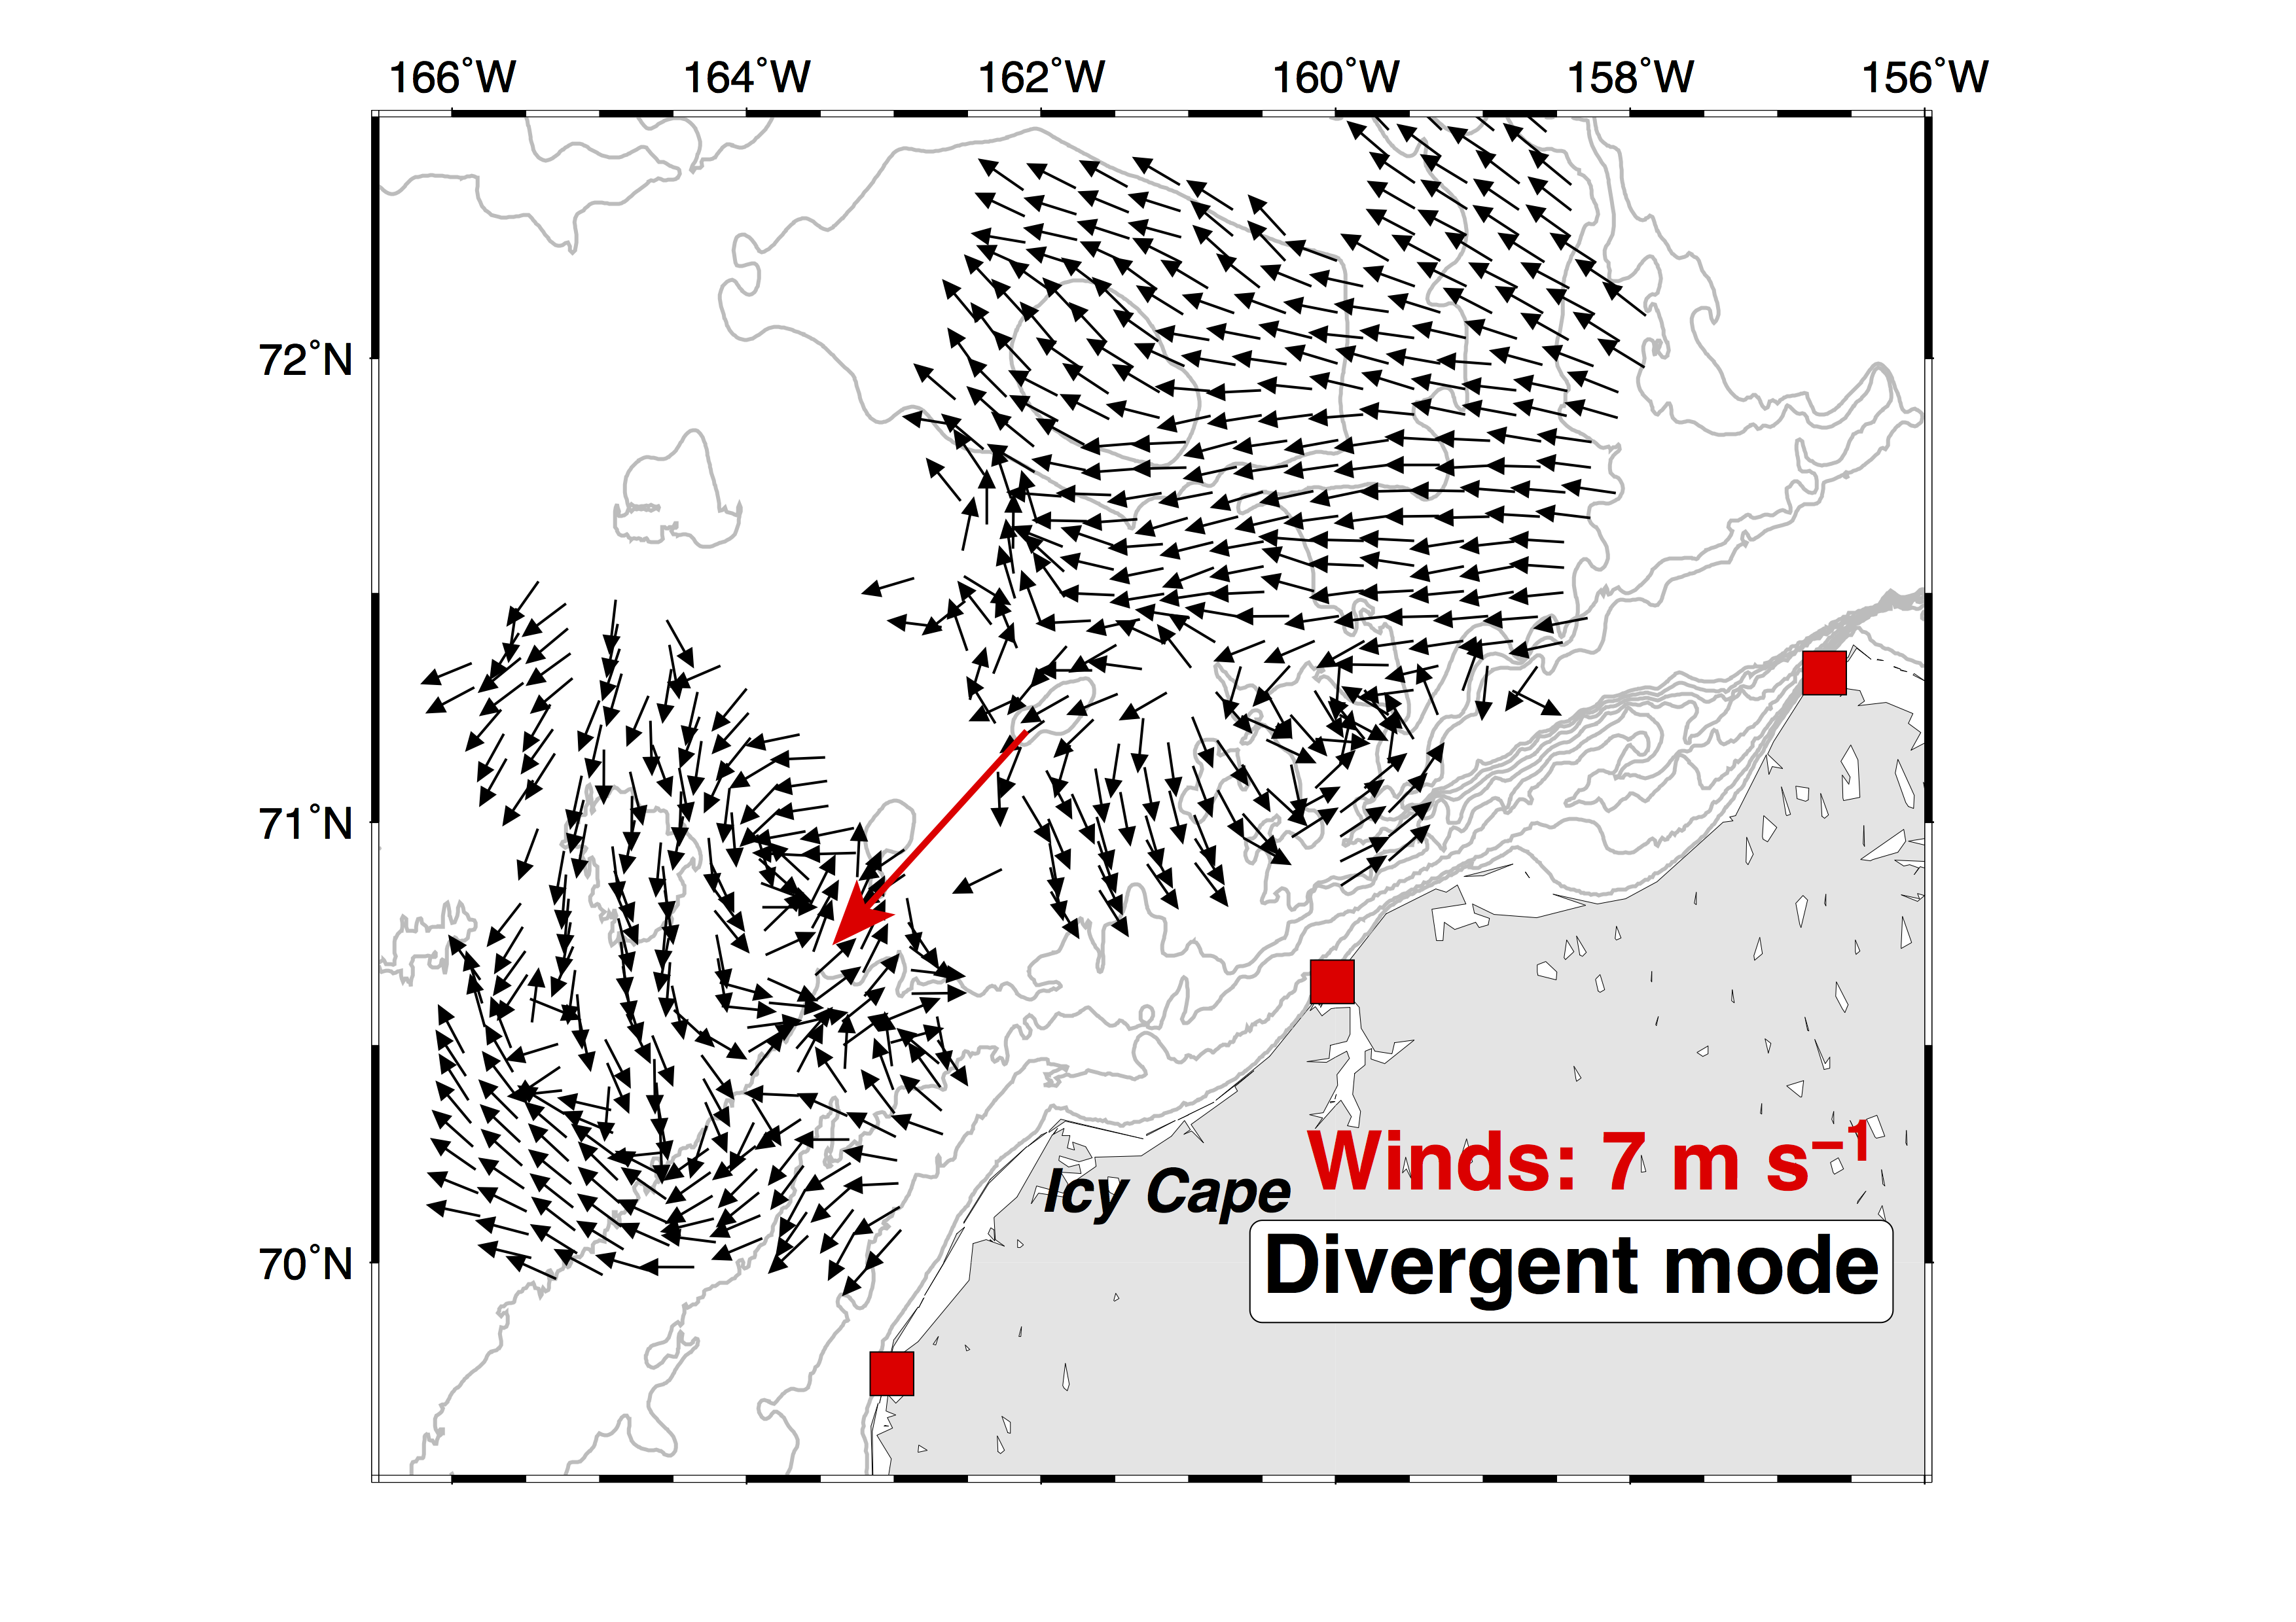
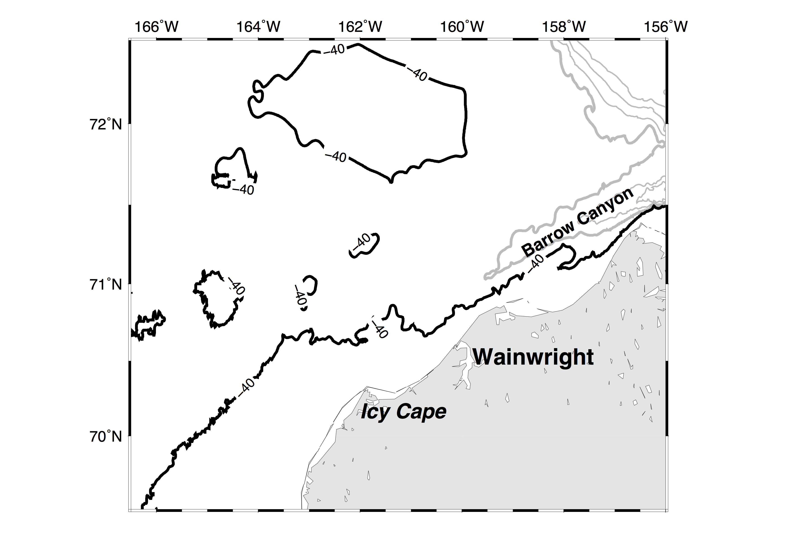
How does divergent mode develop?
Shallower
Deeper
Deeper
Wind
Shallower
PG

Slide 11
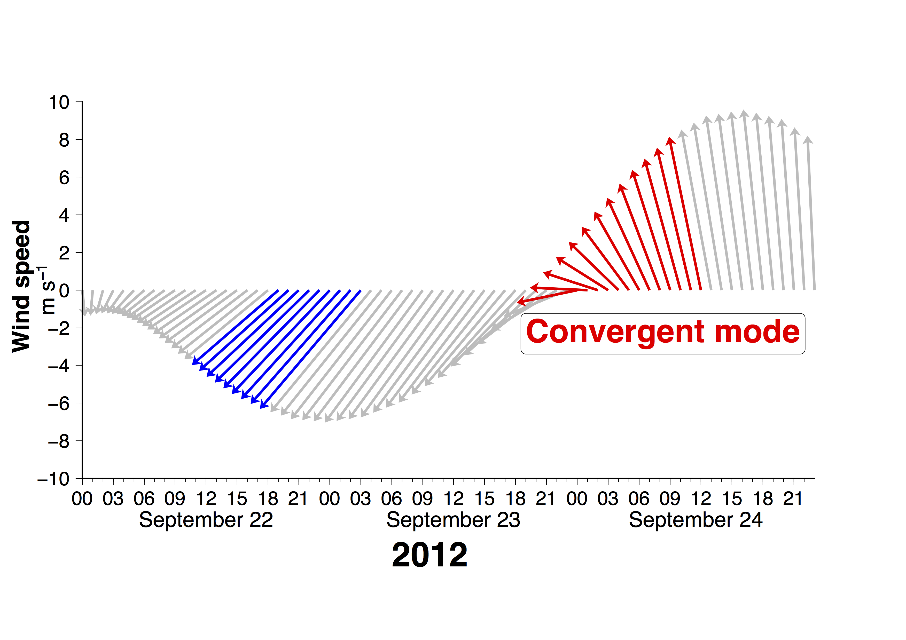
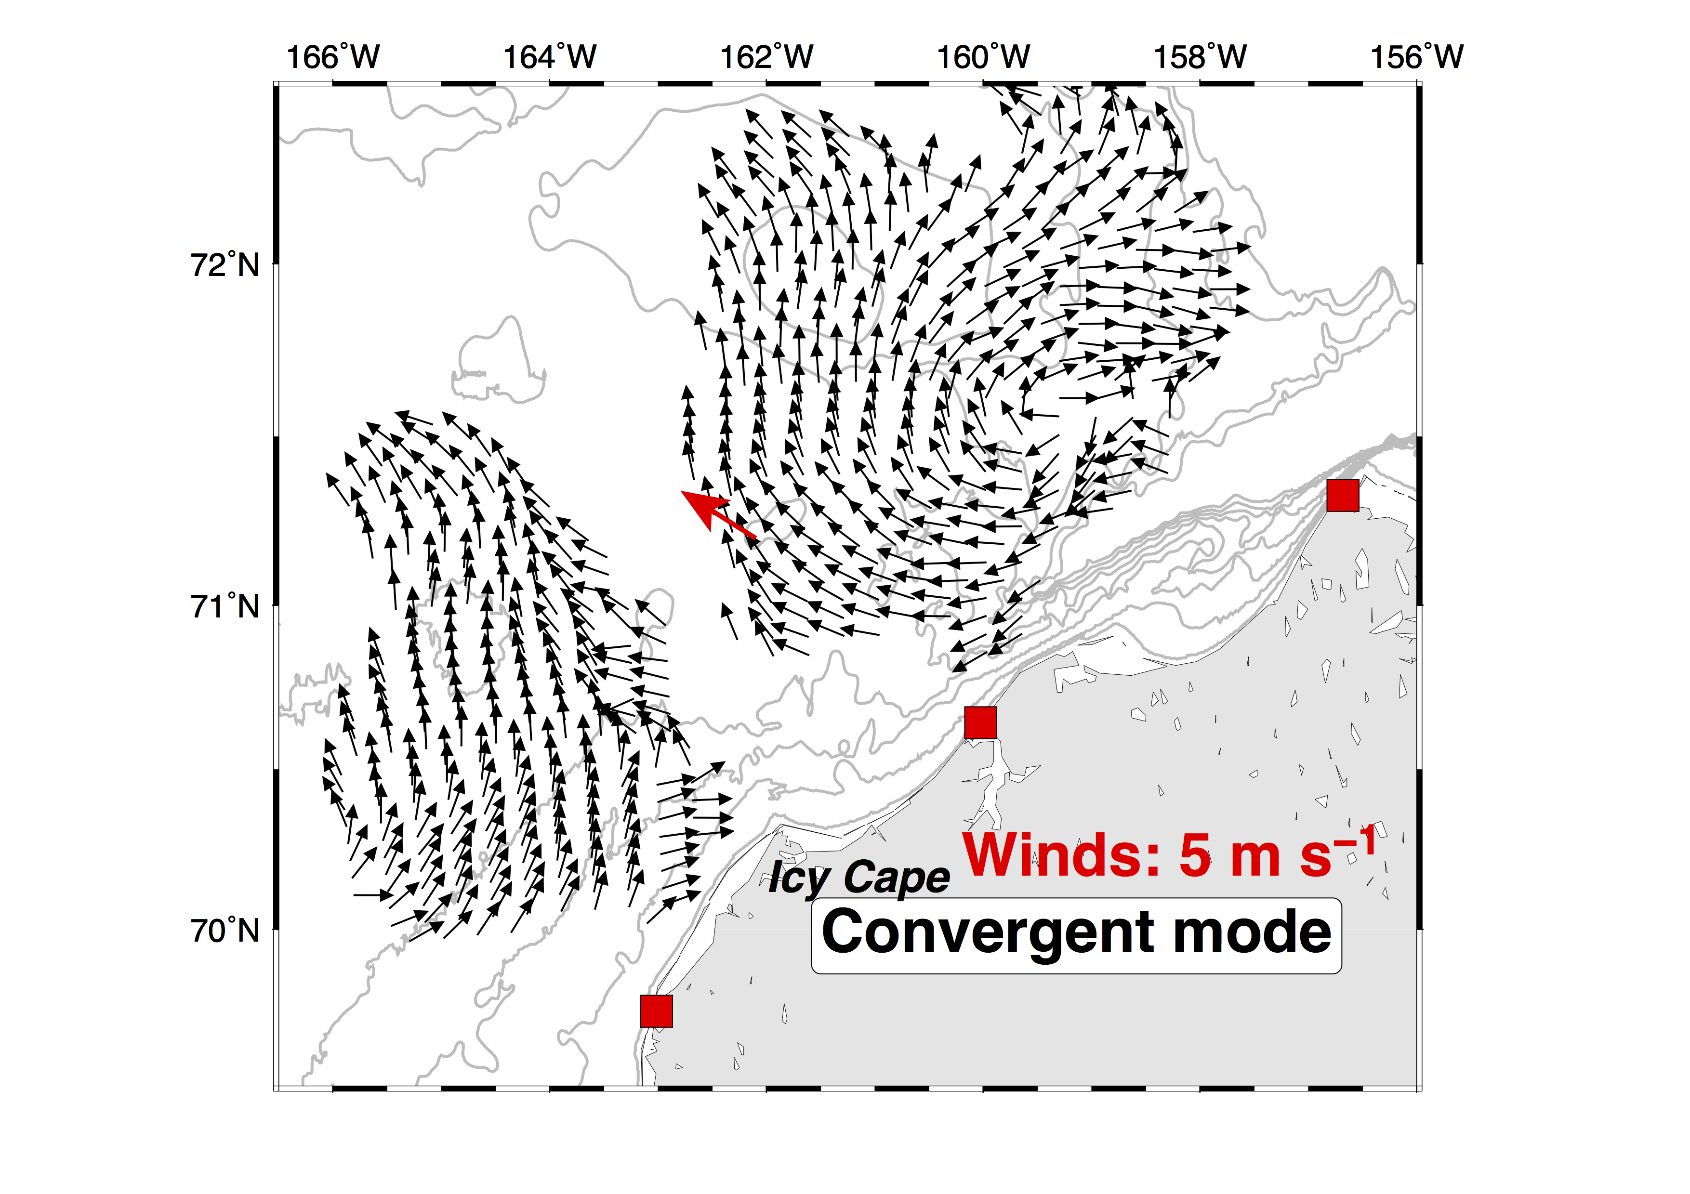
How does convergent mode develop?
Shallower
Deeper
Reversal regime
Deeper
Wind
Divergent mode
Shallower
PG

Slide 12
Concluding Remarks
Northeasterly winds, < 6 m s⁻¹.
And other wind conditions
Northeasterly winds, ~6 m s⁻¹
Northeasterly winds, > 6 m s⁻¹
< ~24 hours
NE currents
Divergent mode
Reversal
Convergent mode

