Slide 1
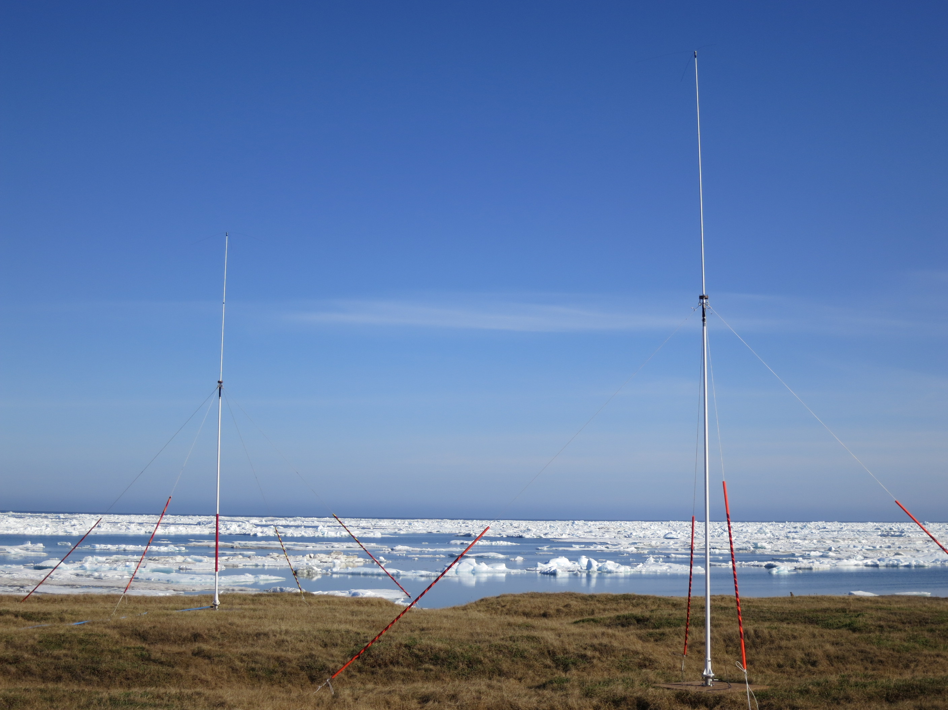



Surface Current Patterns in the Northeastern Chukchi Sea and Their Response to Wind Forcing
Ying-Chih Fang, Rachel Potter,
Hank Statscewich, Thomas Weingartner, Peter Winsor and Brita Irving
College of Fisheries and Ocean Sciences
University of Alaska Fairbanks

Slide 2

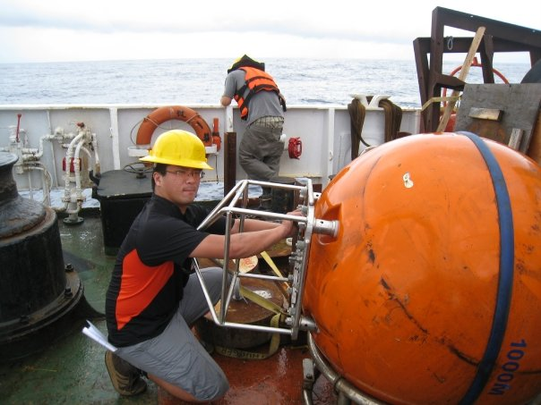

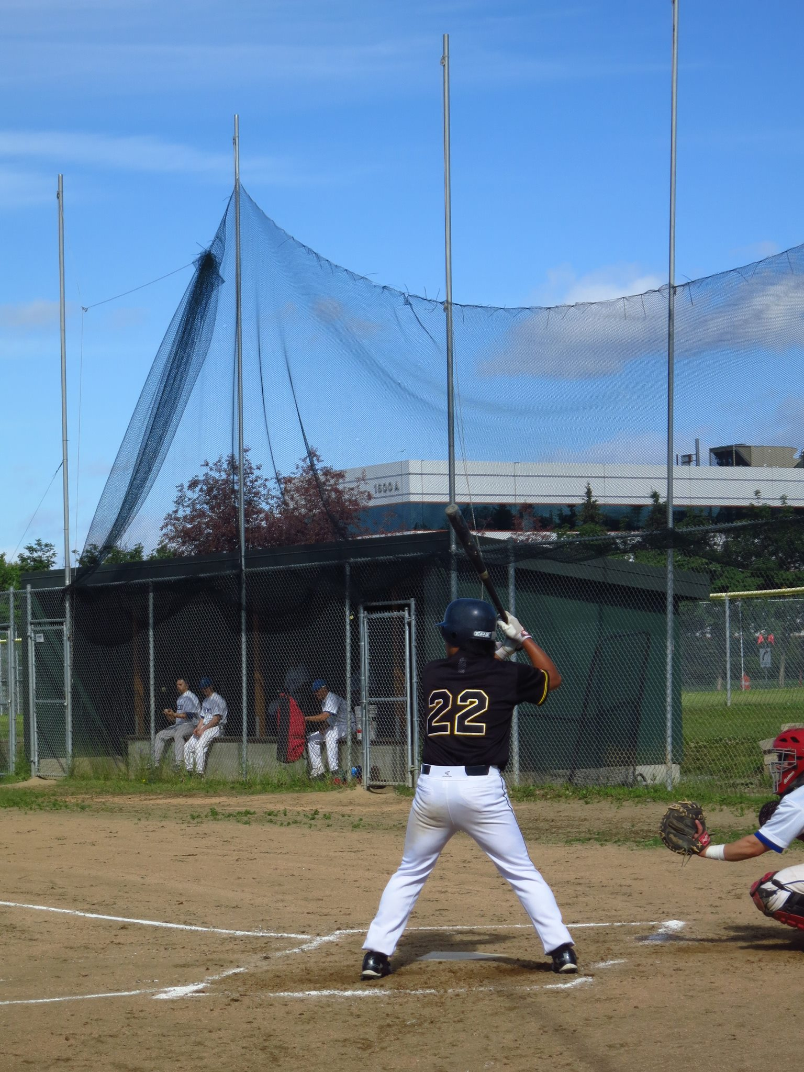
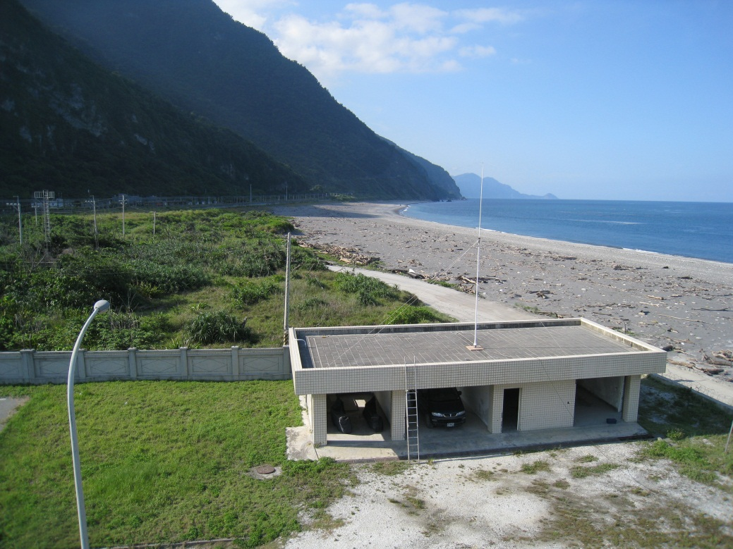
Who am I
2007
High frequency radar
Tank commander
Taiwan Army
$60 per week

Slide 3
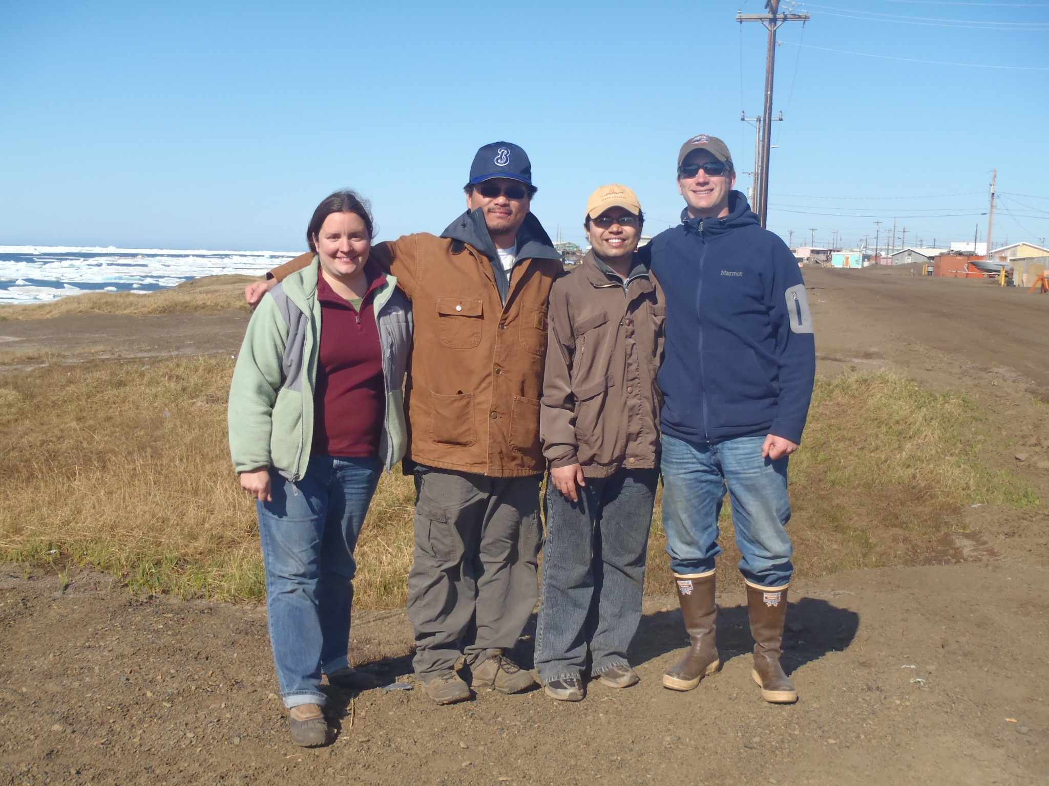

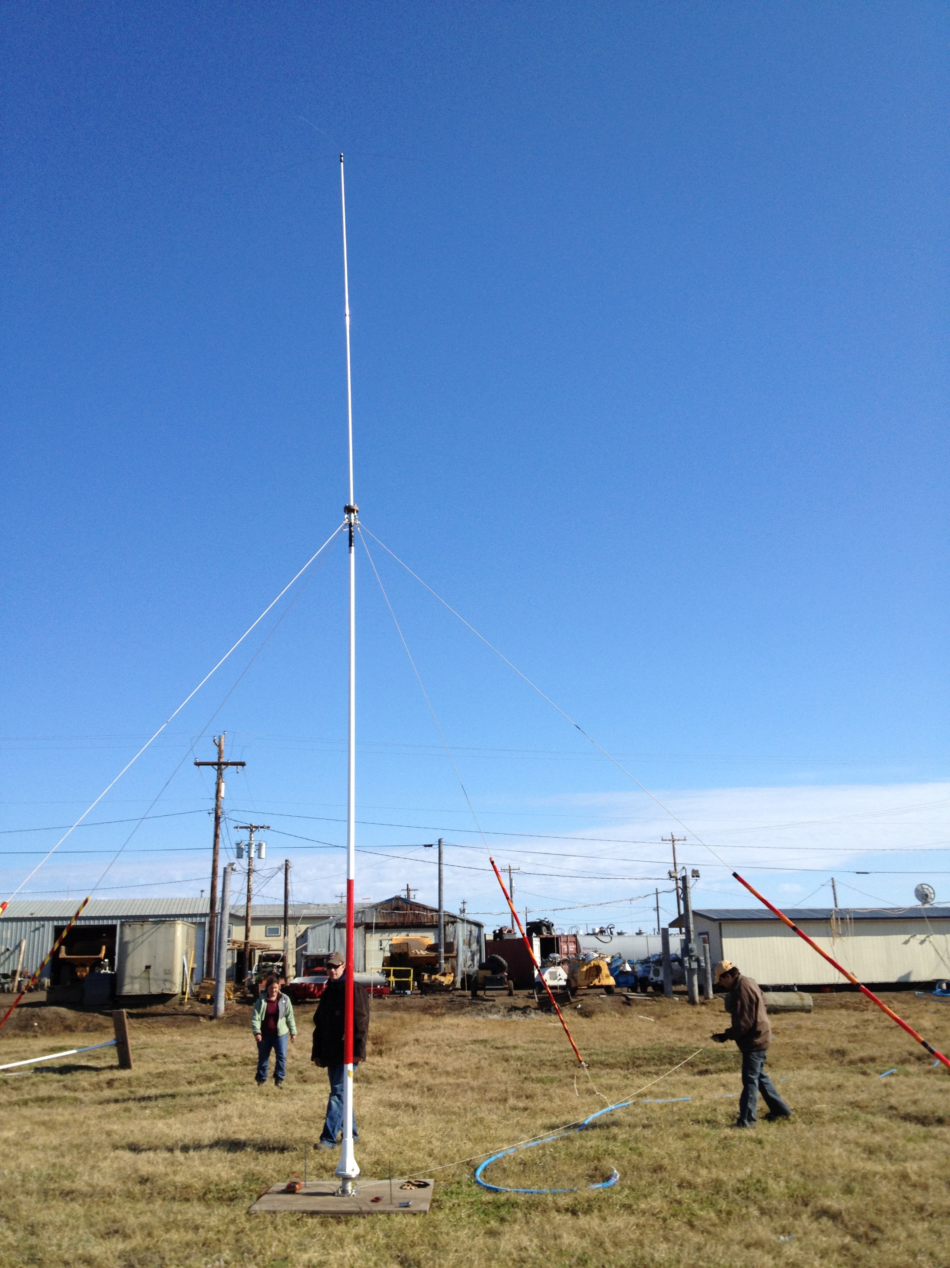
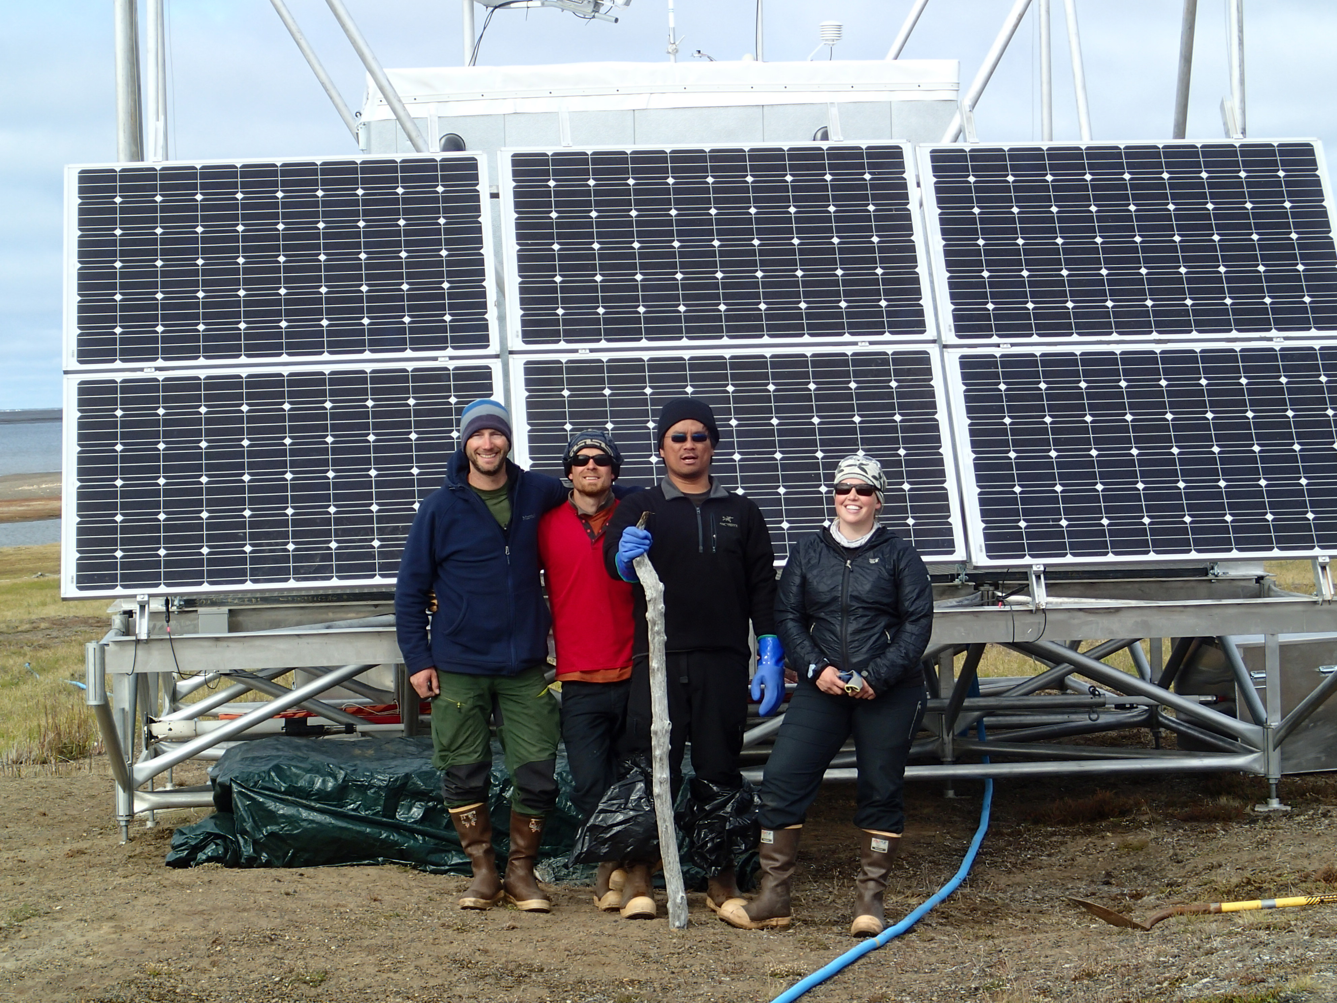
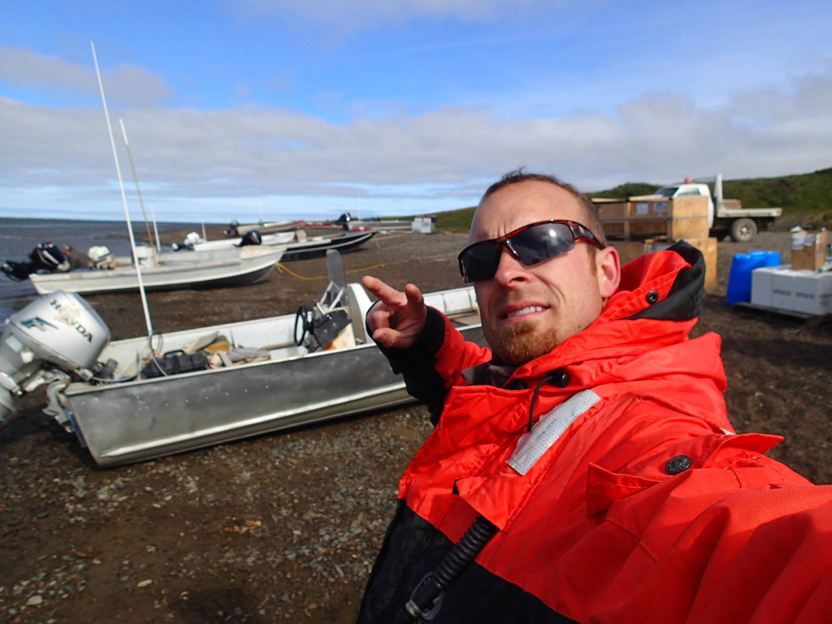
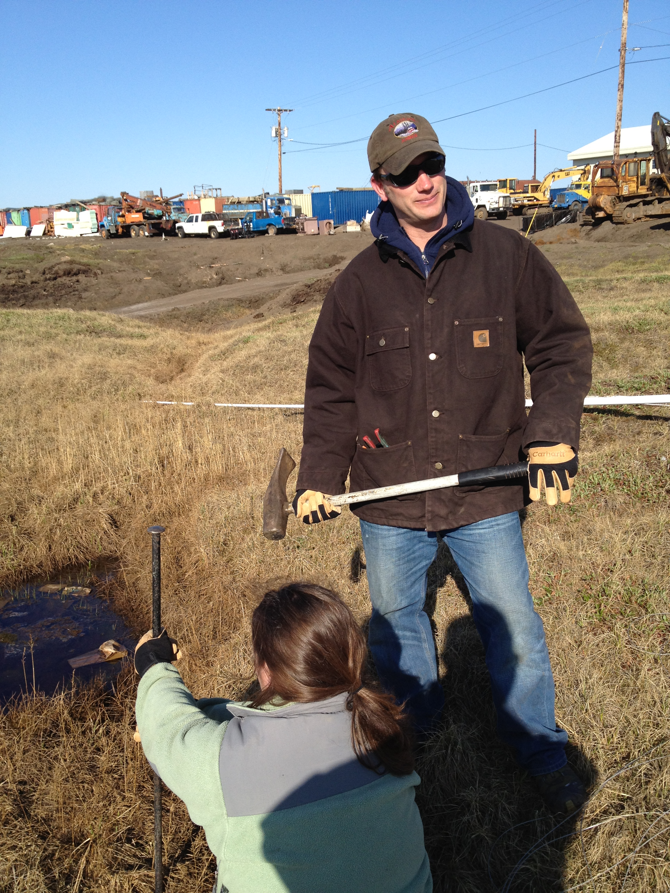
Acknowledgement

Slide 4
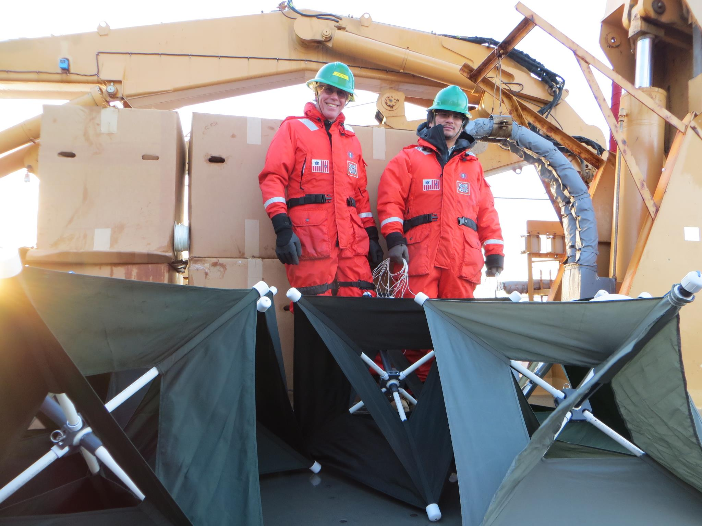


Slide 5
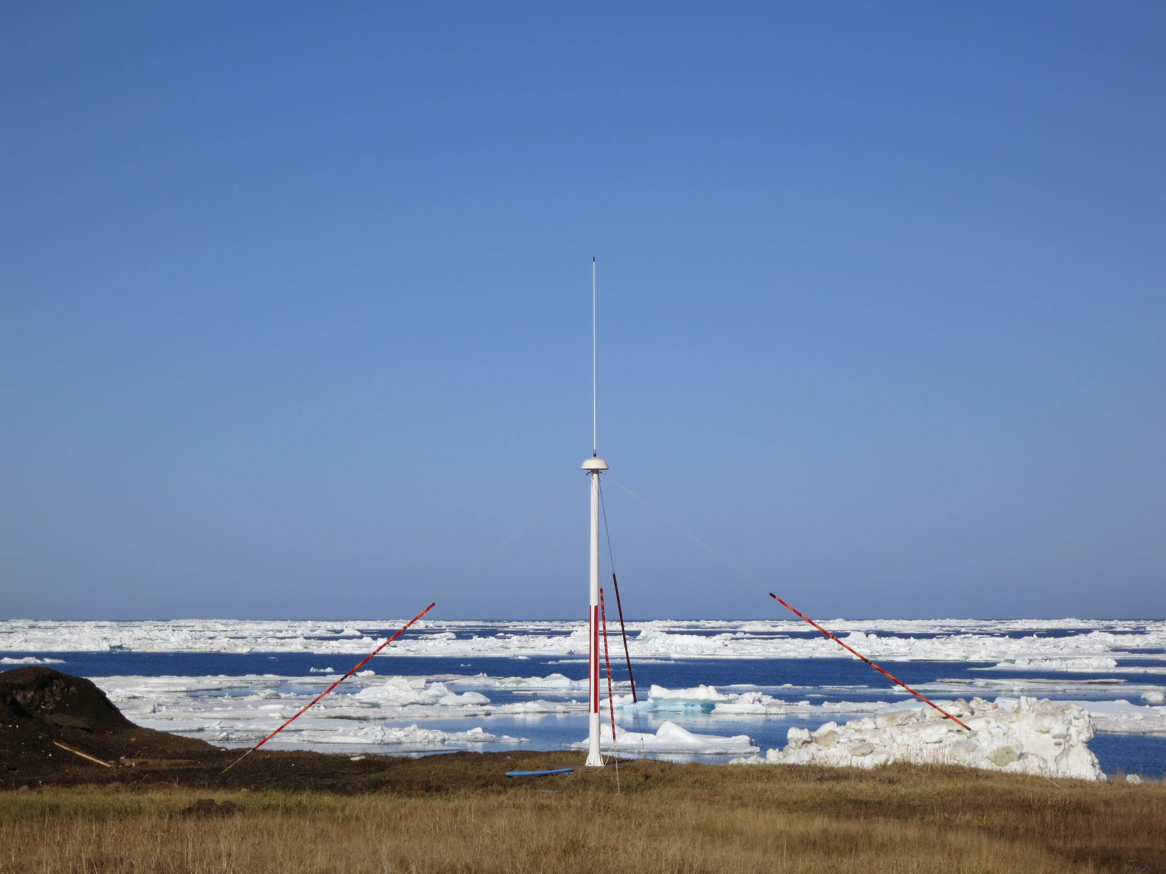
Outline
Background of the Chukchi Sea circulation
Why surface currents?
How do we measure surface currents?
Hippo in a haystack: finding major circulation patterns
Results
Summary

Slide 6
Background of the Chukchi Sea circulation

Slide 7
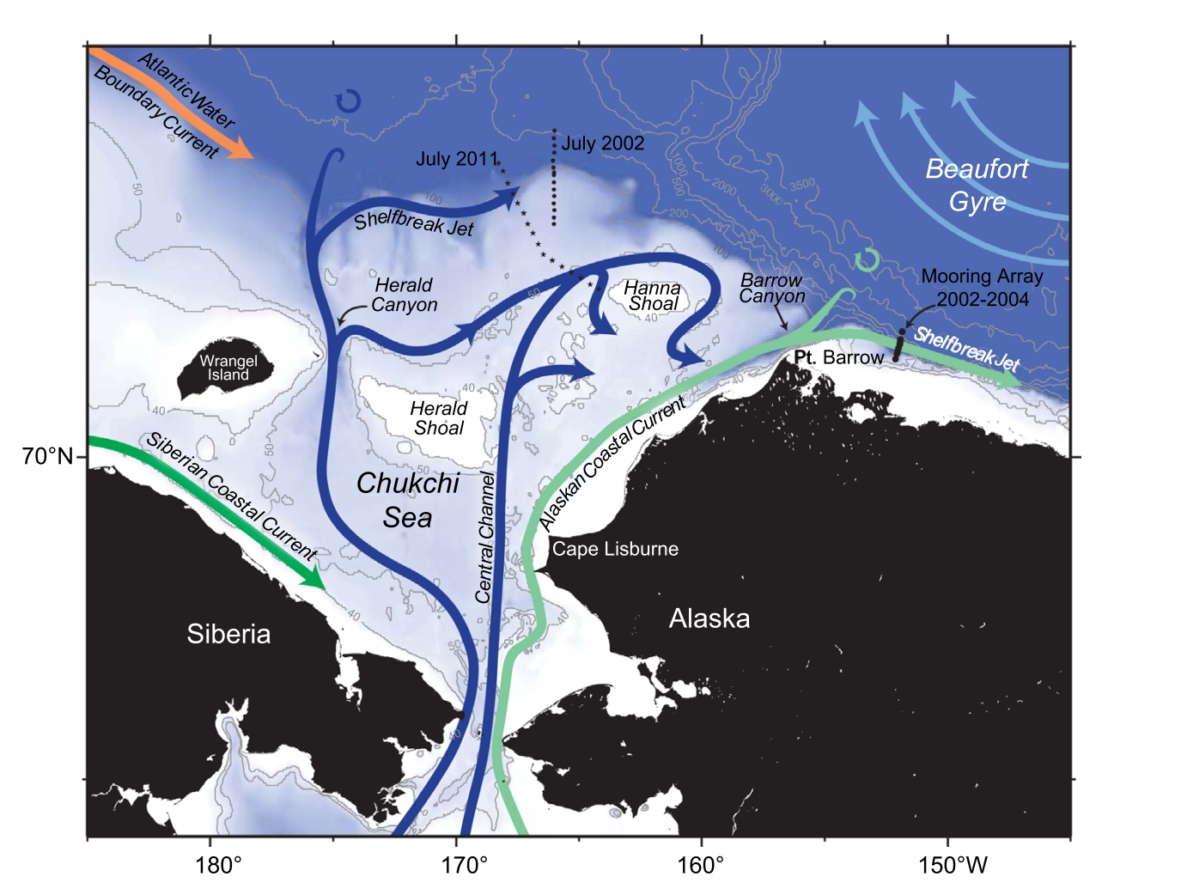
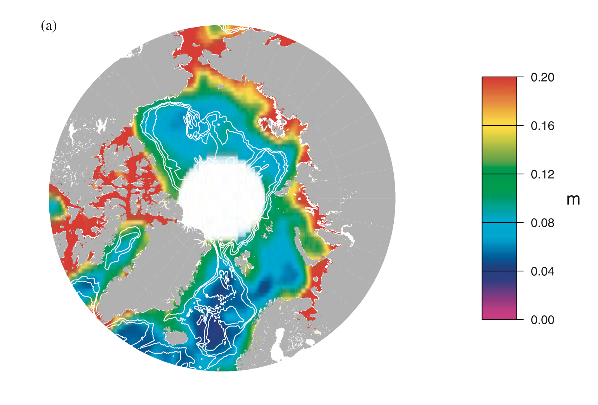
Higher
Alaska
Greenland
Russia
Canada
Canada
Greenland
Russia
Alaska
Spall et al 2014
Peacock and Laxon, 2004
Notes:
Mentioned: vertically averaged flow. Under No winds conditions.

Slide 8
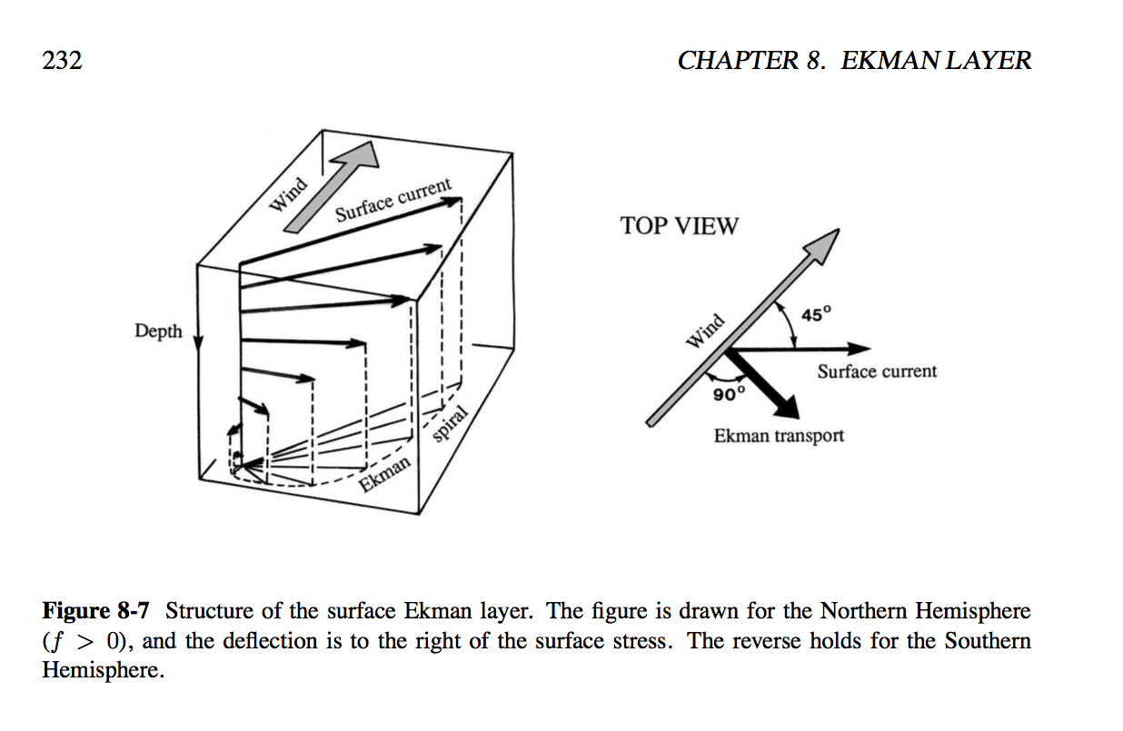
Winds are important, too
Wind-driven Ekman currents
Cushman-Roisin and Beckers, 2009, Introduction to Geophysical Fluid Dynamics: Physical and Numerical Aspects

Slide 9
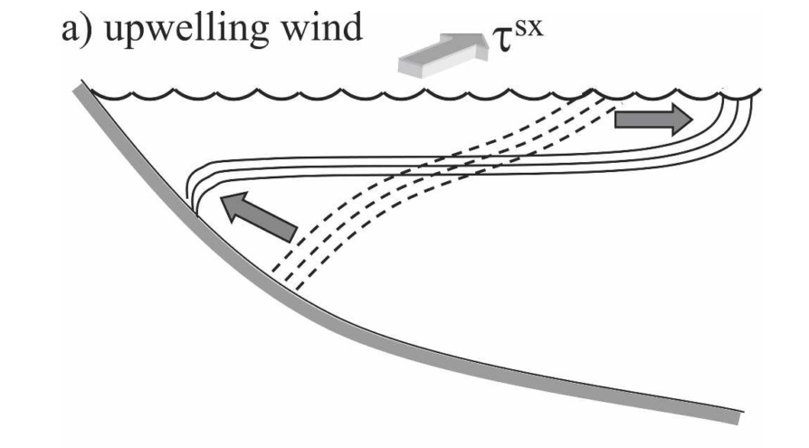
Winds are important, too
Wind-driven Ekman currents modify coastal frontal structure
Winds
Upper mixed layer
Lentz and Largier, 2006, The Influence of Wind Forcing on the Chesapeake Bay Buoyant Coastal Current, Journal of Physical Oceanography
Lentz and Largier, 2006

Slide 10
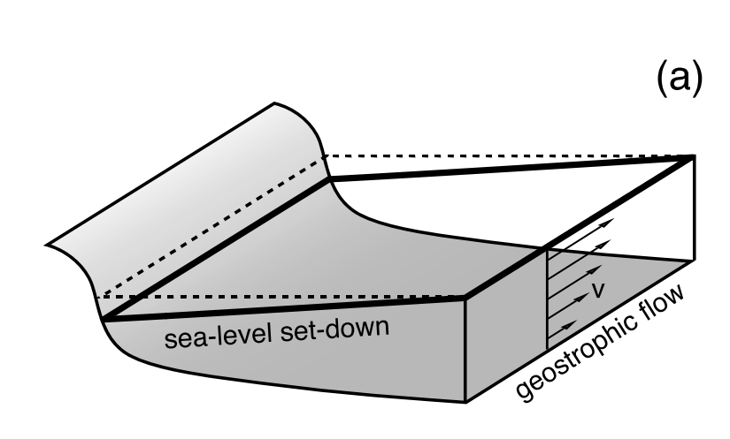
Wind-induced coastal setdown
Waters are transported offshore
A cross-shore sea level difference is created
Geostrophic flow is induced
Waters flow this way
Pressure gradient
Rotation
Fewings and Lentz, 2010, Momentum balances on the inner continental shelf at Martha's Vineyard Coastal Observatory, Journal of Physical Oceanography
Fewings and Lentz, 2010

Slide 11
Geostrophic flows follow contours of isobaths
Flow will be steered by bathymetry

Slide 12
Two major forces influencing the Chukchi Sea circulation
Pressure gradient
(background state)
- northward mean flow
Winds
(mean winds oppose mean flow)
- sheared surface layer
- currents may change directions

Slide 13
Why surface currents?

Slide 14
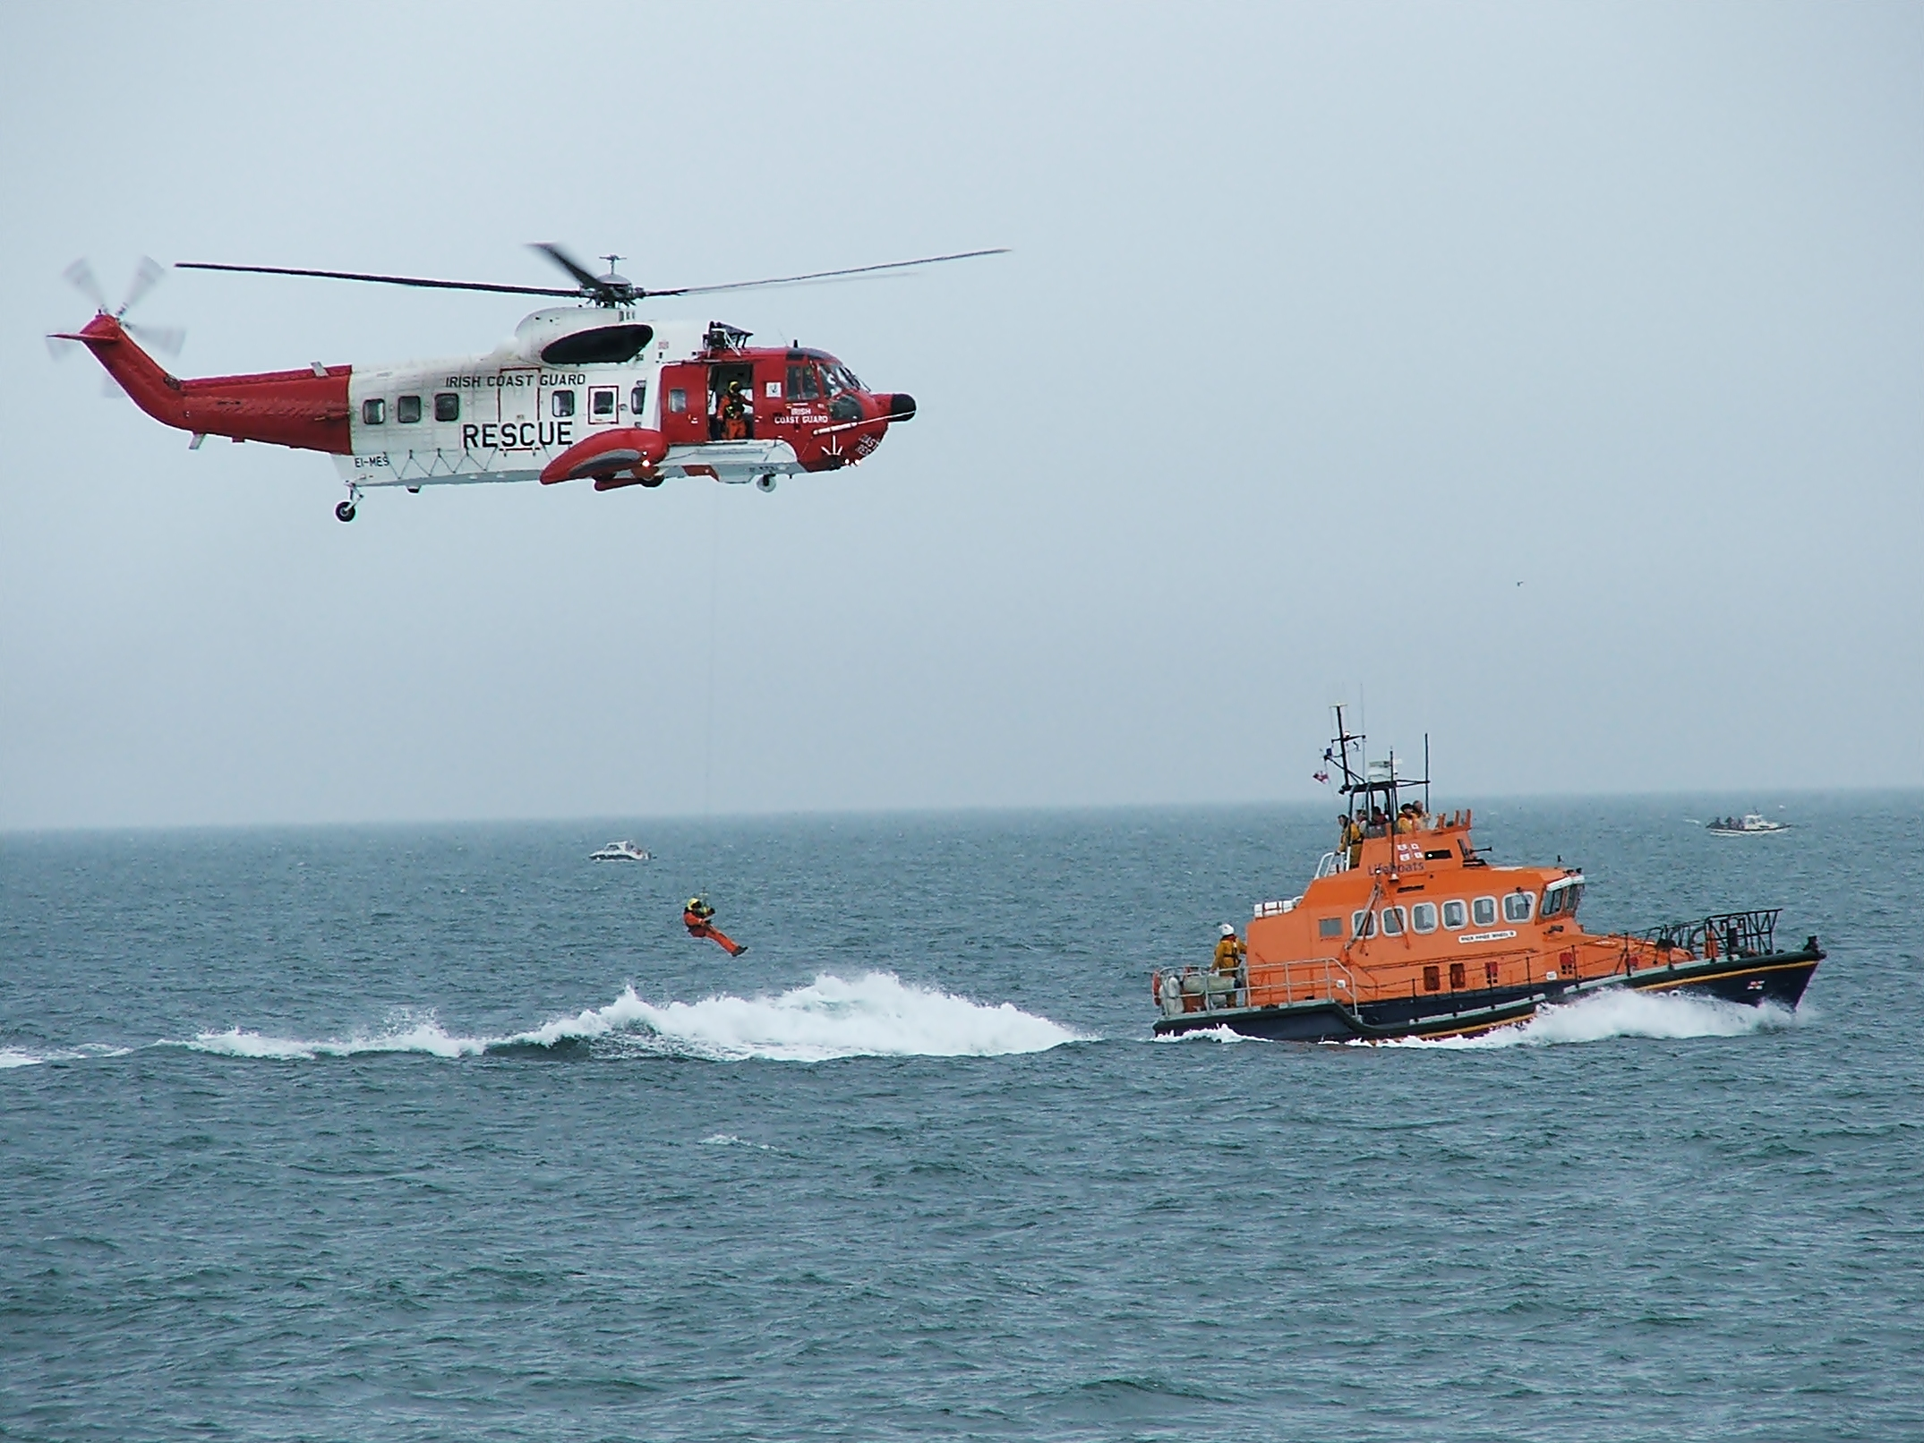
Surface currents are related to our life
Human activities
Fishing
Transportation
Search and rescue operations
Oil spill mitigation
Air-sea interaction
Ecological process
Warfare
Waste disposal

Slide 15
For the Chukchi Sea
Past results are based on subsurface measurements
Evaluate surface current responses
influenced by both winds and pressure gradient
- important for material transport
Notes:
Option:
Surface currents are influenced by both winds and pressure gradient
- important for oil spill models

Slide 16
How do we measure surface currents?

Slide 17
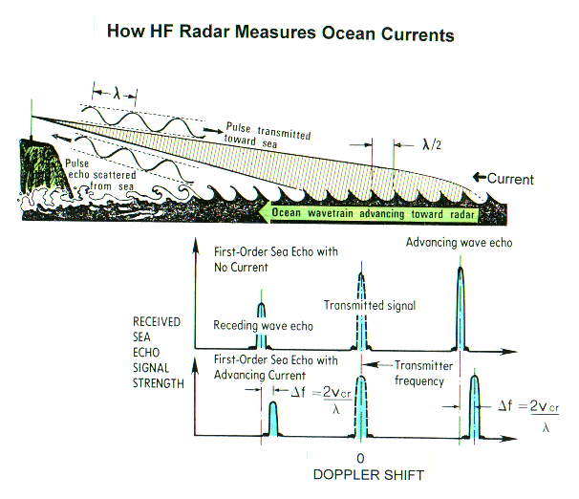

from www.codar.com

Slide 18
A more accessible example

Slide 19
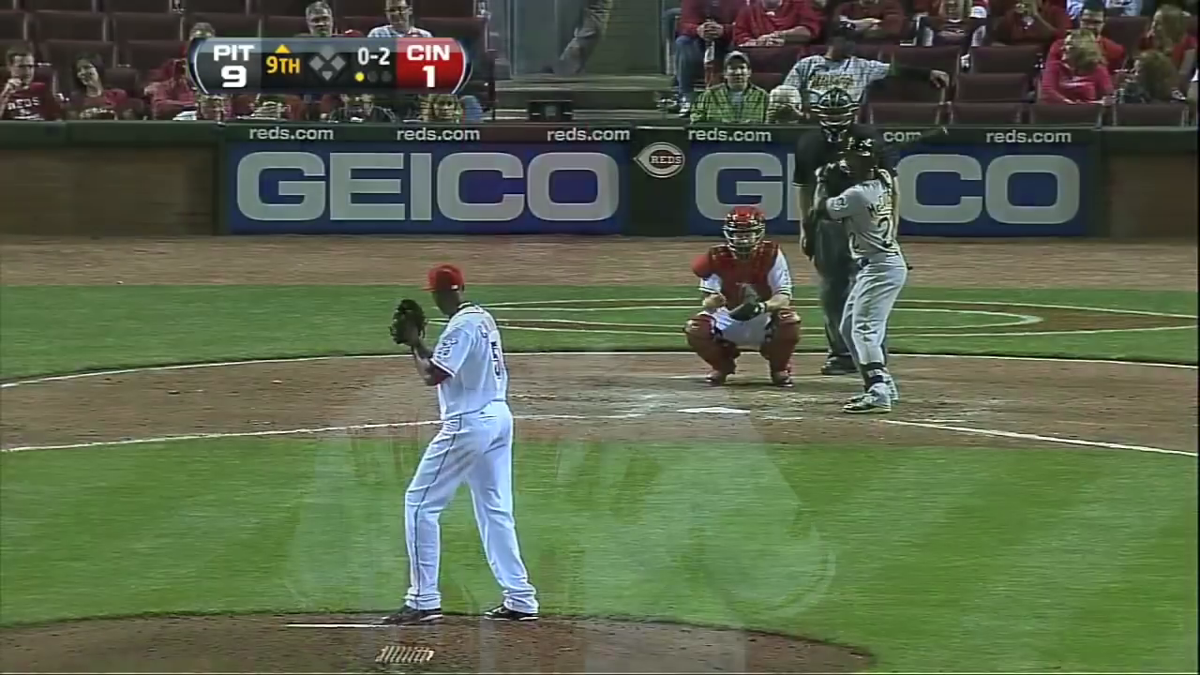

Slide 20
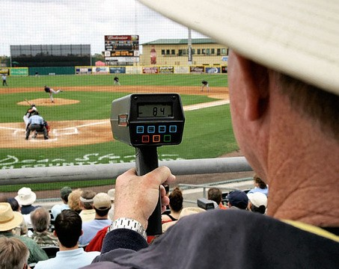

Slide 21
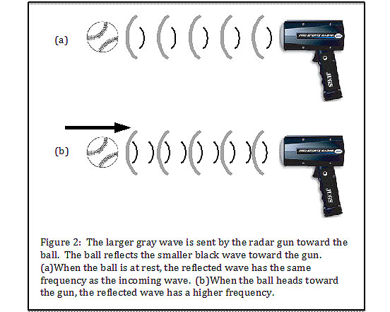
Specific surface waves
Surface currents
Doppler shift
http://www.hardballtimes.com/the-physics-of-radar-guns/

Slide 22

from www.codar.com

Slide 23
One high-frequency (3 – 30 MHz) radar can only measures currents moving toward or away from the radar (one-dimensional)
We need to have at least two radars to make a map of surface currents (two-dimensional)
And we need open water to detect qualified surface waves

Slide 24
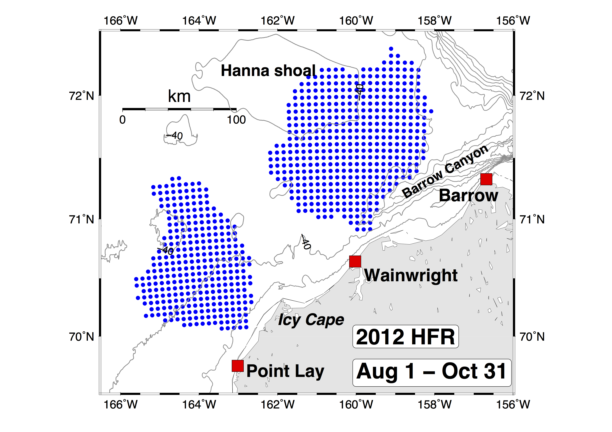
High-frequency radar (HFR)
Wainwright – Barrow
overlap
Radar site
Point Lay – Wainwright overlap
Data grid points

Slide 25
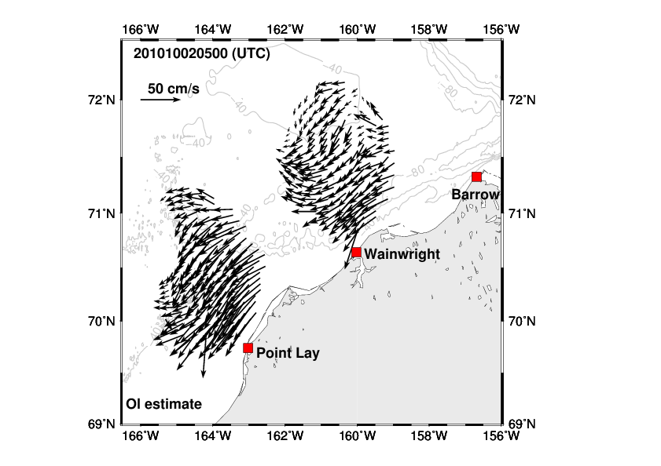
It is like you are shooting many, many pictures of the ocean

Slide 26

Hippo in a haystack: finding major circulation patterns
http://www.setonmagazine.com/family/kids-corner/hippo-in-a-haystack-color-in#prettyPhoto

Slide 27
Data and methods
QA/QC
HFR surface currents +
(< 2 m depth)
North American Regional Reanalysis (NARR) winds (10 m height)
Self-Organizing Map (SOM)
Circulation regimes + paired wind fields
Four regimes for 2012 data

Slide 28
A demo of SOM analysis and a comparison with empirical function (EOF) analysis

Slide 29
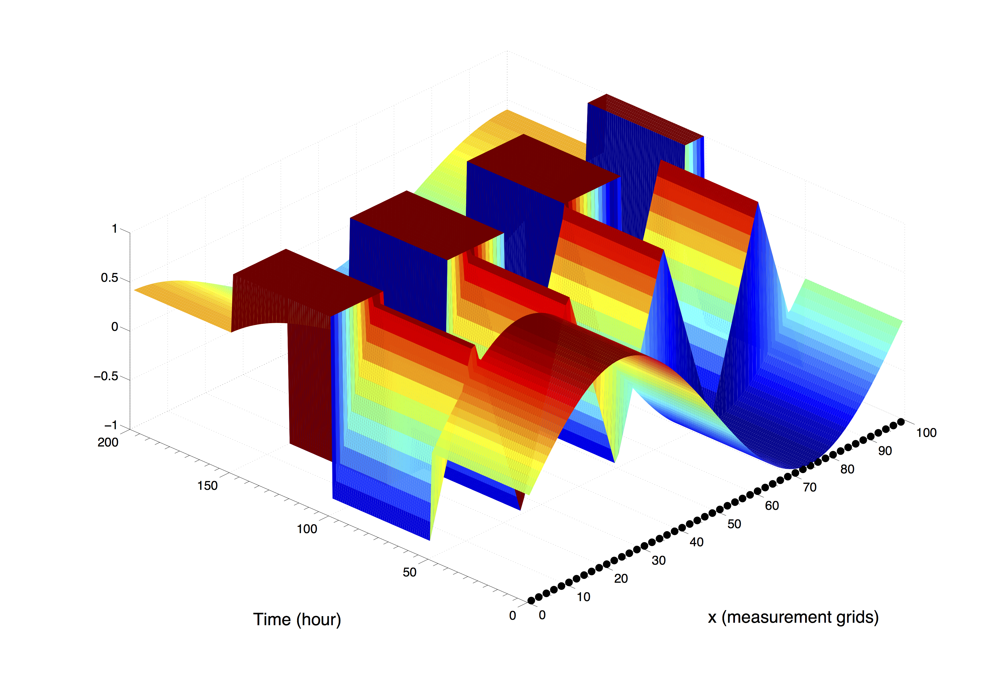
Given four standing waves
Square wave
Cosine wave with smaller amplitude
Saw wave
Question: How many patterns do we have in the data?
Sine wave
Answer: Sine, saw, square and cosine waves. Four patterns.
t4
t3
t2
t1

Slide 30
Procedures of SOM
Assign how many patterns (N) to resolve
if N is large → more detail
if N is small → more general
Apply SOM
Extract patterns
pattern numbers are not a ranking or prioritization, simply an ID
For example, we choose N = 6 …
Notes:
Use “ map number” or solution, not size

Slide 31
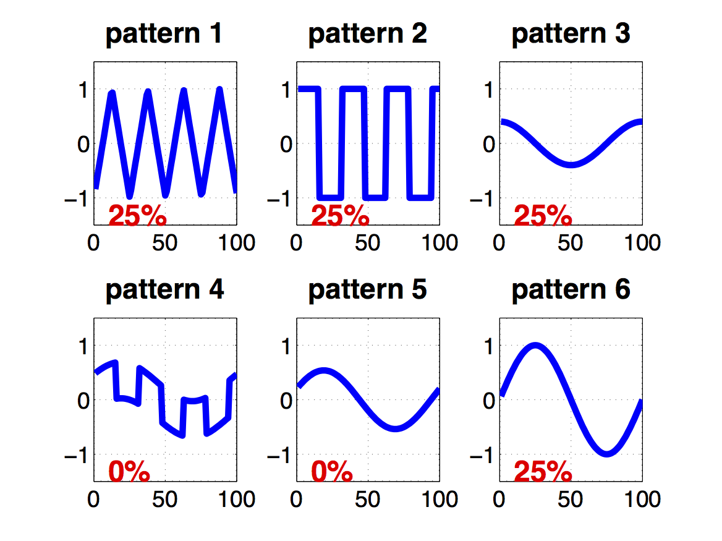
Derived SOM patterns
(the pattern number is meaningless in SOM)
Saw wave
Square wave
Cosine wave
with smaller amplitude
Sine wave
Notes:
Pattern number is meaningless. Remember to say it!

Slide 32
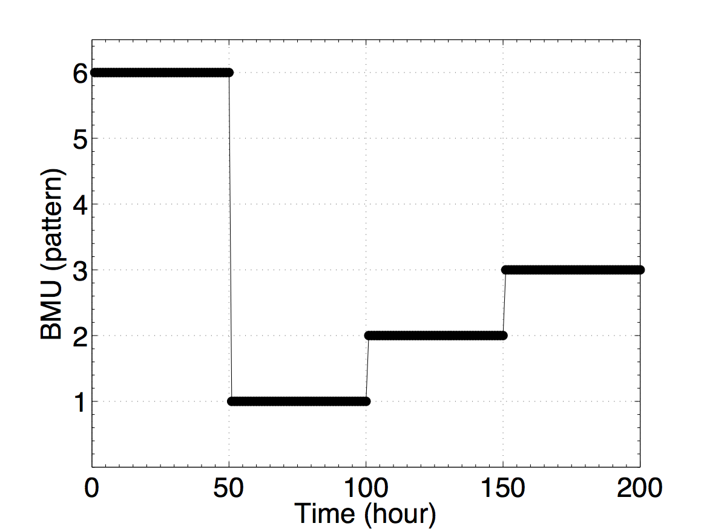
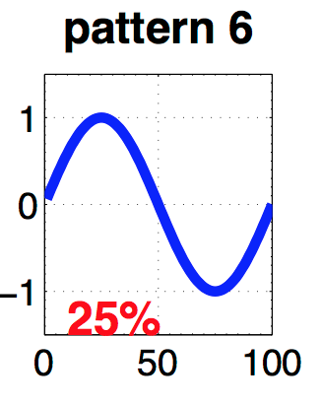
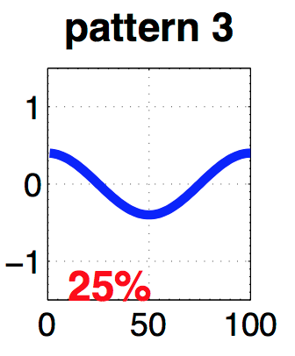
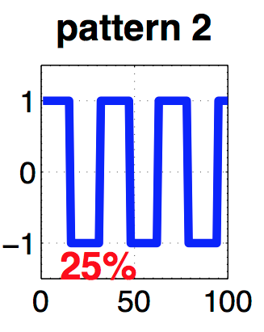
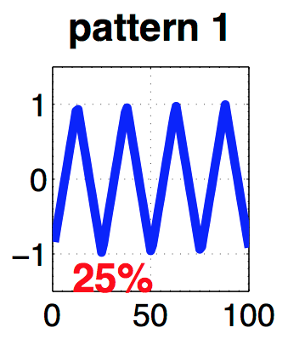
Time series of SOM patterns
Sine wave
Pattern
Cosine wave
Square wave
Saw wave
Notes:
Add small patterns!

Slide 33
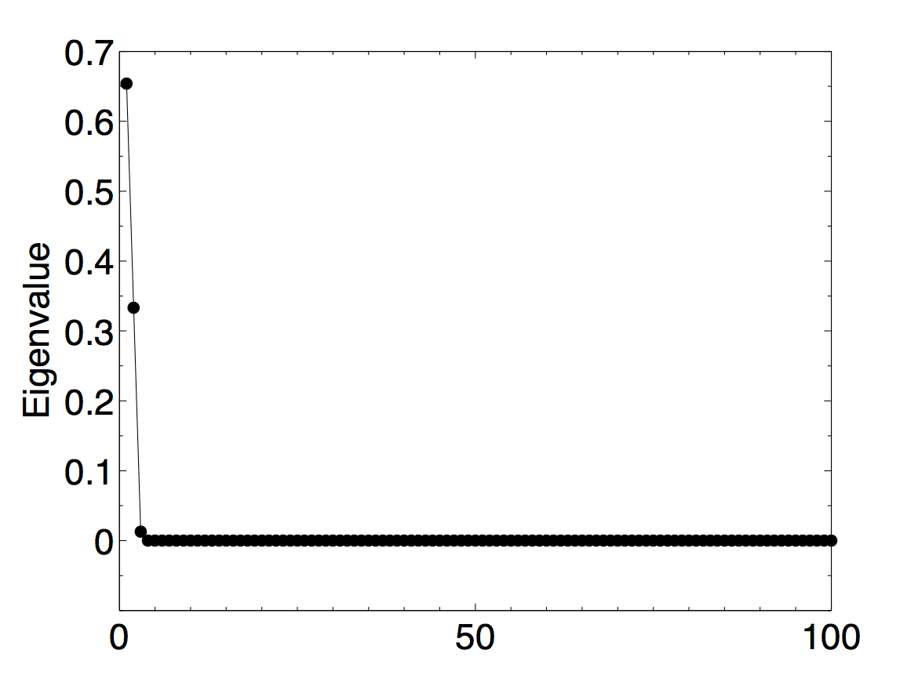
Traditional EOF analysis
EOF reveals only 2 major signals,
instead of 4.

Slide 34
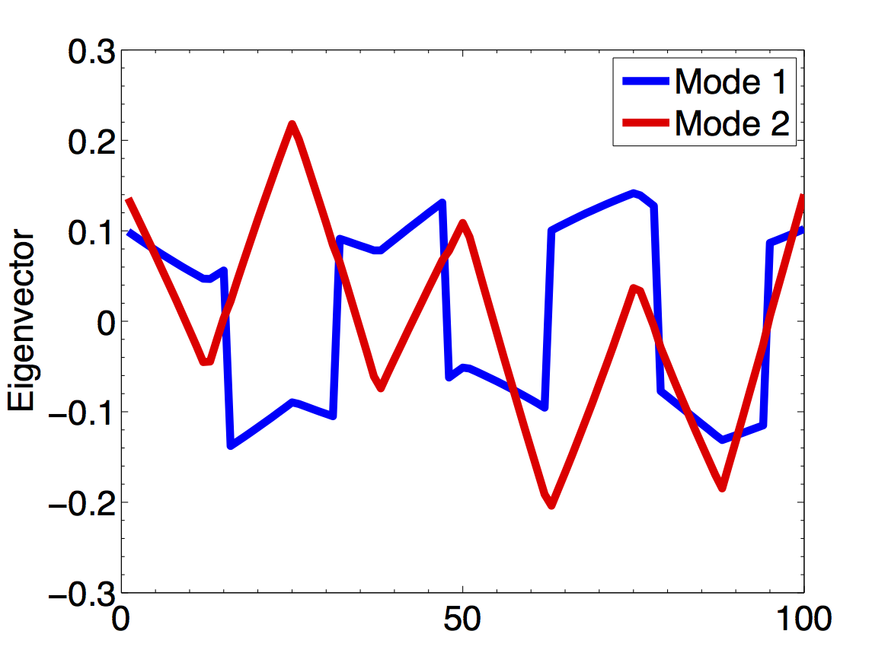
Eigenvectors show square and saw waves. Sine and cosine waves are not seen.

Slide 35
SOM vs EOF
This simple example illustrates the ability of SOM to extract patterns of given signals (data).
SOM patterns can not be used to reconstruct data since it preserves topology, not variance.
EOF, linear, can reconstruct data by summing up all modes.
Both methods have advantages and disadvantages.

Slide 36
Results

Slide 37
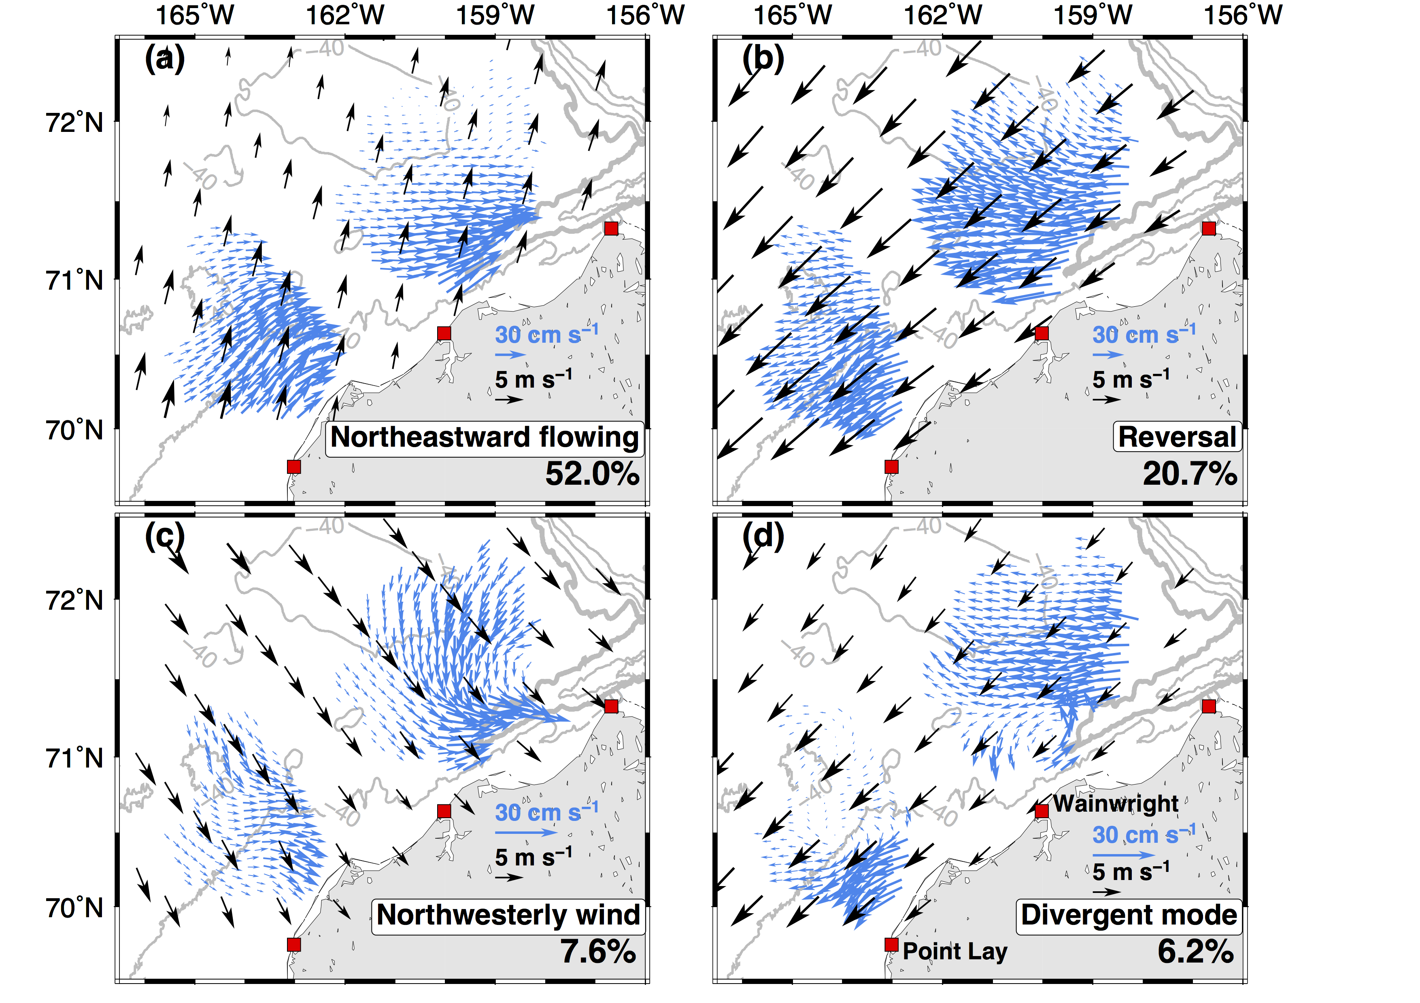
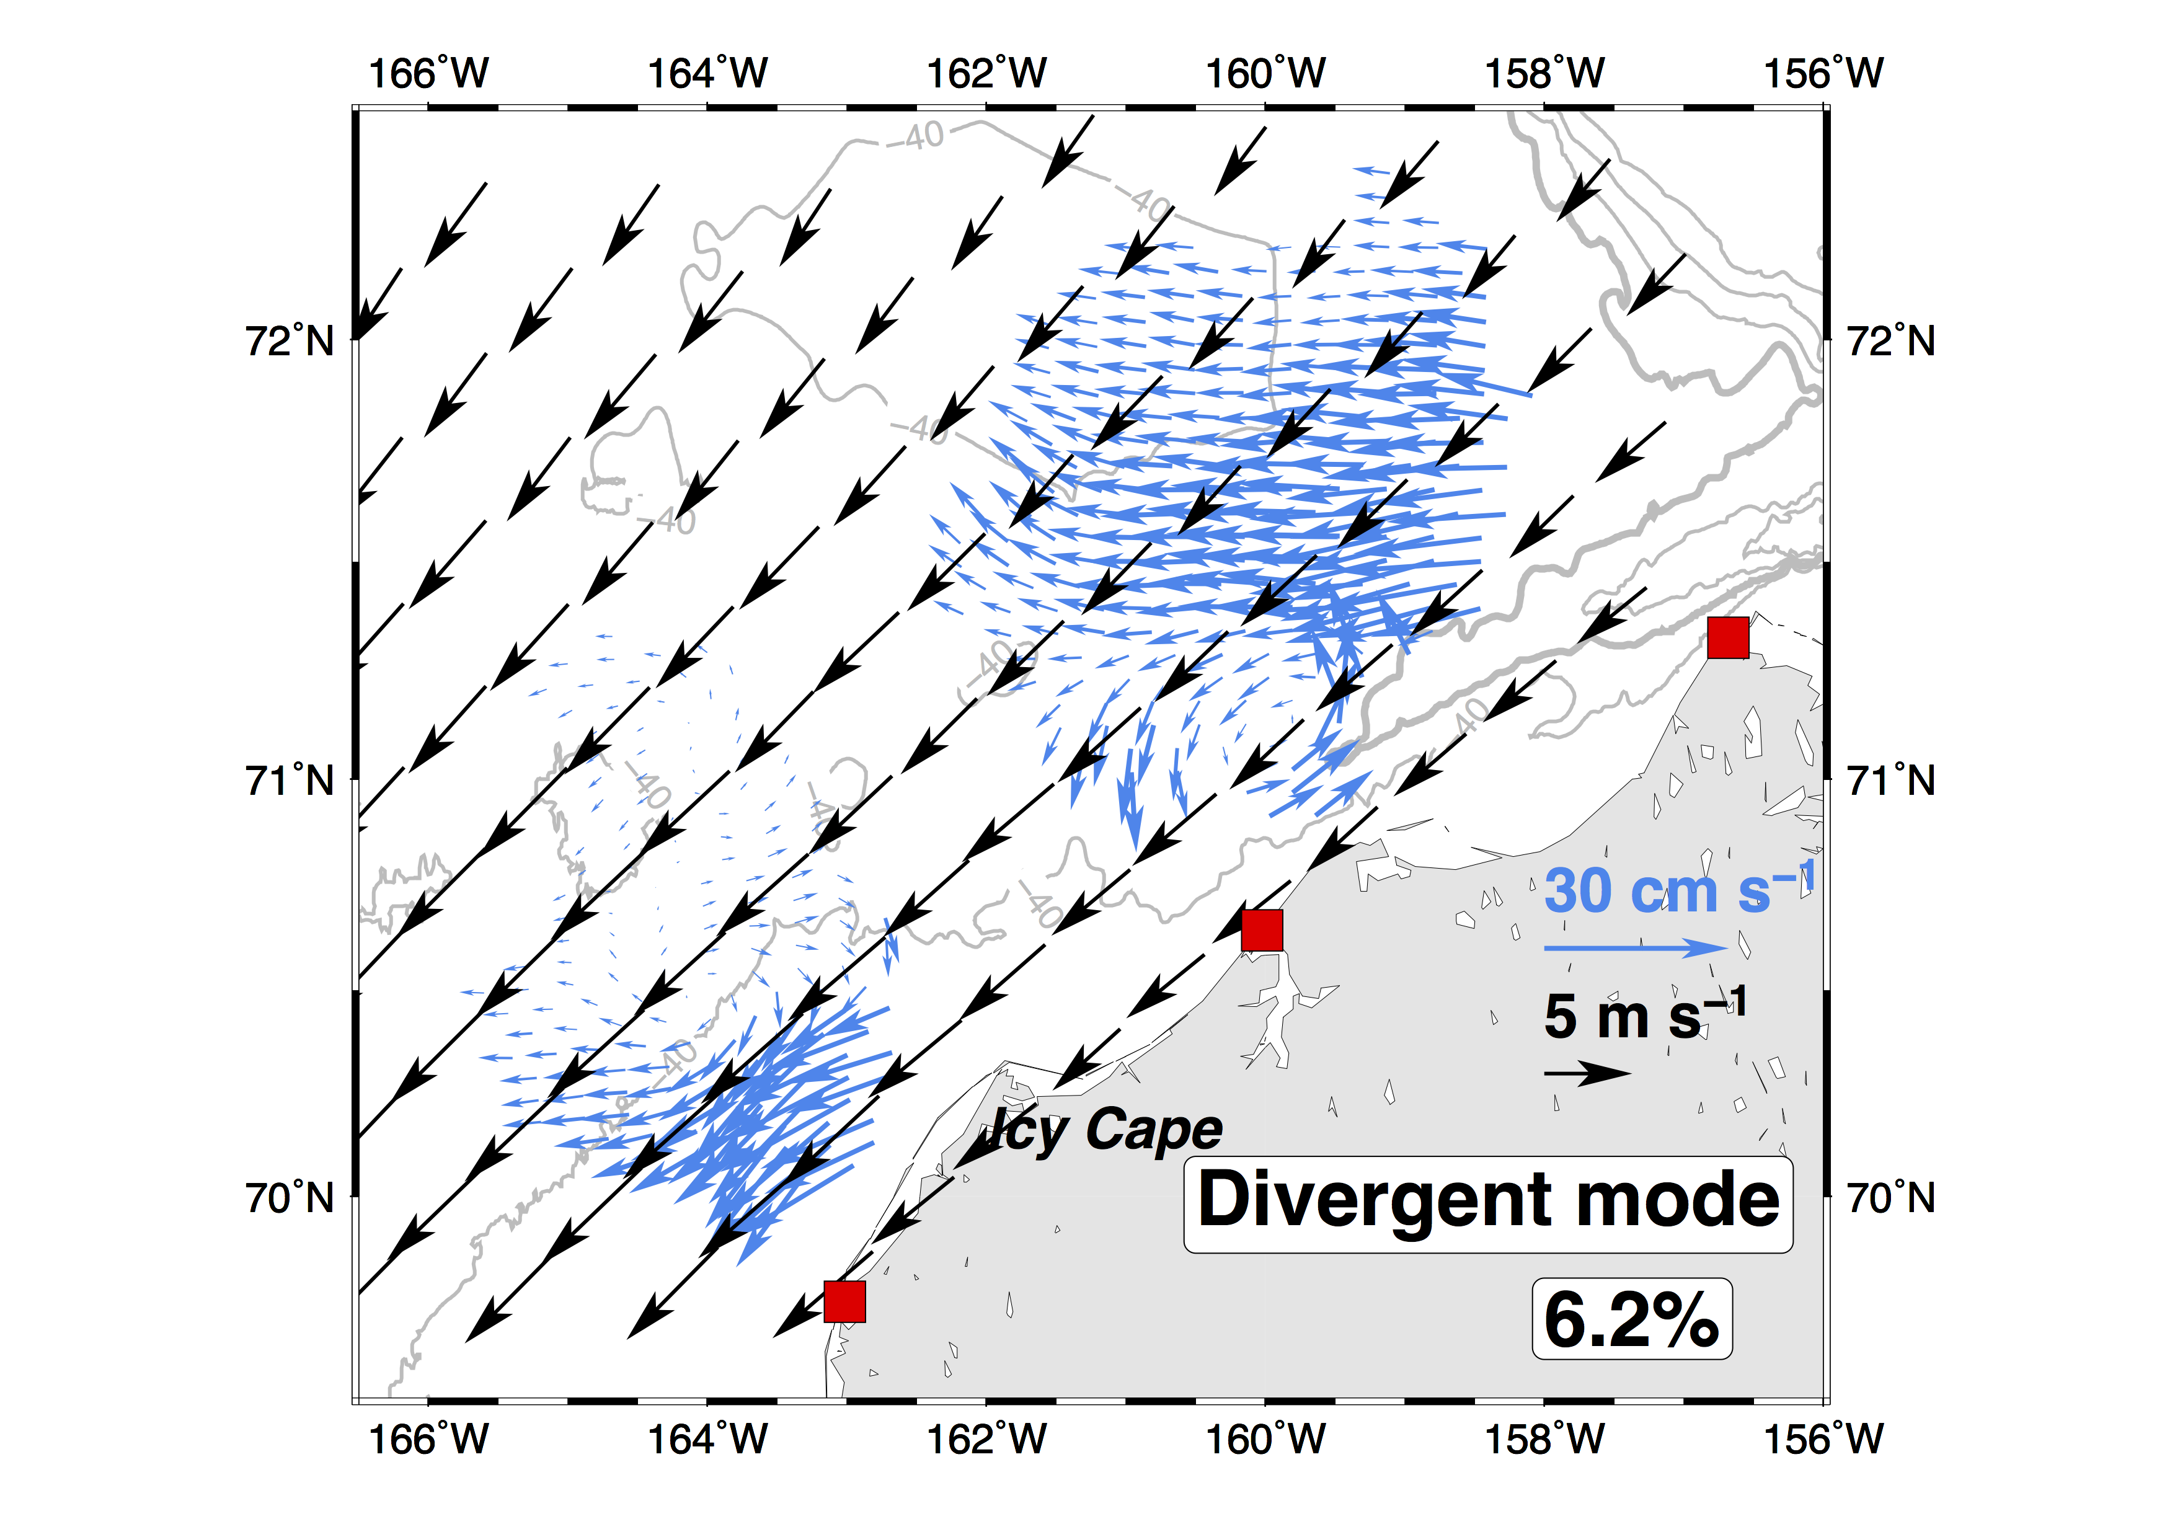
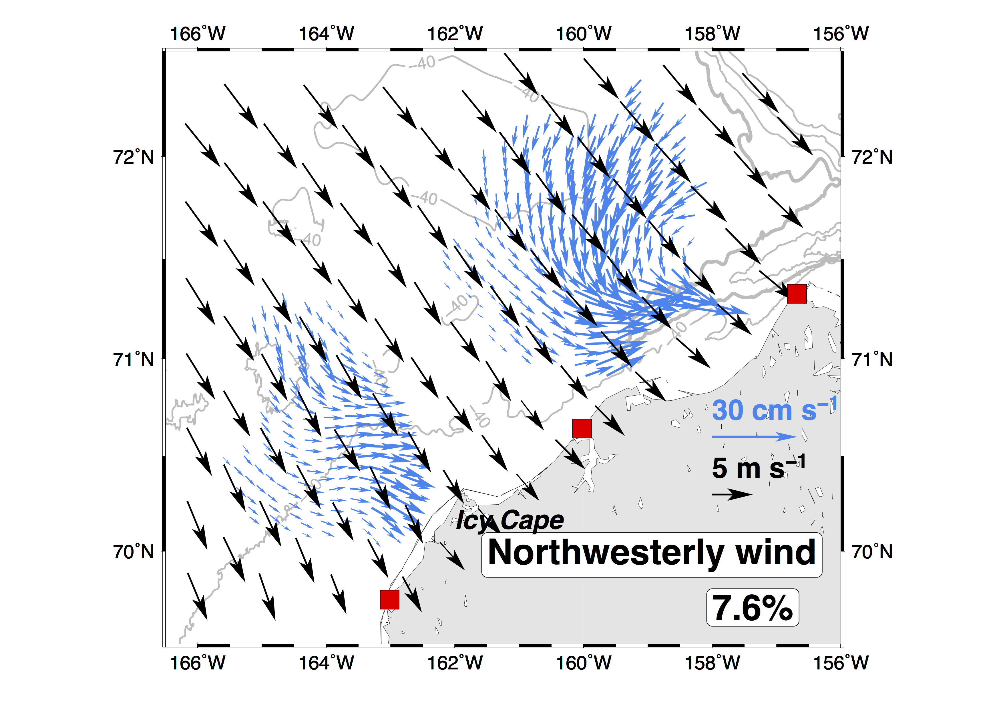
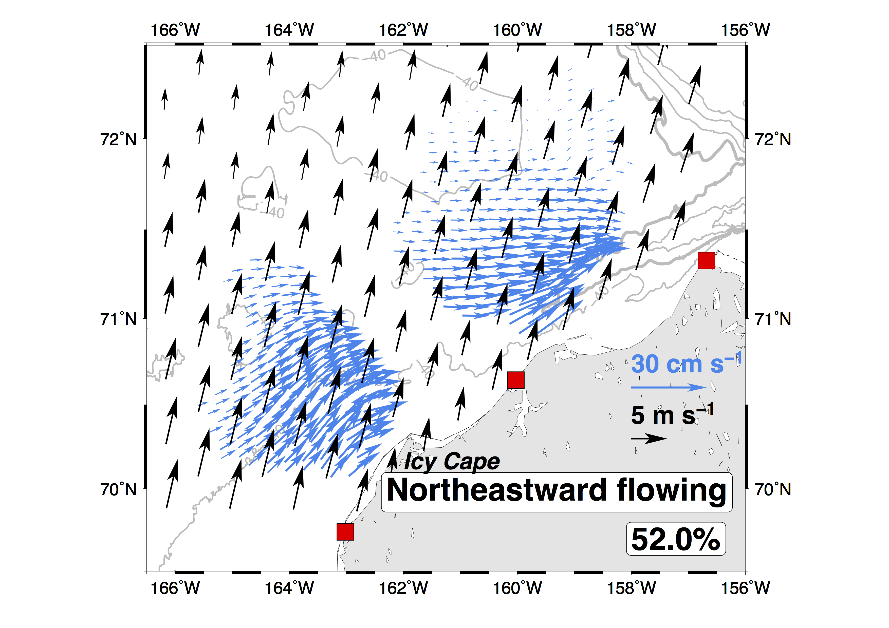
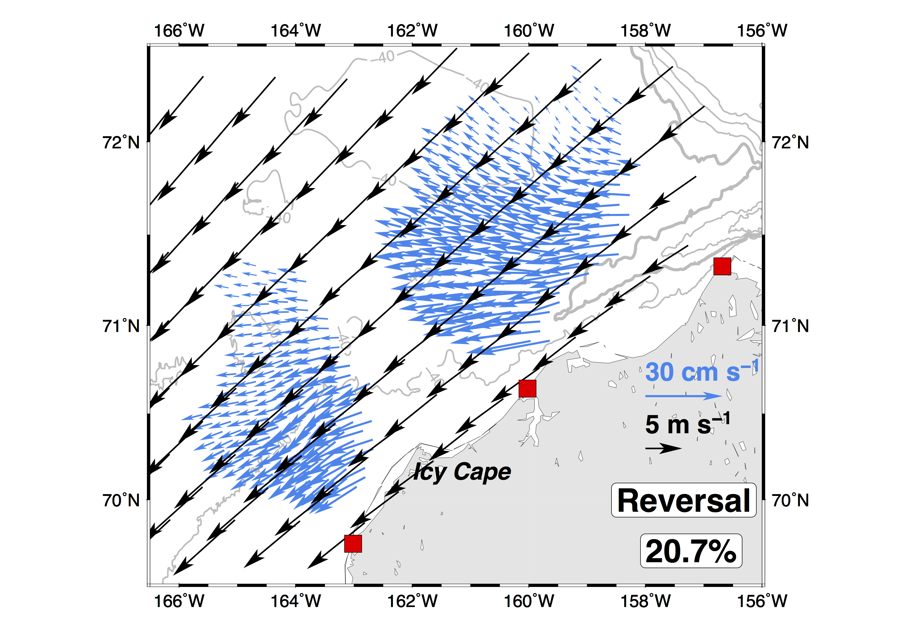
Self-Organizing Map (SOM) derived regimes
Notes:
提及有13.5%是 Data gaps

Slide 38
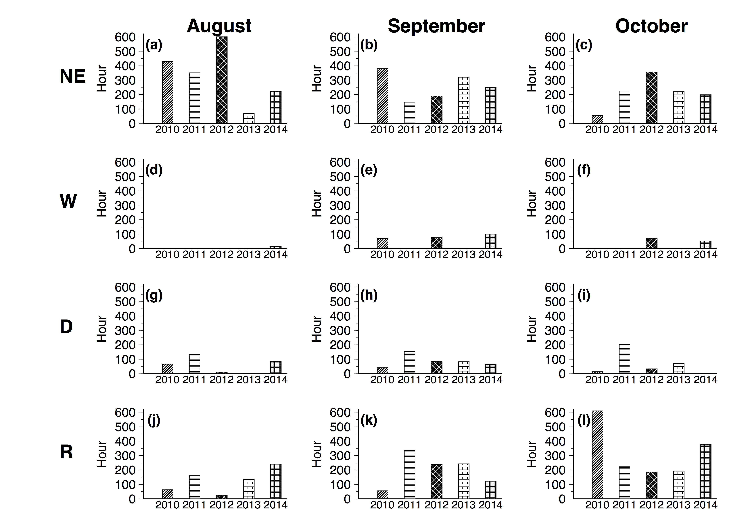

Slide 39
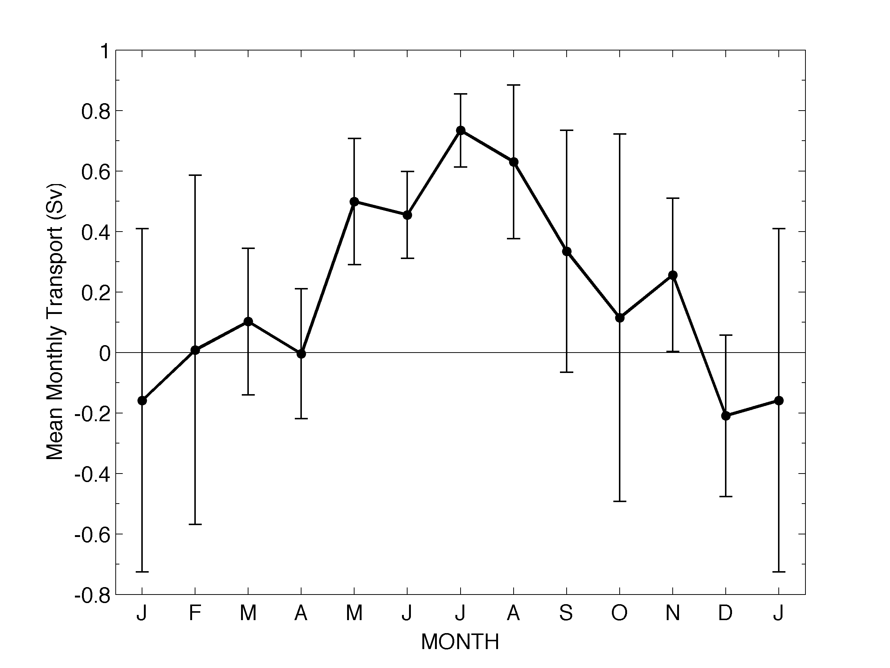
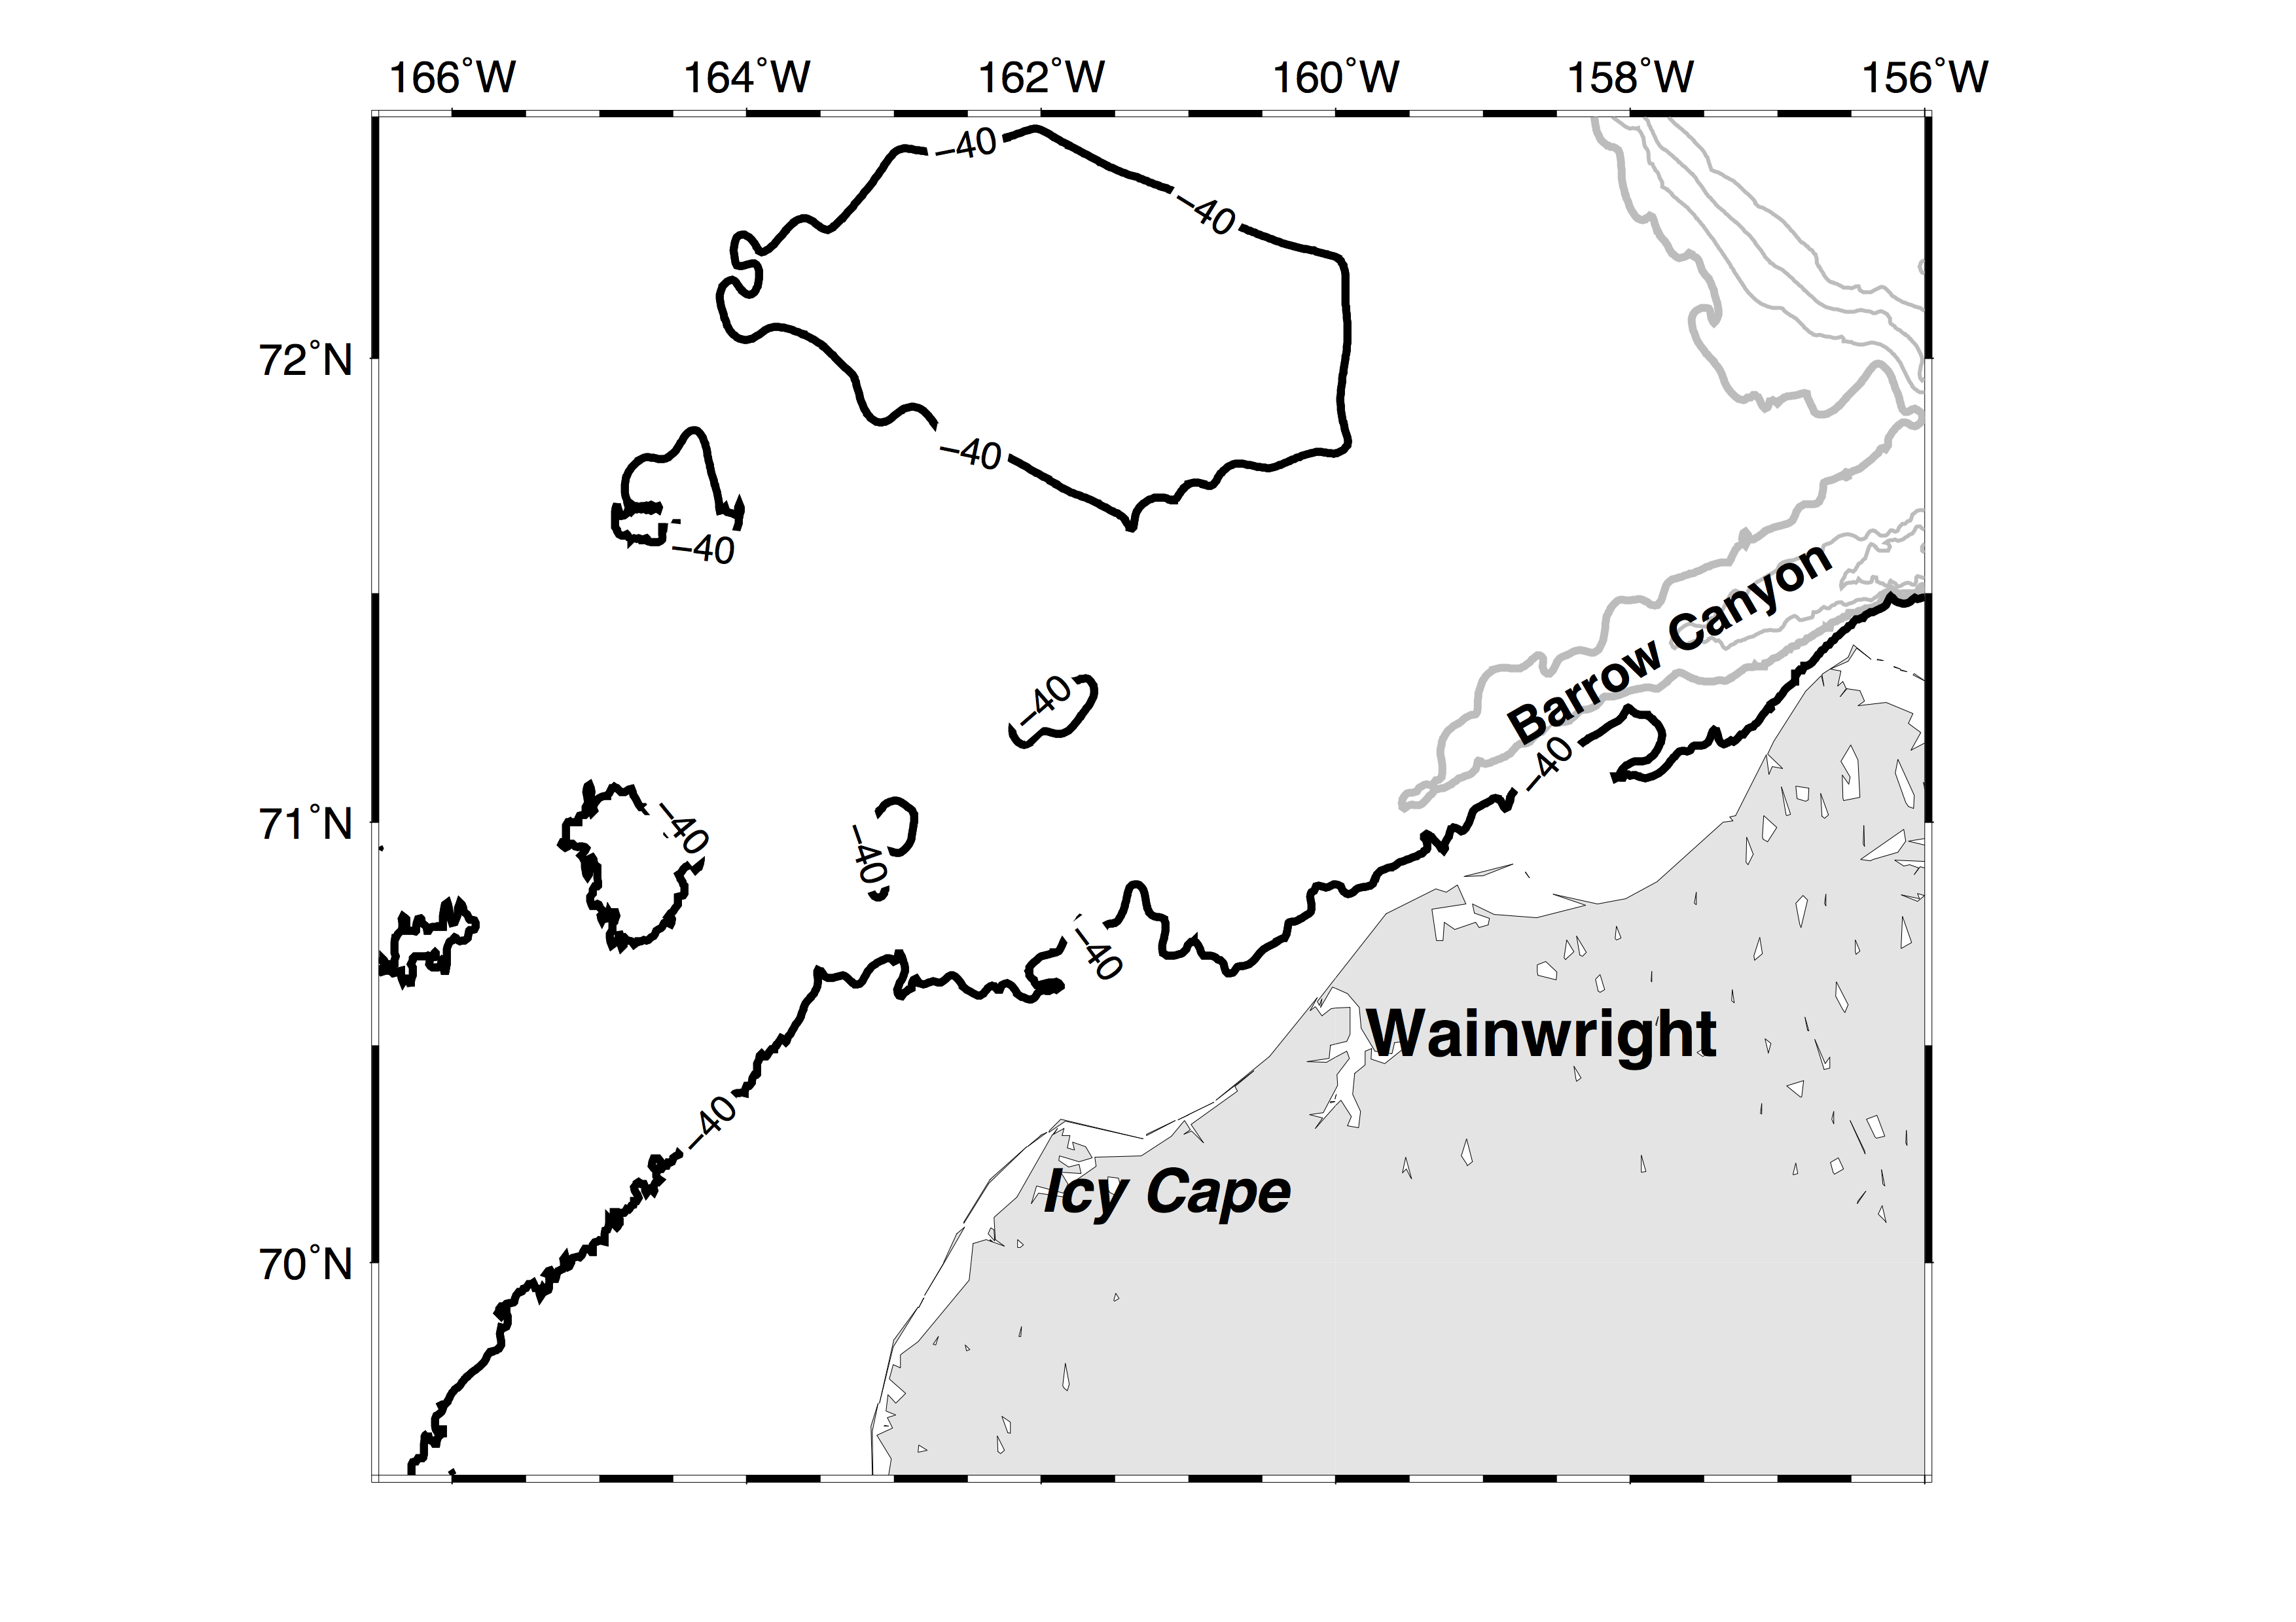
Along Barrow Canyon transport
Downcanyon
NE flows
Upcanyon
SW flows
Weingartner et al., 2017

Slide 40
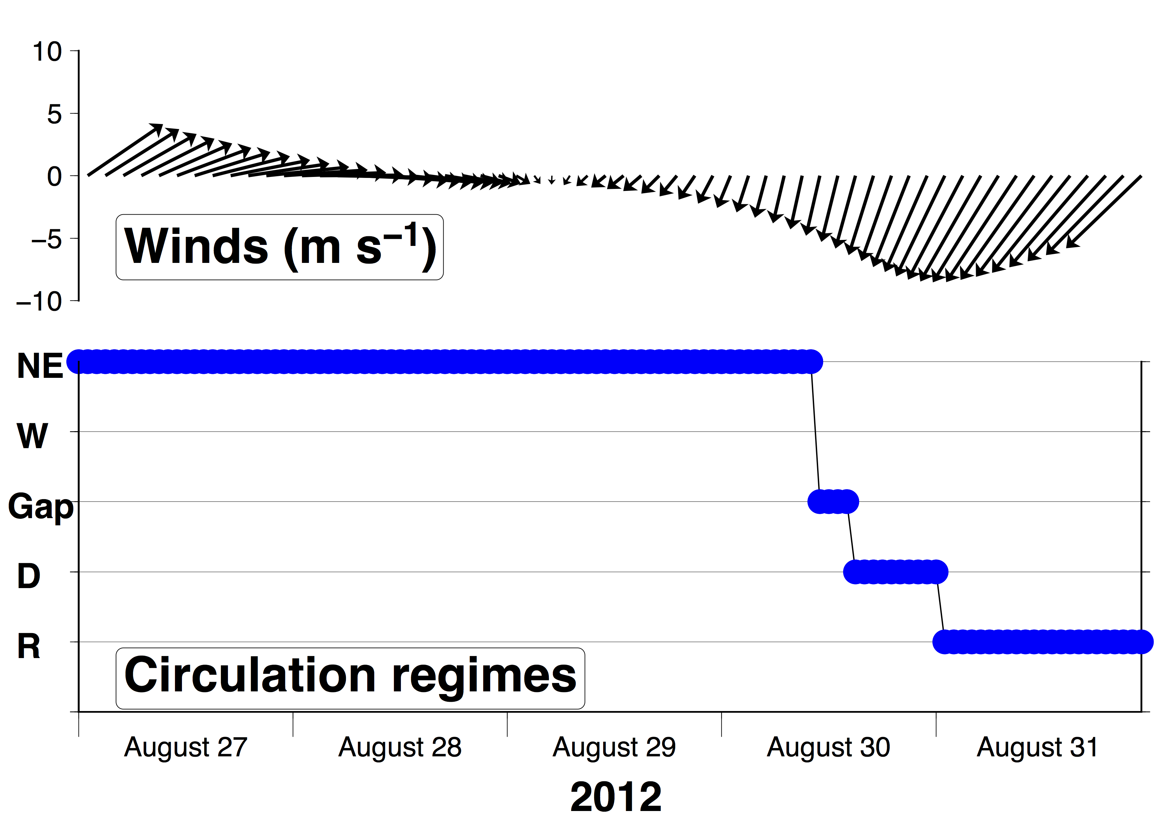
Time series analysis

Slide 41
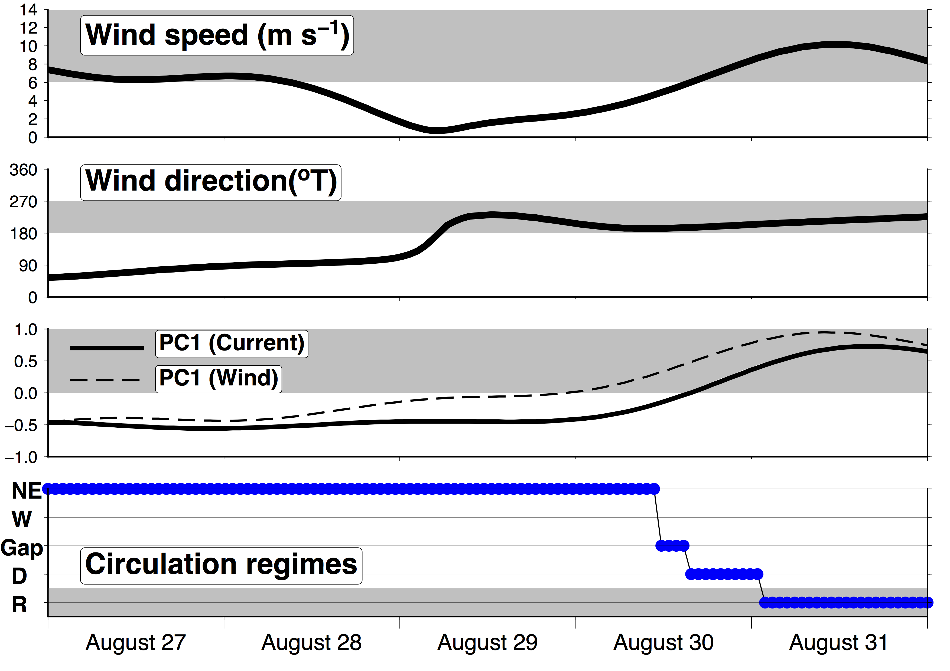
6 m s⁻¹
northeasterly
Reversal regime
Northeasterly winds
16 h
Divergent mode
Reversal
2012

Slide 42
Circulation regimes are related to winds.
Current reversal occurs when northeasterly winds > 6 m s⁻¹
Divergent mode is a transitional state before currents fully reverse

Slide 43
Do not forget Stratification

Slide 44
“Height” difference is resulted from density difference
Lighter waters
Denser waters
Baroclinic pressure gradient

Slide 45
Two Hydrographic transects in September 2013

Slide 46
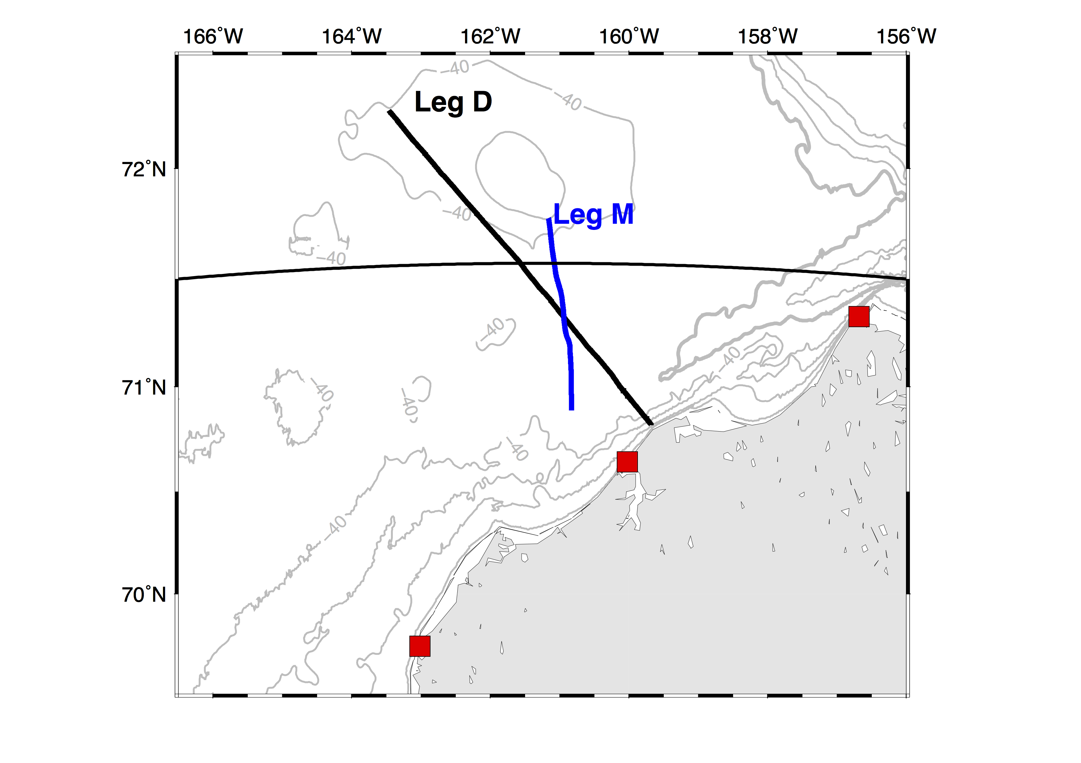

Slide 47
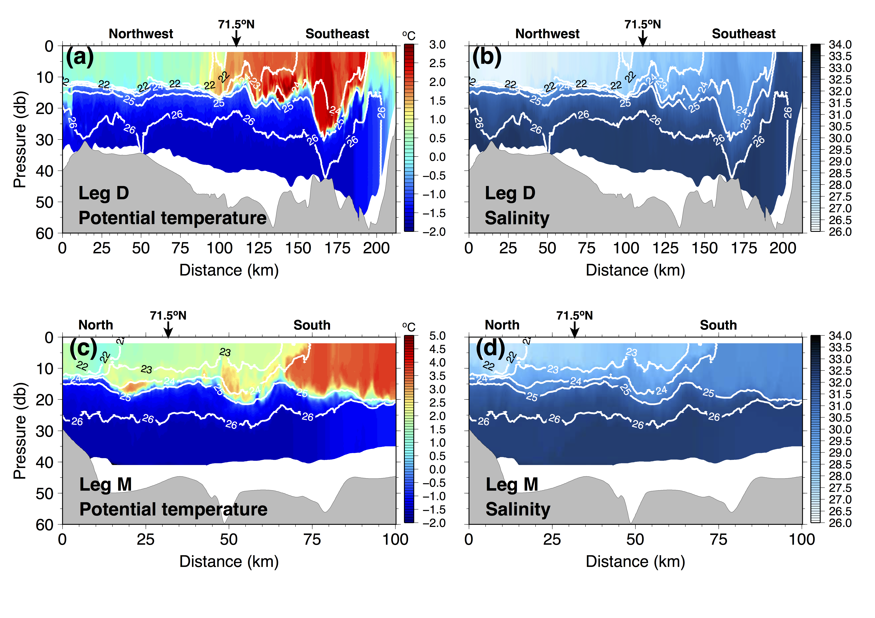
Strong pycnocline

Slide 48
Stronger pynocline,
~10 m mixed layer
Colder, fresher
Warmer, saltier
This north-south density gradient and shallow mixed layer have important influences on surface current behaviors.

Slide 49
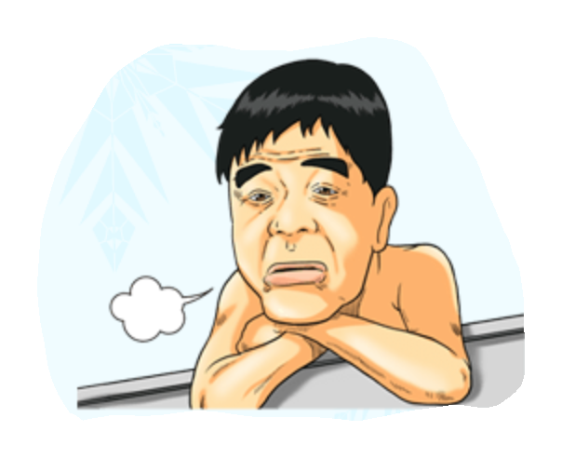
How does the divergent mode develop?

Slide 50
For upper layer (< 10 m)
North-south density gradient
vs
Northeastward pressure gradient
North-south density gradient
v.s.
Northeastward pressure gradient
And, east-west density gradient gradient near Hanna Shoal drives geostrophic shear, upper flow is westward. They all counter the Northeastward pressure gradient
North of 71.5ºN,
U_{HFR} = U_{G} + U_{EK}
Shallow mixed layer facilitates influence of winds
South of 71.5ºN,
U_{HFR} = U_{G} + U_{EK}

Slide 51
A divergent mode case in 2011 observations

Slide 52
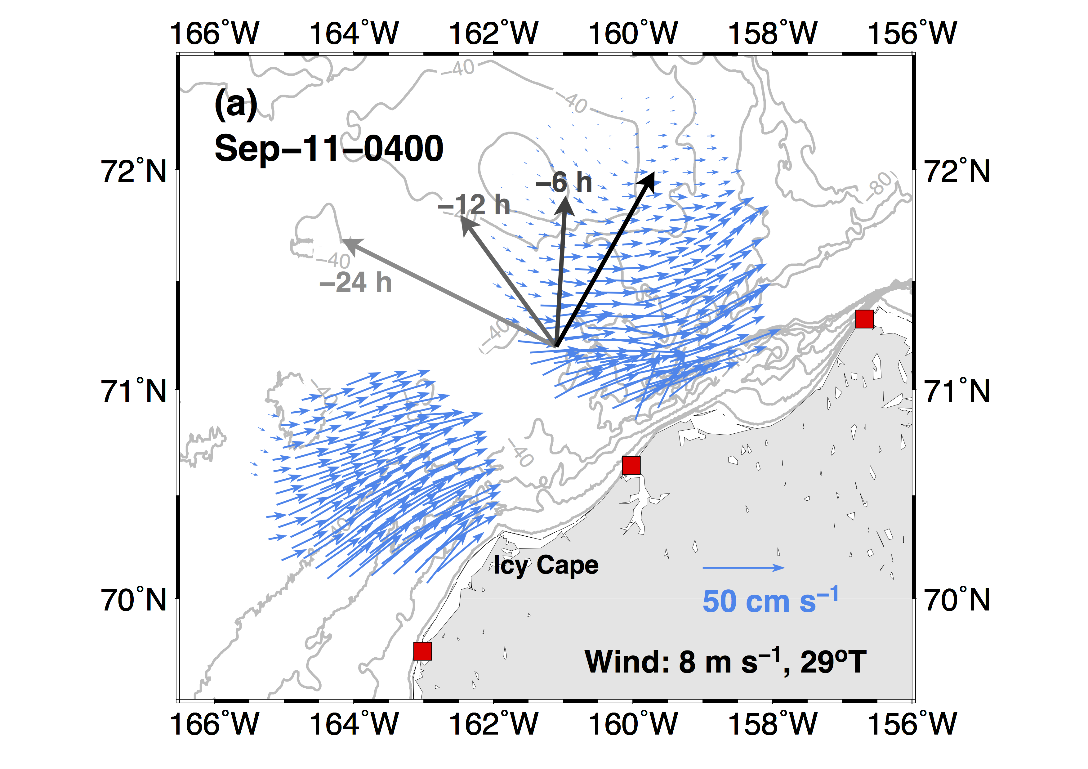
southerly winds, inducing coastal setup, promote the coastal current. Flows follow depth contours. Flows are driven by large scale pressure gradient and cross-shore pressure gradient.
North of 71.5, Flows are weak, wind driven Ekman.

Slide 53
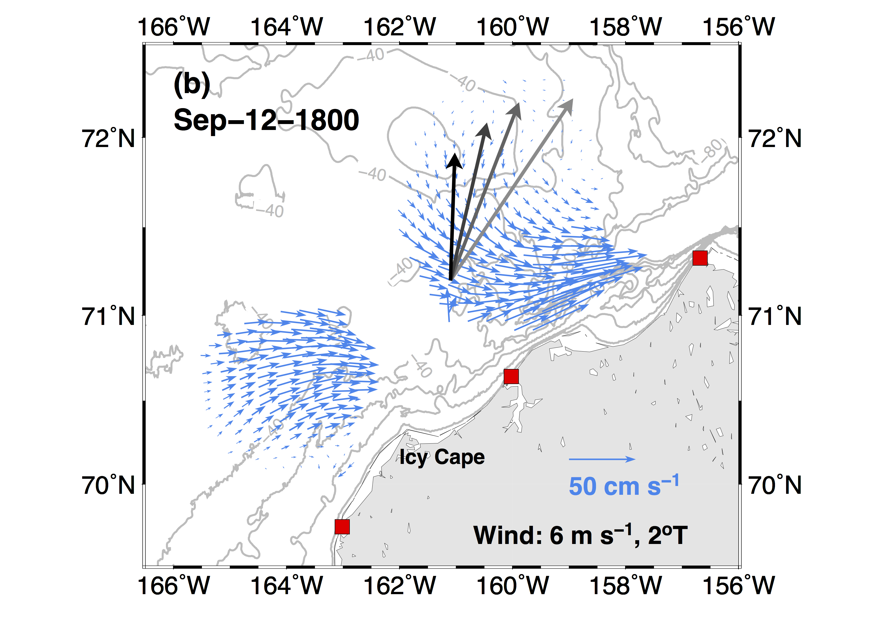
Alongshore winds continue. The coastal current becomes more eastward but still follow depth contour. Some weak return flow offshore Icy Cape due to the coast.
North of 71.5, Flows are weak, wind driven Ekman.

Slide 54
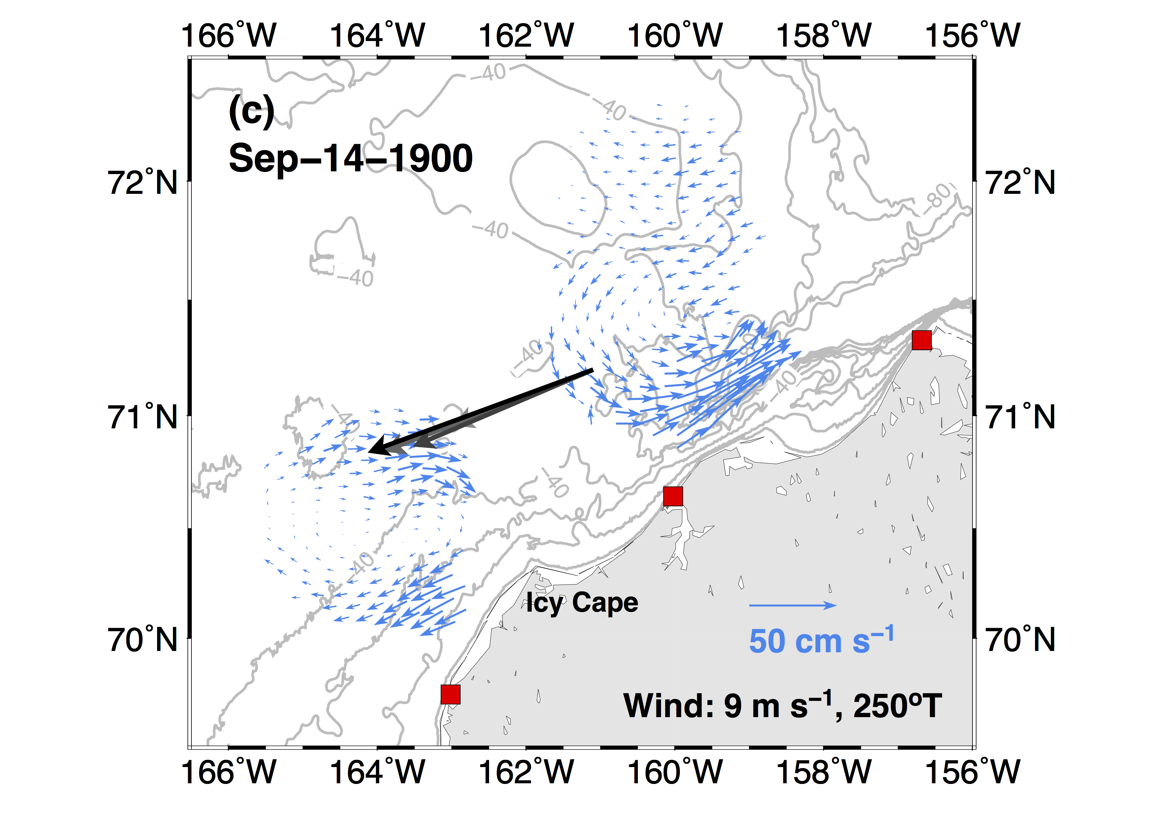
Di
NE winds develop in two days. Div mode is seen.
North of 71.5, Flows change directions with Ekman behaviors.
Nearshore flows off Icy Cape are affected by winds and change directions due to shallow depths, where stratification is weak.
Offshore 40 m, flow is still eastward and follows depth contour. This is the manifestation of PGF-driven flow.
This flow is related to flow near canyon and the eastward flow south of Hanna Shoal
Currents veered to right hand side of the winds.
Ekman
Deeper depths near the canyon. Winds have not fully penetrate the water column
accelerated by winds
Divergent mode appeared

Slide 55
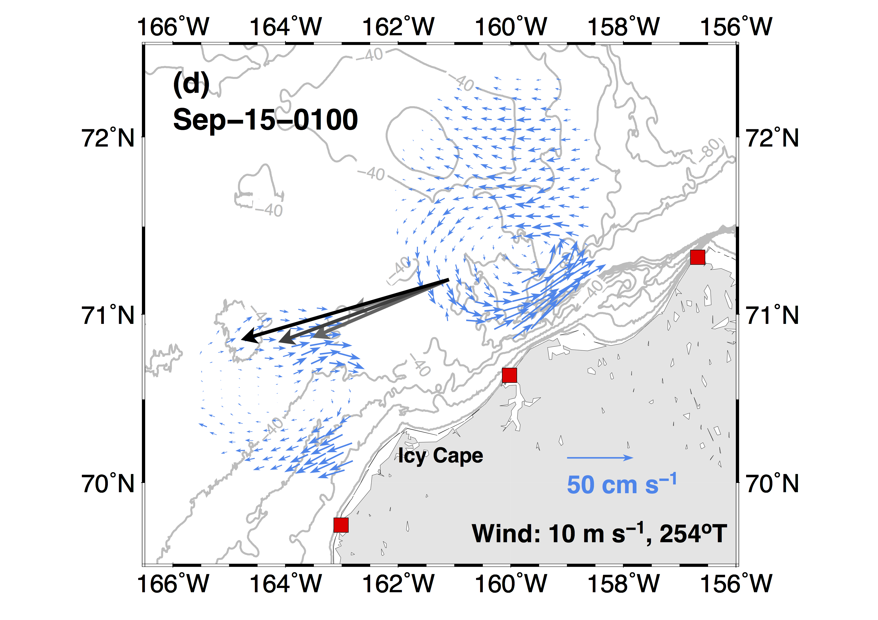
After 5 hours, NE winds continue. Major features remain.
Flow north of 71.5N become stronger and veer to right-hand direction. Ekman.
Currents veered to right hand side again.
Ekman

Slide 56
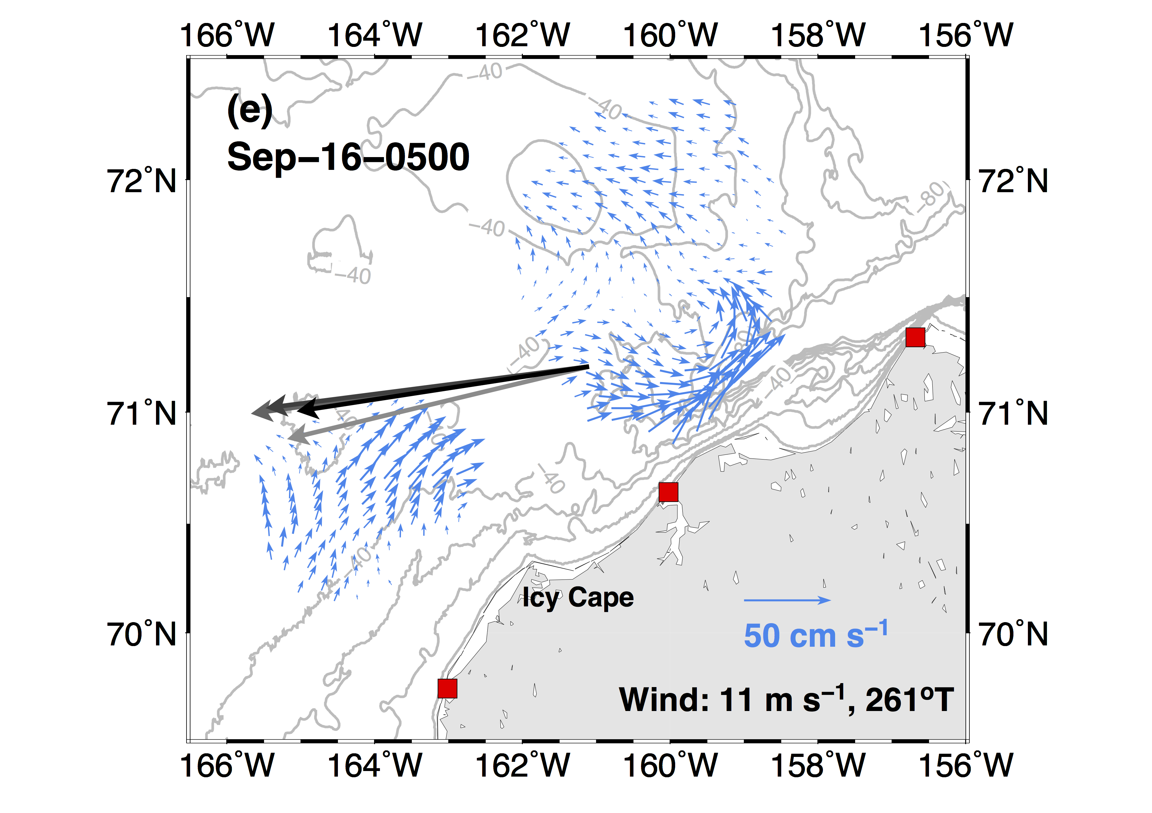
After 1 day, NE winds get stronger.
Nearshore flow forced by winds off Icy Cape become steady and start to feel rotation, inducing offshore Ekman transport, this process results in coastal setdown.
Coastal current off 40 m still goes NE,
The coastal current still follows 40 m isobath

Slide 57

After 1 day, NE winds continue.
Nearshore flow off Icy Cape still goes offshore (Ekman), but coastal setdown eventually create a cross-shore PG, and is large enough to drive a coastal jet, following depth contour.
Flow near canyon still goes NE.
Flow north of 71.5 becomes stronger.
Still Ekman
Still northeastward
Wind stress and wind-induced coastal setdown drives a geostrophic flow, overwhelms northeastward coastal currents

Slide 58

NE winds become stronger.
Coastal jet in the south is developed.
The cross-shore PG is large enough, making flow near canyon start to turn (to left hand side direction)
Currents near the canyon eventually turned.
The coastal setdown and wind stress were large enough to reverse the NE flow.

Slide 59

NE winds blow for one more day.
At this stage, a large scale, cross-shore PG is fully developed, driving a strong SW jet.
North of 71.5, the cross-isobath Ekman currents continue mixing and reduce surface density gradient and is eventually controlled by large scale cross-shore PG. So the flow tends to follow the isobath of Hanna Shoal.
Subsurface flow in Barrow Canyon fully reversed this day
Wind stress and a large scale, ~150 km wide, cross-shore sea level difference was created by winds, driving a shelf-wide geostrophic flow to the SW.

Slide 60

NE become weaker on Sep 19.
The coastal jet remains.
North of 71.5, assuming water re-stratified and weakening winds can nort becomes more Ekman style again (cross isobath)
This is what we see in SOM-derived pattern, reversal regime.
Winds weakened on Sep 19. Flows north of 71.5ºN returned to Ekman style.

Slide 61

More Ekman
Under the unset of strong northeasterly winds, surface current response is not just a simple reversal.
PGF
Shallow depths
These two regions response to winds first
This is what we see from SOM-derived pattern

Slide 62
Mean circulation patterns of 2010 – 2014 observations

Slide 63


Slide 64


Slide 65
summary

Slide 66
Response of surface current circulations under varying local winds are defined.
Strong northeasterly winds (> 6 m s⁻¹) reverse the northeastward flowing coastal current to the southwest.
A transitional pattern, the divergent mode, will appear during the onset of strong northeasterly winds.
Surface currents north of 71.5ºN are weak due to a weaker pressure gradient force, and therefore behave as wind-driven Ekman currents. Strong stratification traps wind stress in a shallow mixed layer, increasing influence of winds.

Slide 67
Concluding Remarks
Northeasterly winds, < 6 m s⁻¹.
And other wind directions and magnitudes
Northeasterly winds, ~6 m s⁻¹
Northeasterly winds, > 6 m s⁻¹
< ~24 hours
NE currents
Divergent mode
Reversal

Slide 68
Why are regions north of 71.5ºN, east of Hanna Shoal so stratified?

