Slide 1
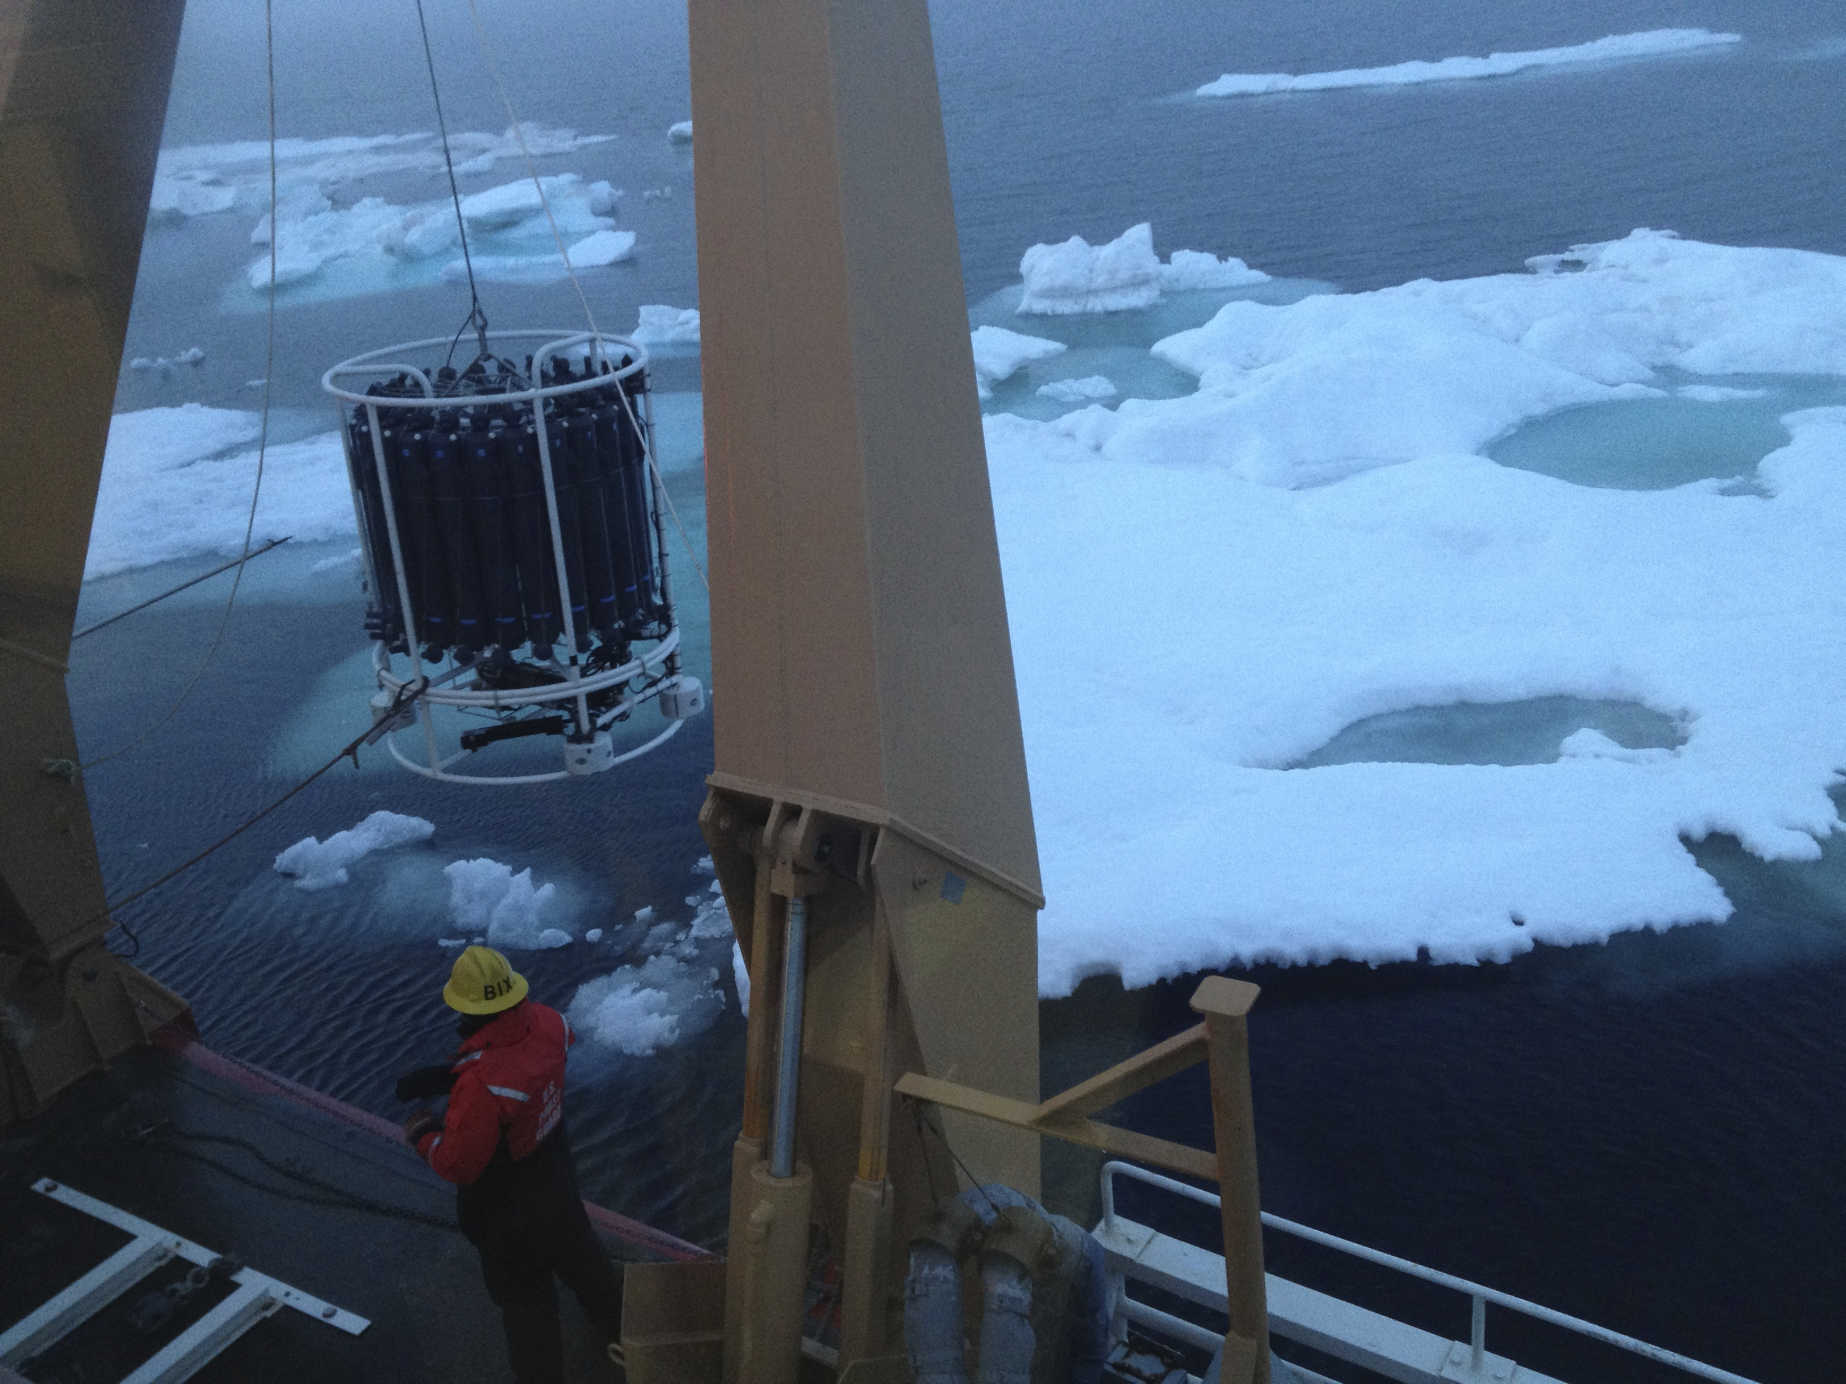

The Circulation Structure Around Hanna Shoal on the Northeastern Chukchi Sea Shelf
Ying-Chih Fang, Thomas Weingartner,
Rachel Potter, Chase Stoudt and Elizabeth Dobbins
School of Fisheries and Ocean Sciences, University of Alaska, Fairbanks, Alaska, U.S.A
Notes:
Good morning, this research is part of the BOEM-funded program, Chukchi Sea offshore Monitoring in Drilling Area, as known as COMIDA. We again appreciate BOEM for providing the funding.

Slide 2
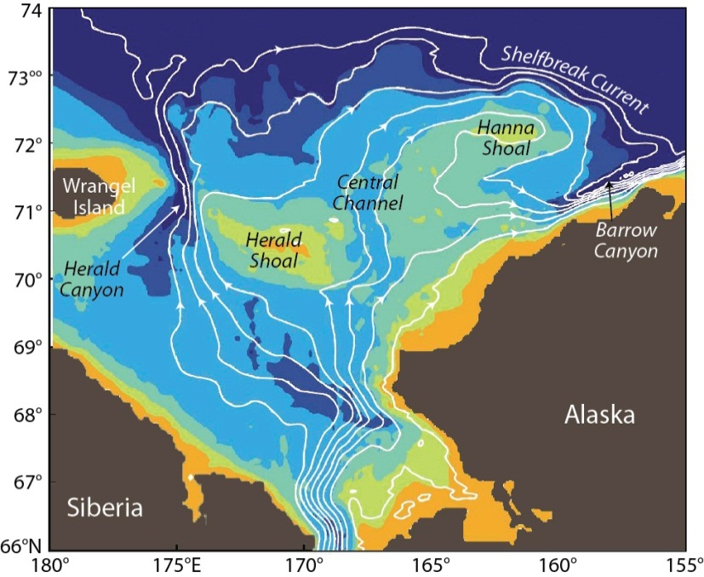
Circulation pattern from numerical model output
Based on Spall (2007)
Notes:
This picture is based on numerical model output. The white lines in the figure are the flow streamlines. This picture tells us as the inflow from Bering Straight comes into the Chukchi Sea Shelf, the flow will be topographically steered by local bathymetric features, and will be split into three major branches. One goes to the west, and exits the shelf through Herald Canyon, the other branch flow following the Alaskan coast as Alaskan Coast current and exit the shelf through Barrow Canyon.
The third branch goes to the north and as it encounters Hanna Shoal, it is steered and behave as a clockwise-like circulation around the Shoal. However, due to sparse measurements, this picture is yet to be validated.

Slide 3
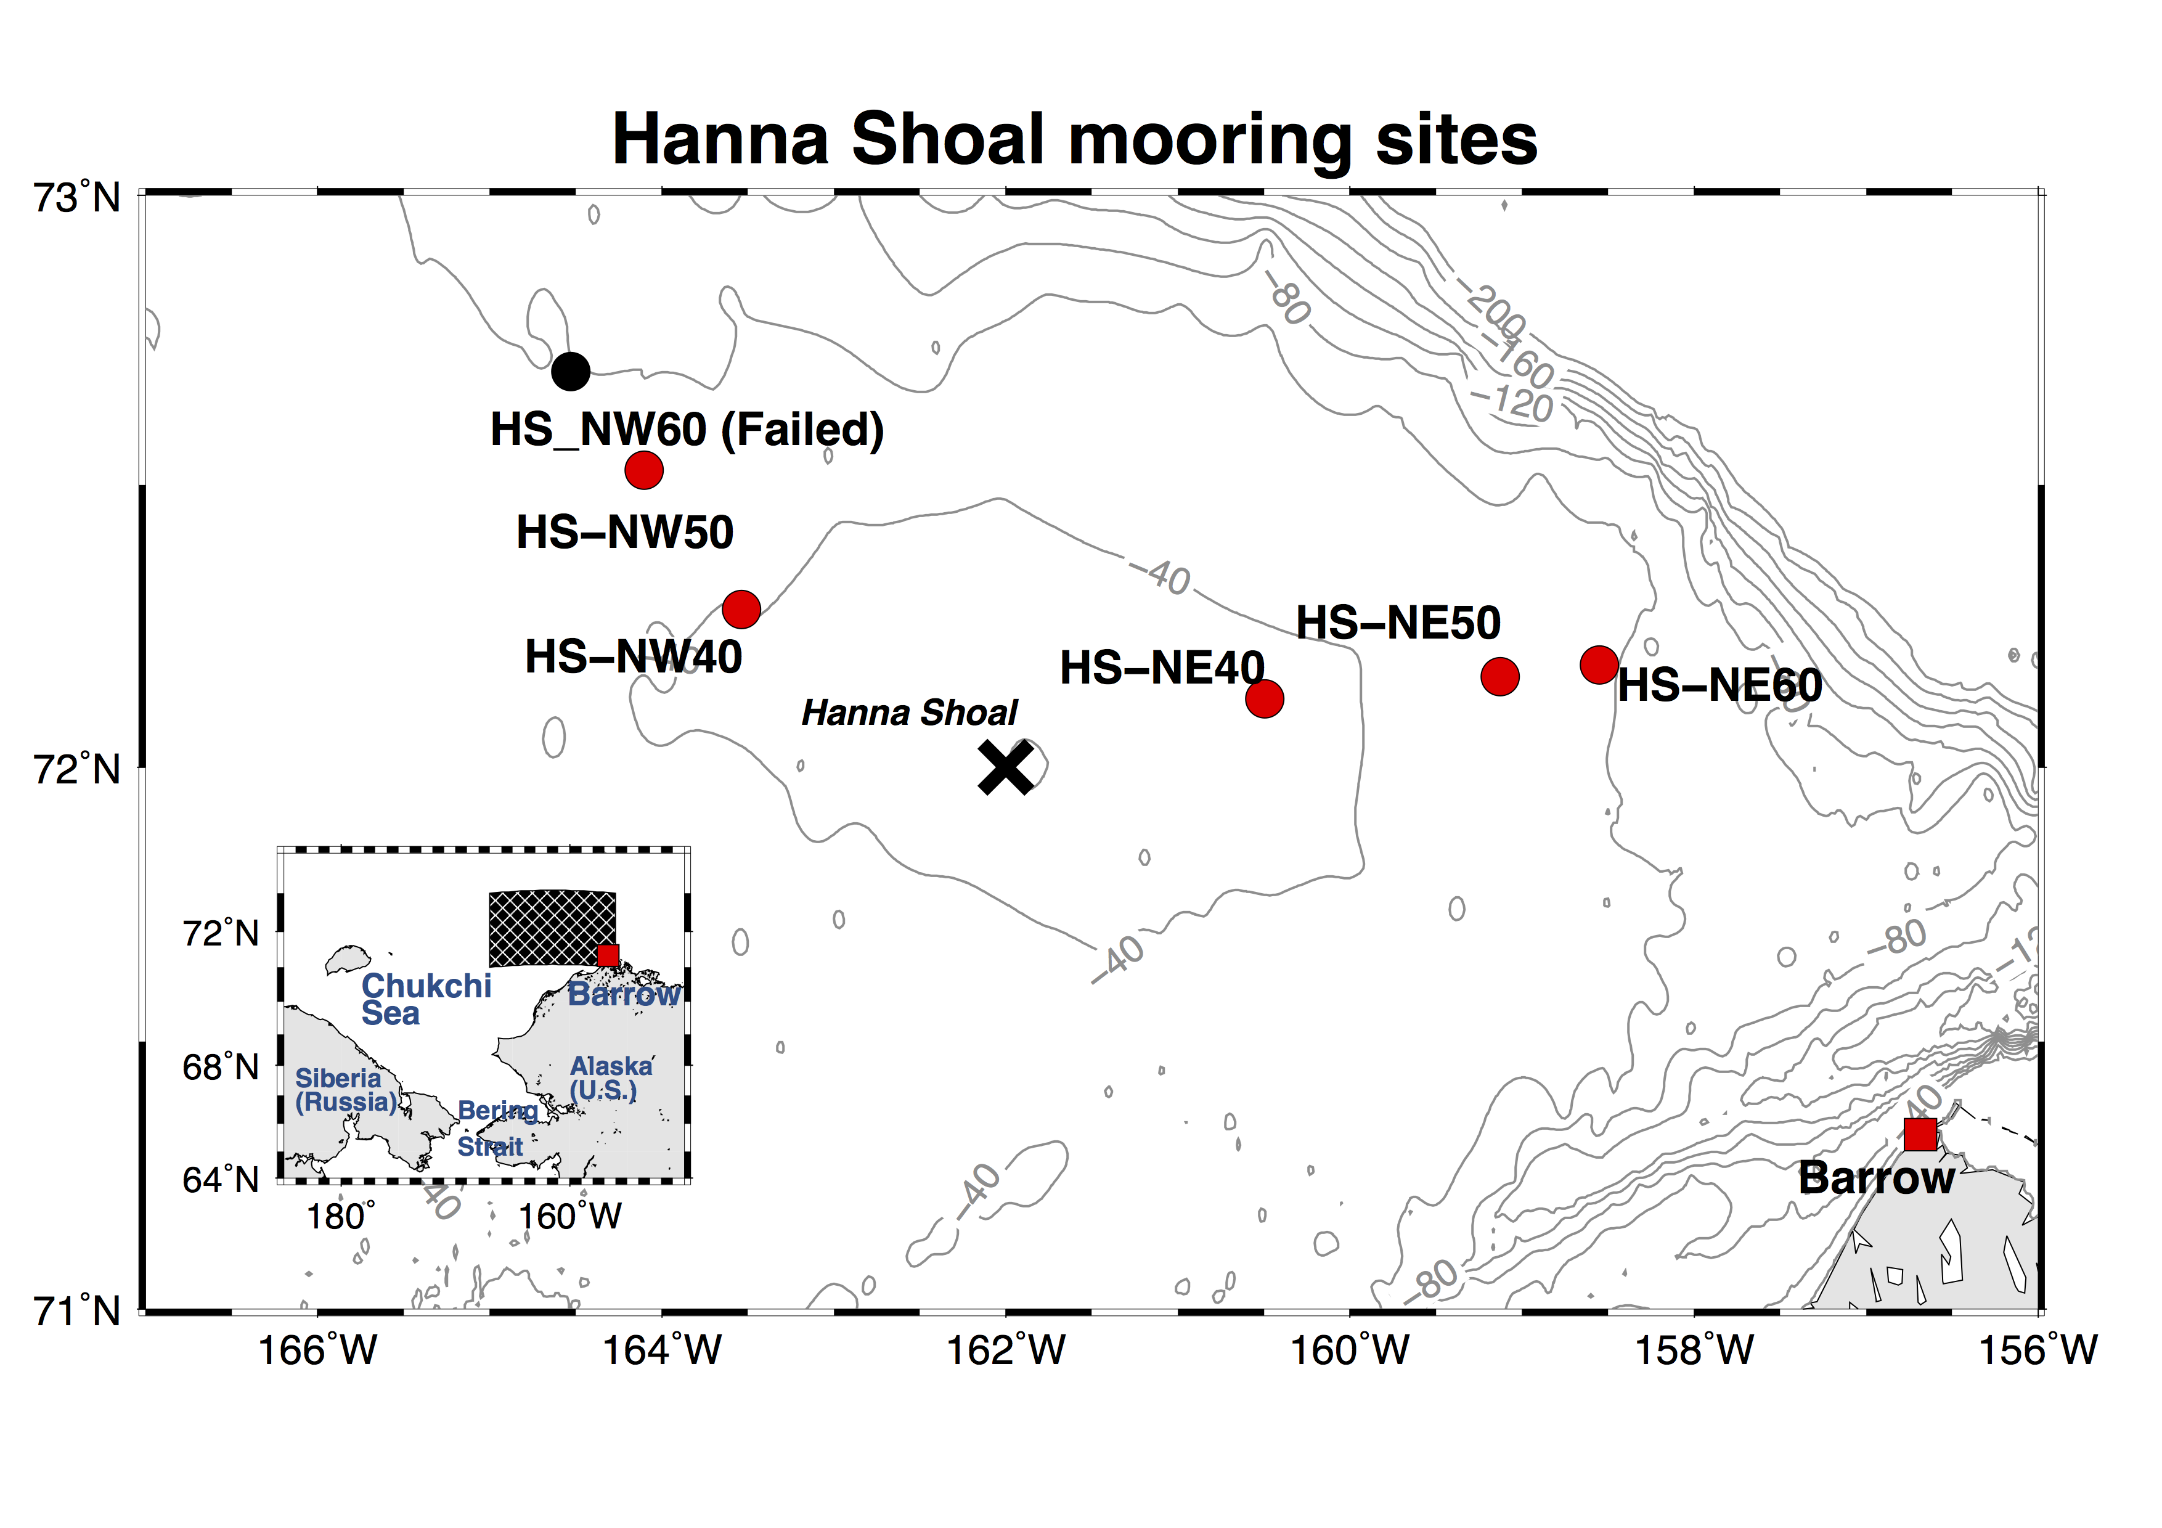
West CTD transect
East CTD transect
Deployment period: 2012 - 2013
2013 - 2014
Notes:
We used two summertime cruises to deploy six moorings around Hanna Shoal, Three were on the northwestern side, and three on the northeastern side. They were deployed along the 40, 50, and 60 m isobath. For convenience, we nominate mooring based on their location and local water depth. Therefore, for mooring at the northeast side and located as 40 m isobath, we called it NE40. Therefore, NE50, NE60.., etc. However, due to thick ice and tight ship schedule, we were not able to recover the mooring NW60. We believe it was still there. The cross sign shown here is the grid point for local wind derived from North America Regional Analysis product. We also present two CTD transect, and for simplicity, I will call them as West and east transect. The reason for showing this is to provide an idea of local stratification, and we will show stratification is important for the circulation around Hanna Shoal.

Slide 4
Mooring Design
Iscat T/C/P
25 m – NE50 (2012 – 2013)
32 m – NE60 (2012 – 2013)
300 kHz ADCP T/P/U/V
Microcat T/C/P
1 m
Notes:
Here is the mooring design, at each site we have a bottom mounted upward looking ADCP and a microcat sensor. During the first deployment, there was also an Iscat sensor at 25 m depth and 32 m depth at NE50 and NE60. You can think Iscat is a microcat but with ice avoiding ability.

Slide 5
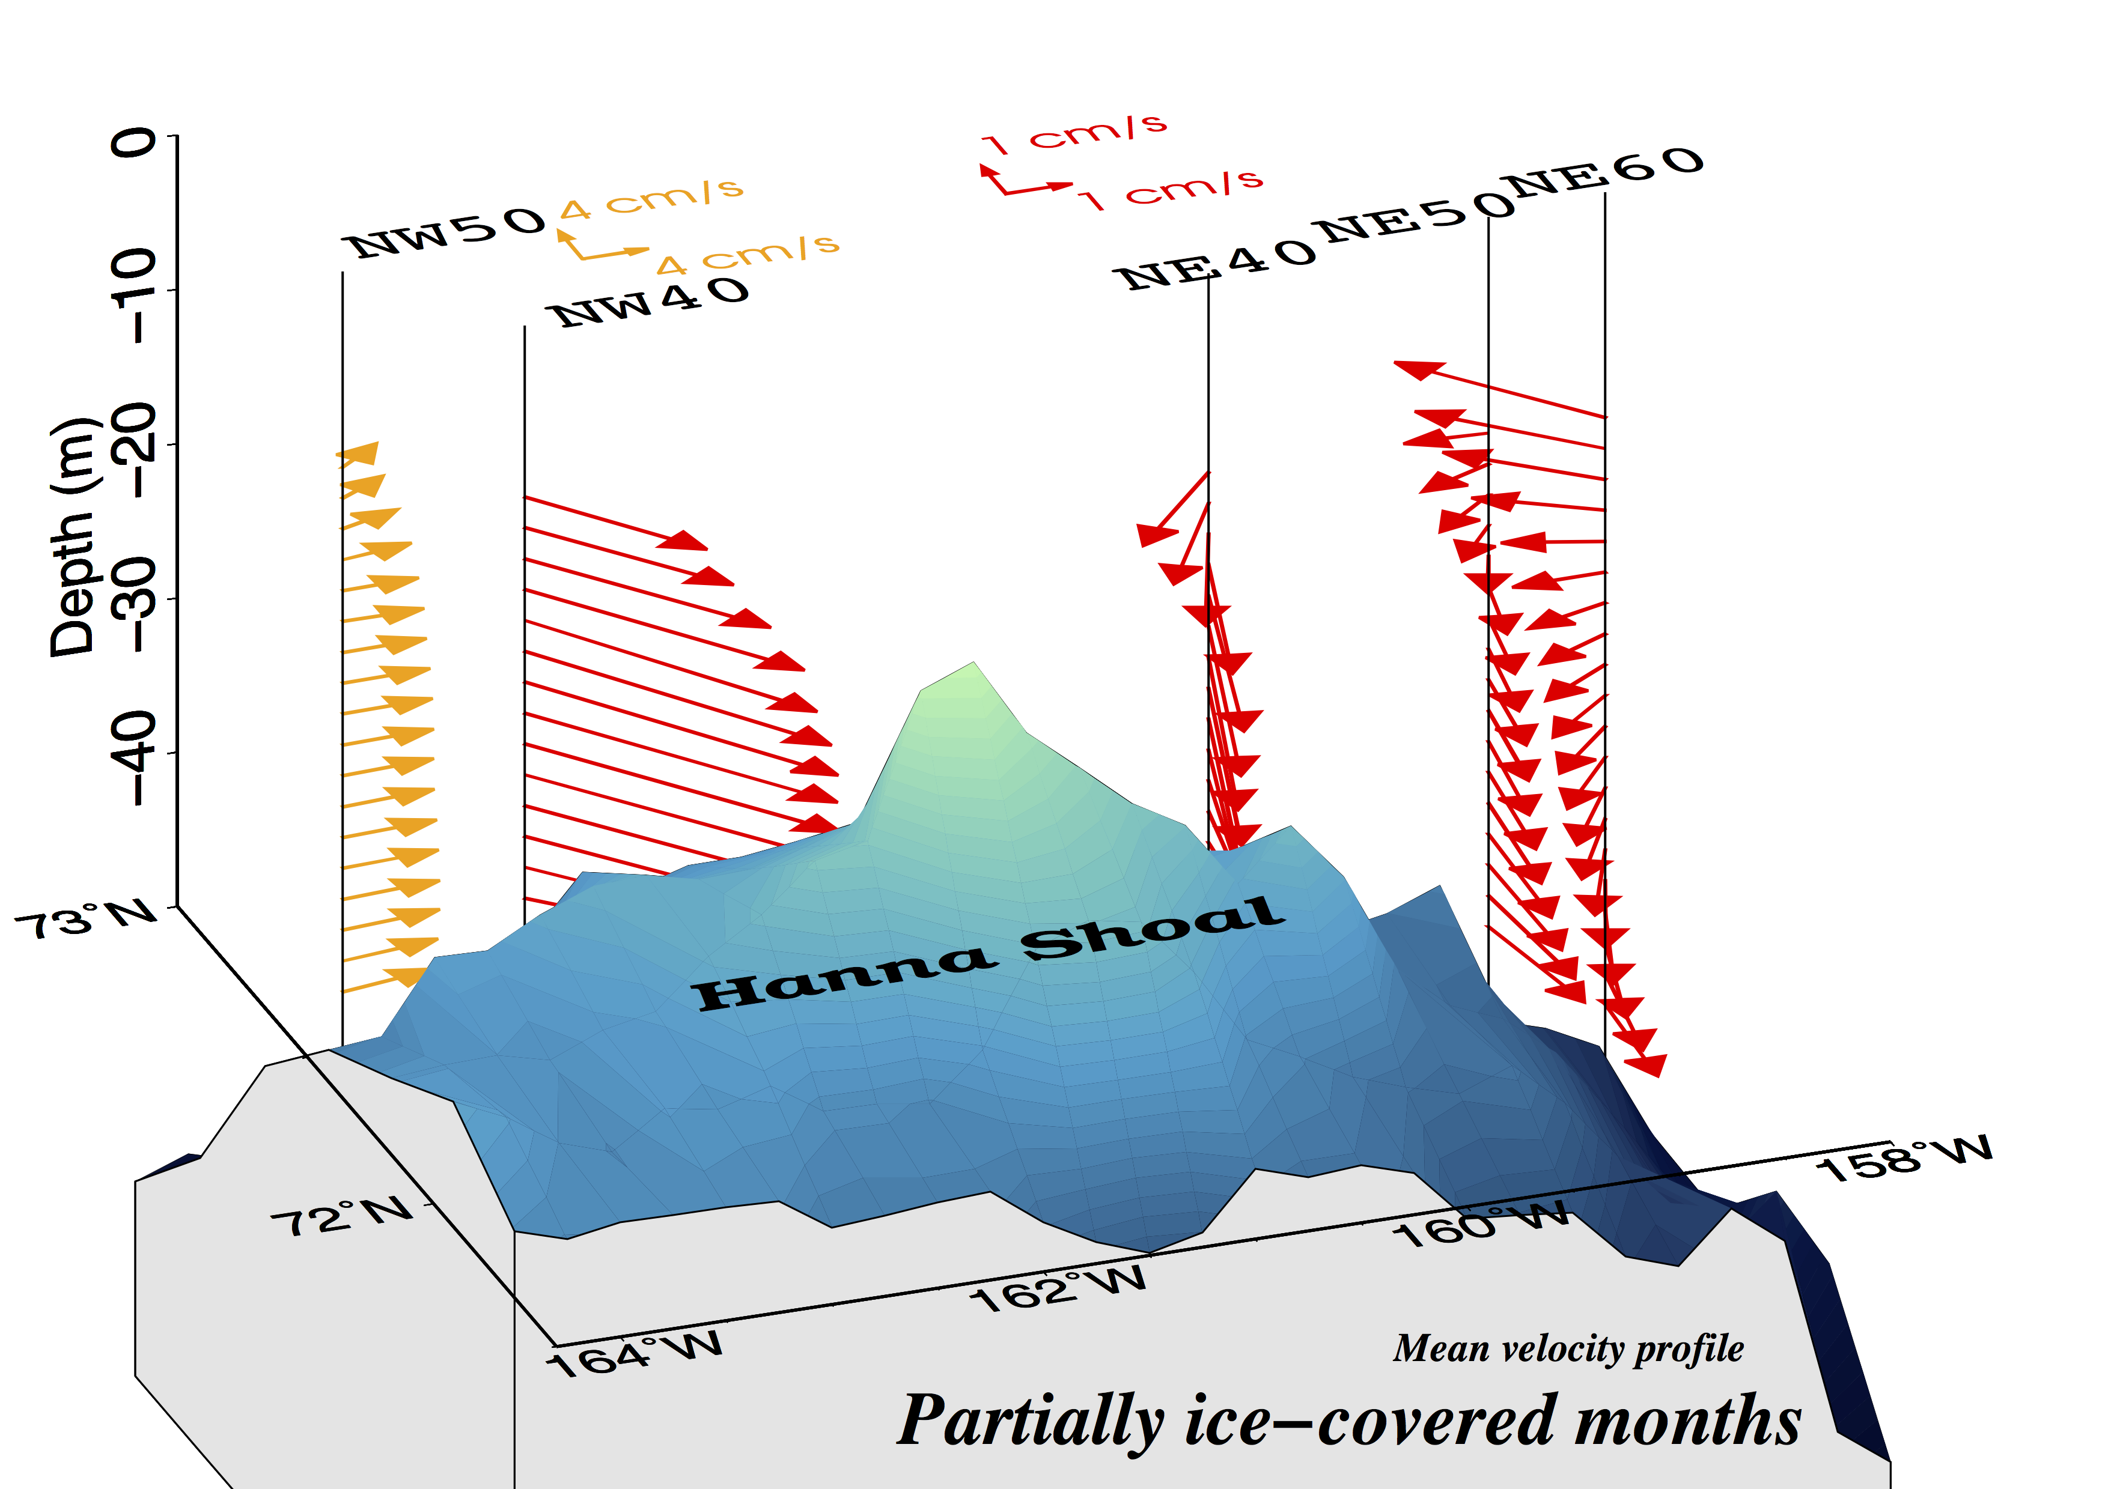
Mean flow structure (2013 -2014)
Note that the flow is sheared and veers counterclockwise with depth on the eastern side of Hanna Shoal
June - October
Notes:
It is interesting to know what the mean flow look like. So we compute the mean flow of 40-hour low passed current at each bin. This is an picture for period with partially ice-covered. The period is chosen from June to October. Here we can see that, at the western side of Hanna Shoal, the flow is relatively uniform and stronger. Interestingly, you can see that the flow is sheared and veers counterclockwise with depth on the eastern side, with southward bottom flow and flow tends to be westward at the upper part of the water column. We think and will show that, this is because there is a horizontal density gradient on the eastern side of the shoal, and this density gradient creates a vertical shear due to the thermal wind dynamics. Therefore, with thermal wind, if I move eastward on the eastern side of the shoal, I should expect a decreasing density or downward sloping isopycnal.

Slide 6
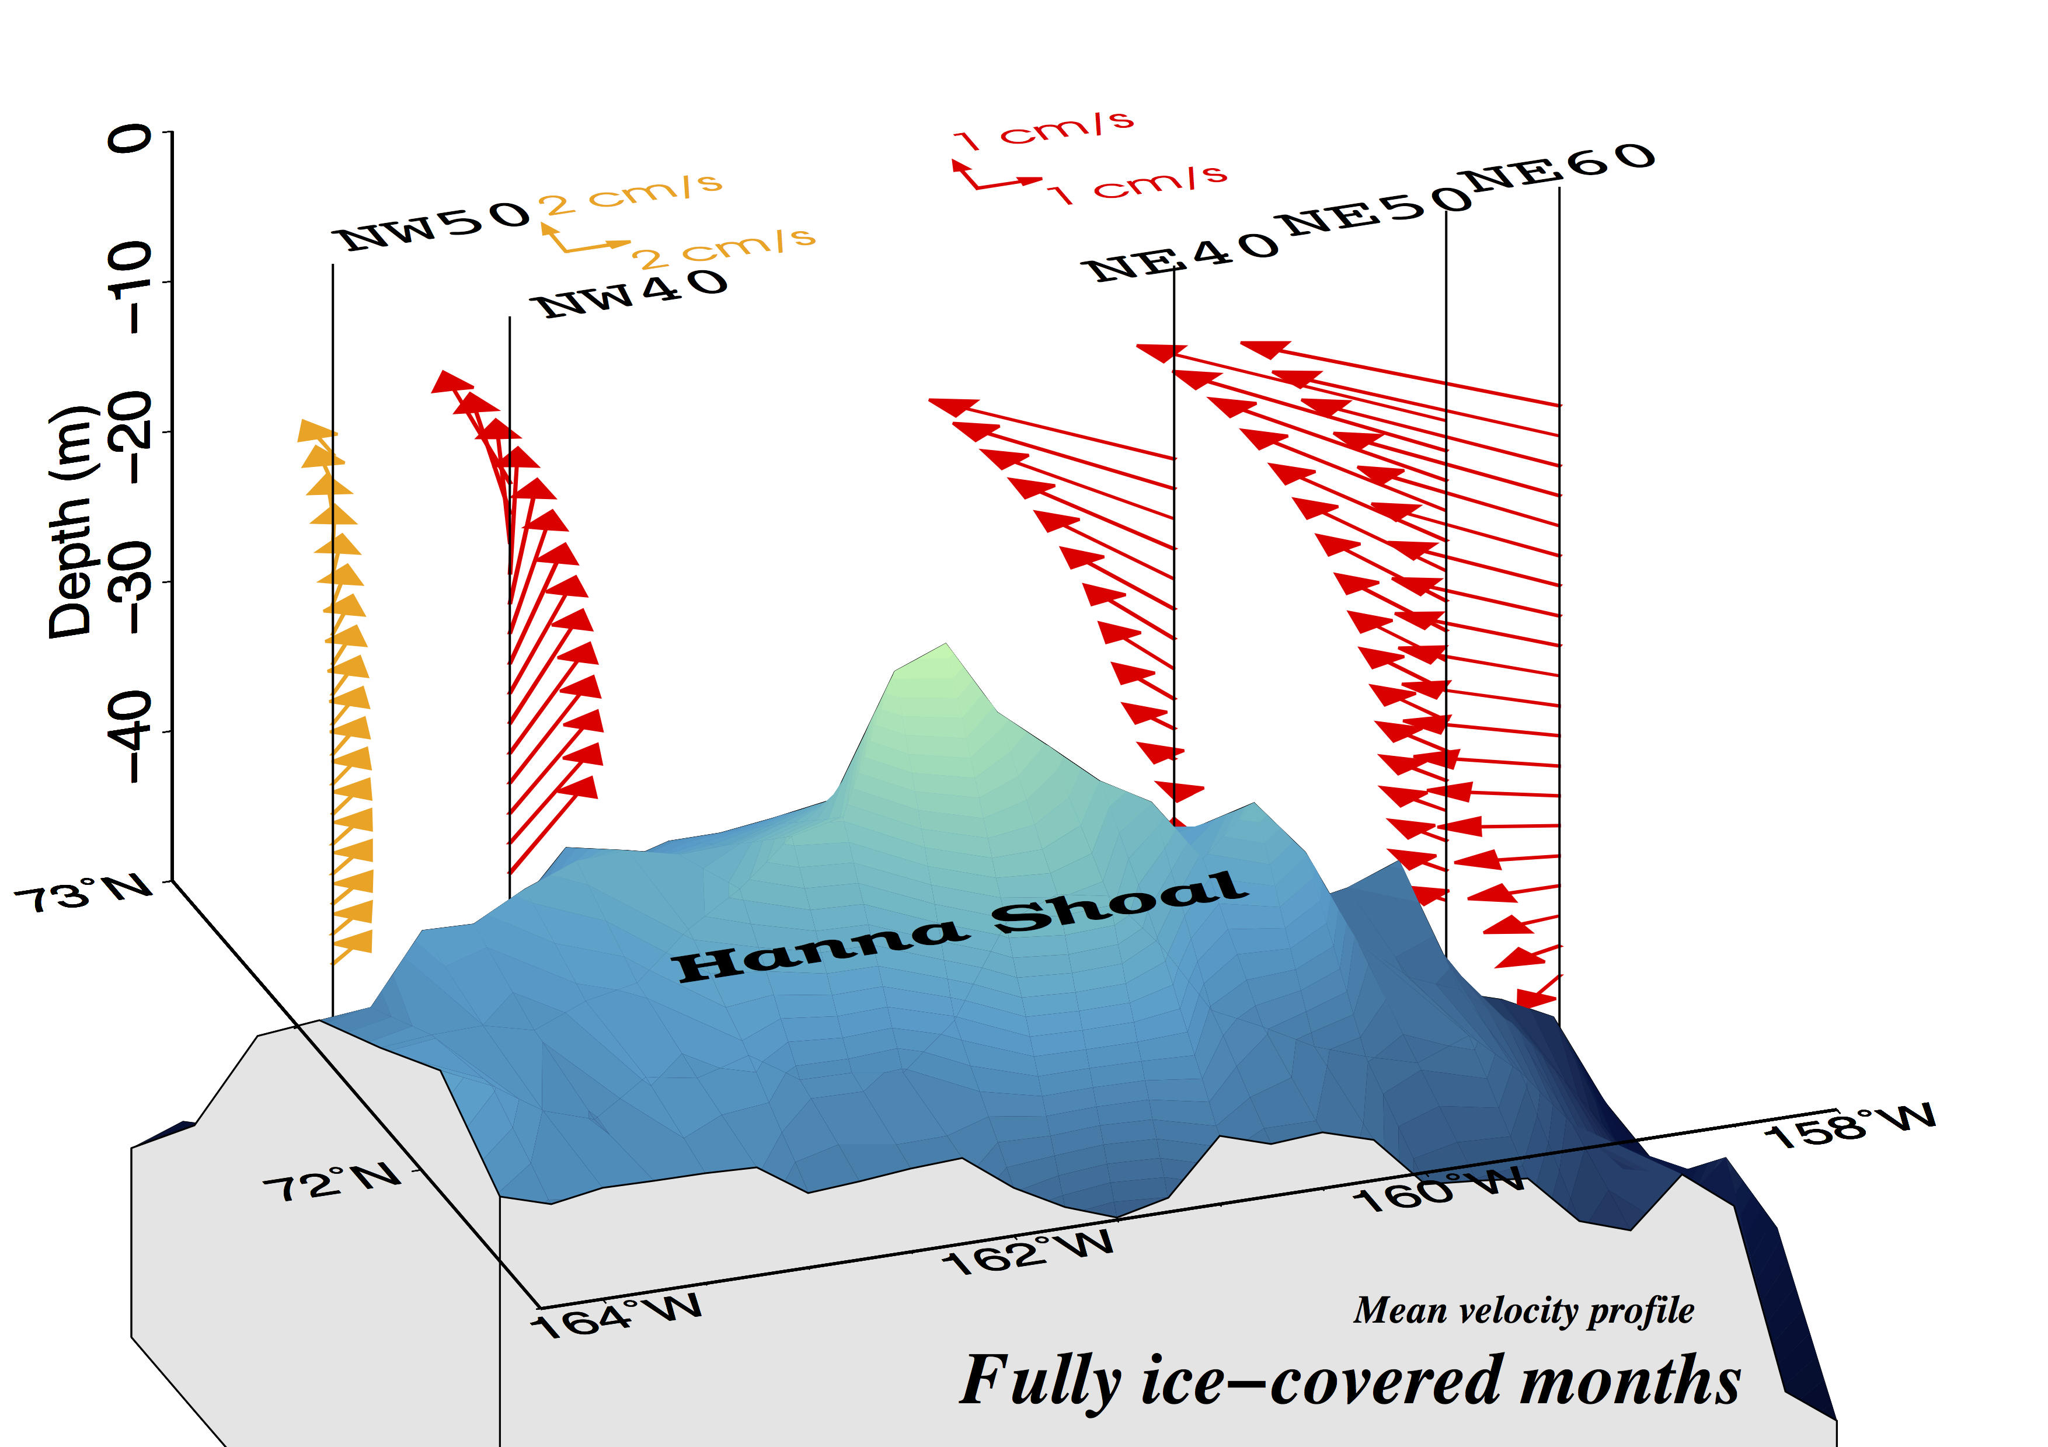
December - April
Notes:
Because this is a very shallow shelf, we have to consider the influence of wind and ice as well. So we compute similar pattern for the period that the shelf is fully ice covered. The period is between December and April. Now the picture is a little different, that the flow is weaker, but still relatively uniform on the western side. At upper part of the water column the flow is deflected to the north, but foe deeper depth the flow is mostly to the east. On the other hand, at the upper part of water column, you can see there is a clear enhanced westward flow on the eastern side of Hanna Shoal, as it becomes weaker at deeper depths. This different response at both sides somehow tells me, we have density gradient on the eastern side. The physics can be explained as following,
First we talk about the flow on the eastern side of Hanna Shoal, Since the winter northeasterly wind blows, it started to push water to the north and create a pressure gradient at the north, this pressure gradient maintain this westward current on the top, however, because we have a density gradient below, there it induces vertical shear, the shear weaken the mean flow and therefore prevent bottom stress from becoming large to balance the surface pressure gradient, this is why we see strong current on the eastern side. On the western side, this density gradient is weaker so the vertical shear is muss less, so the bottom stress can be established and balance the imposing pressure gradient. So can we see this density gradient?

Slide 7
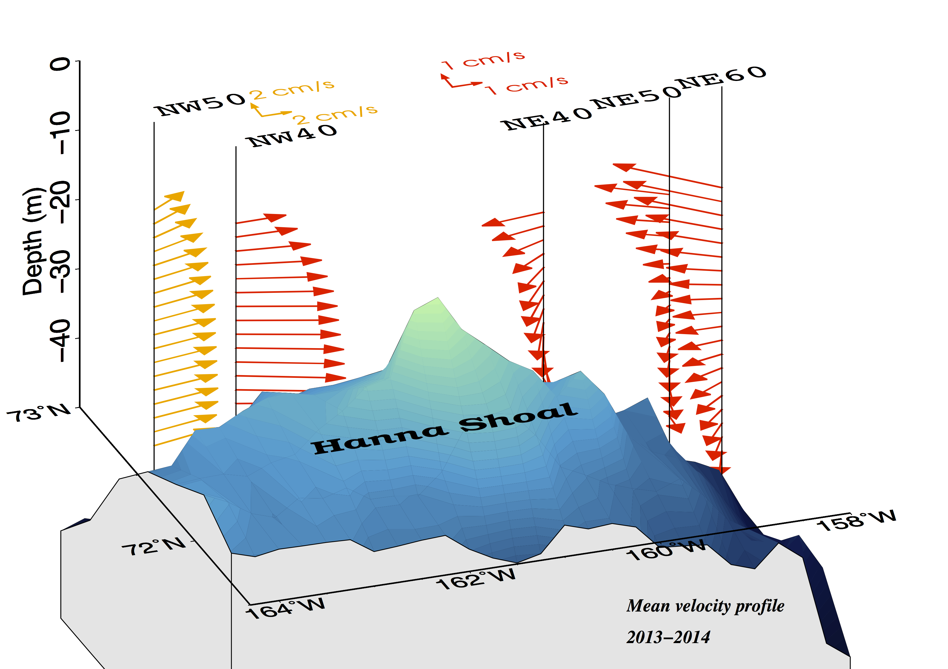
Annual mean flow structure
Relatively uniform
Sheared

Slide 8
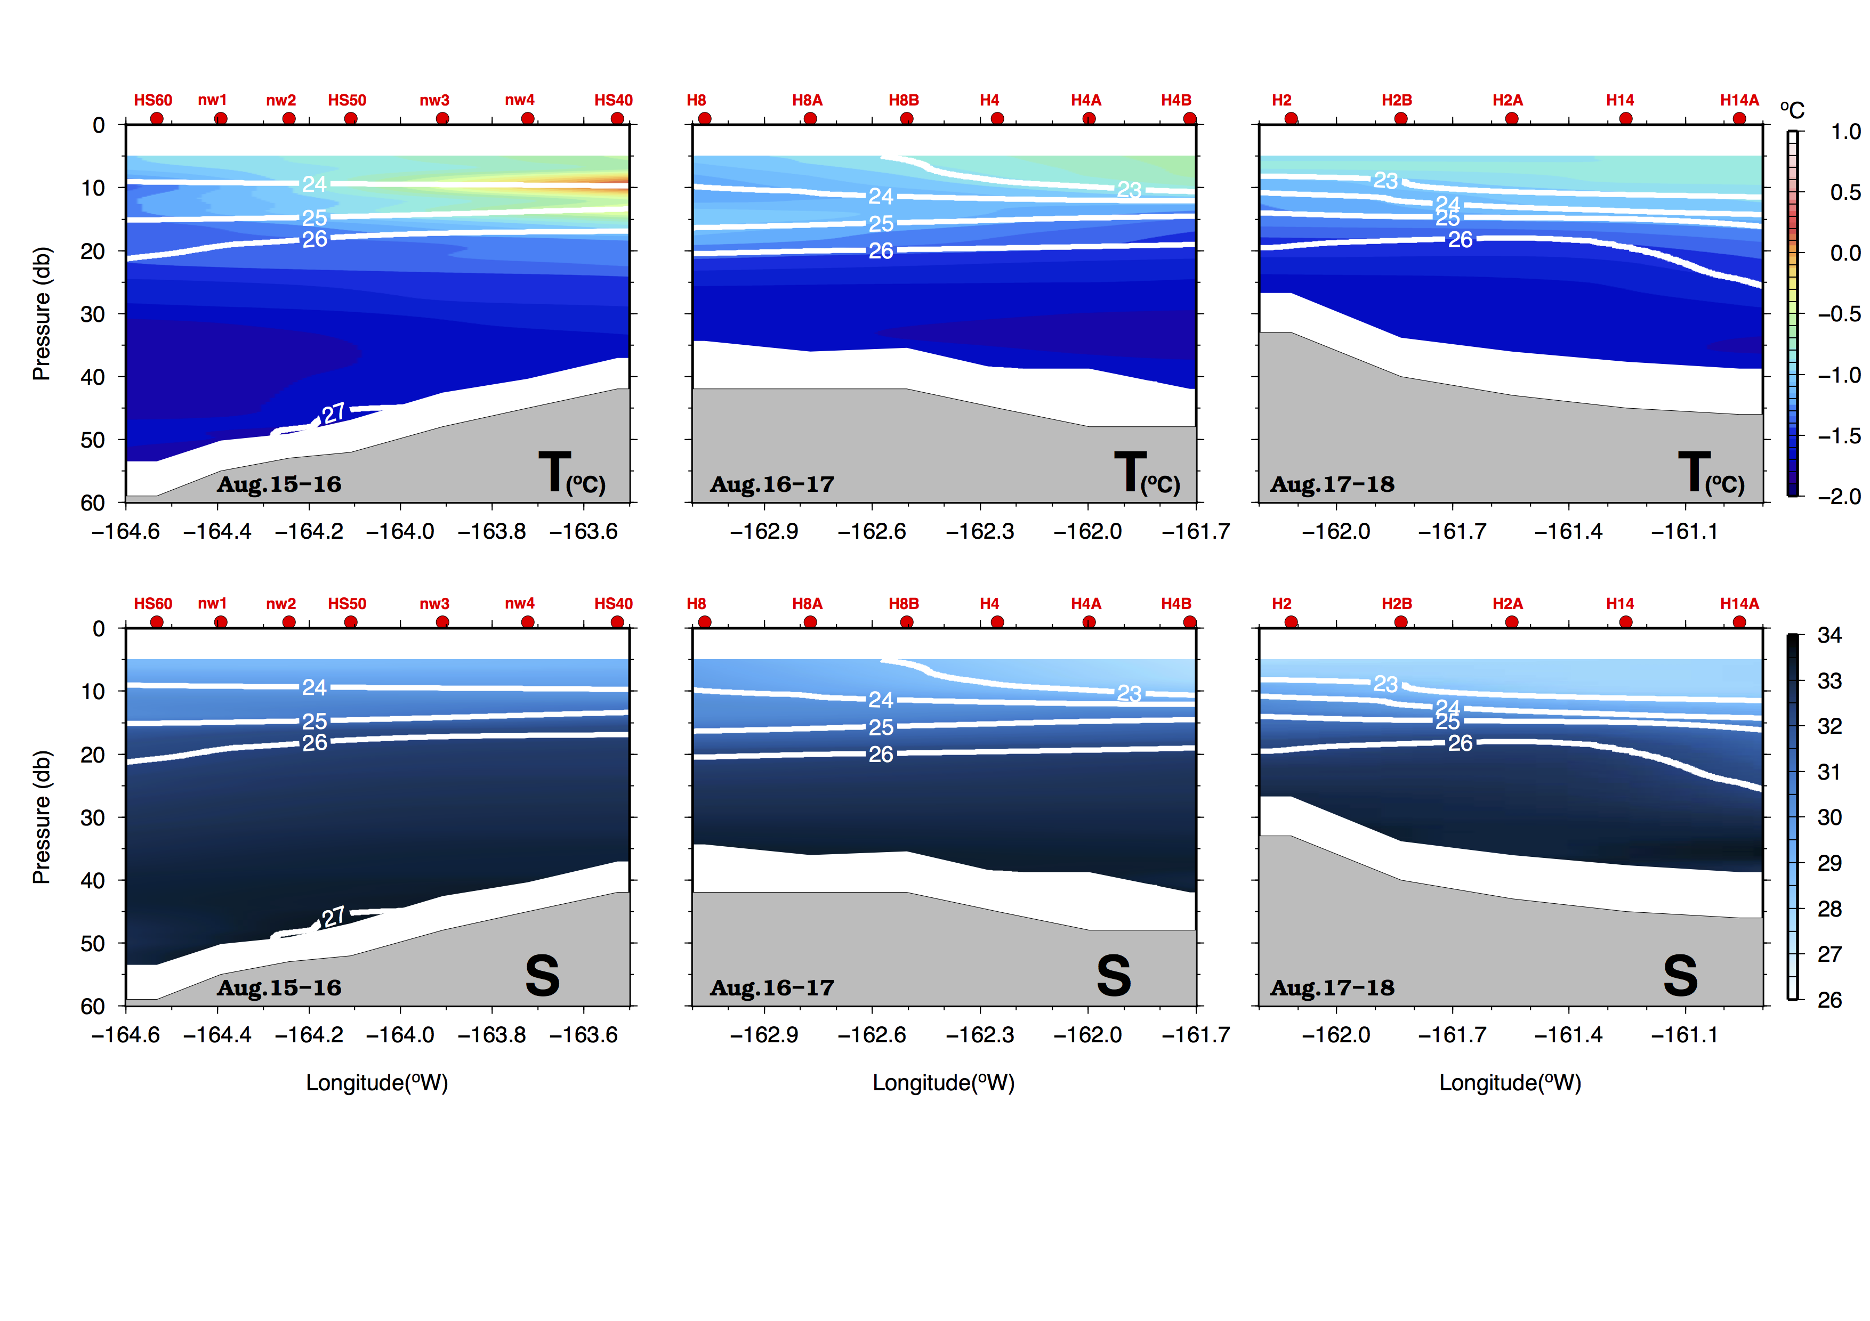
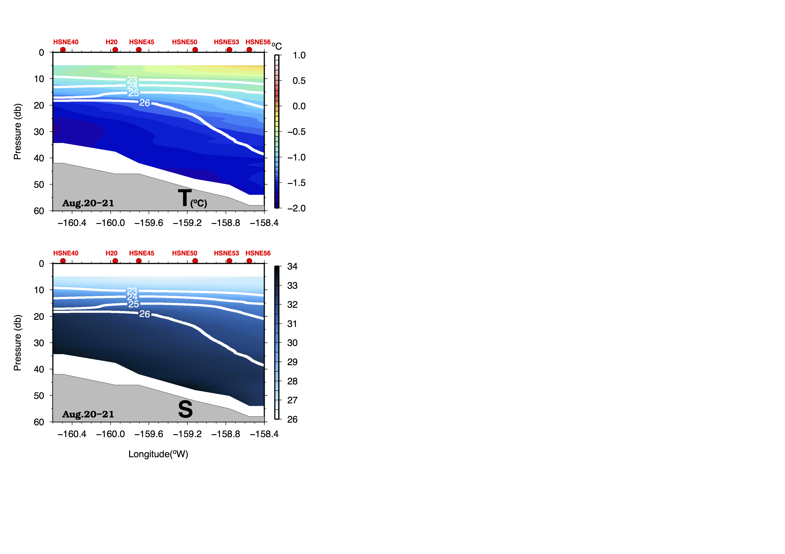
West
East
Notes:
Here is the two CTD transect I just mentioned. My left hand side is the west transect, and the east transect is on my right. The upper panel is temperature and lower panel is for salinity. We are facing to the north. The white contour lines is density. Here I want to point out this 26 isopycnal. On the west, this isopyncal is just gently sloping, but on the eastern side, this isopycnal is downward sloping, which means you will have smaller density if move eastward. These two transect were taken in August 2012. We can not loudly say this is the general picture. We then use two microcat sensors on NE50 to have an idea what stratifiation look like in a year.

Slide 9
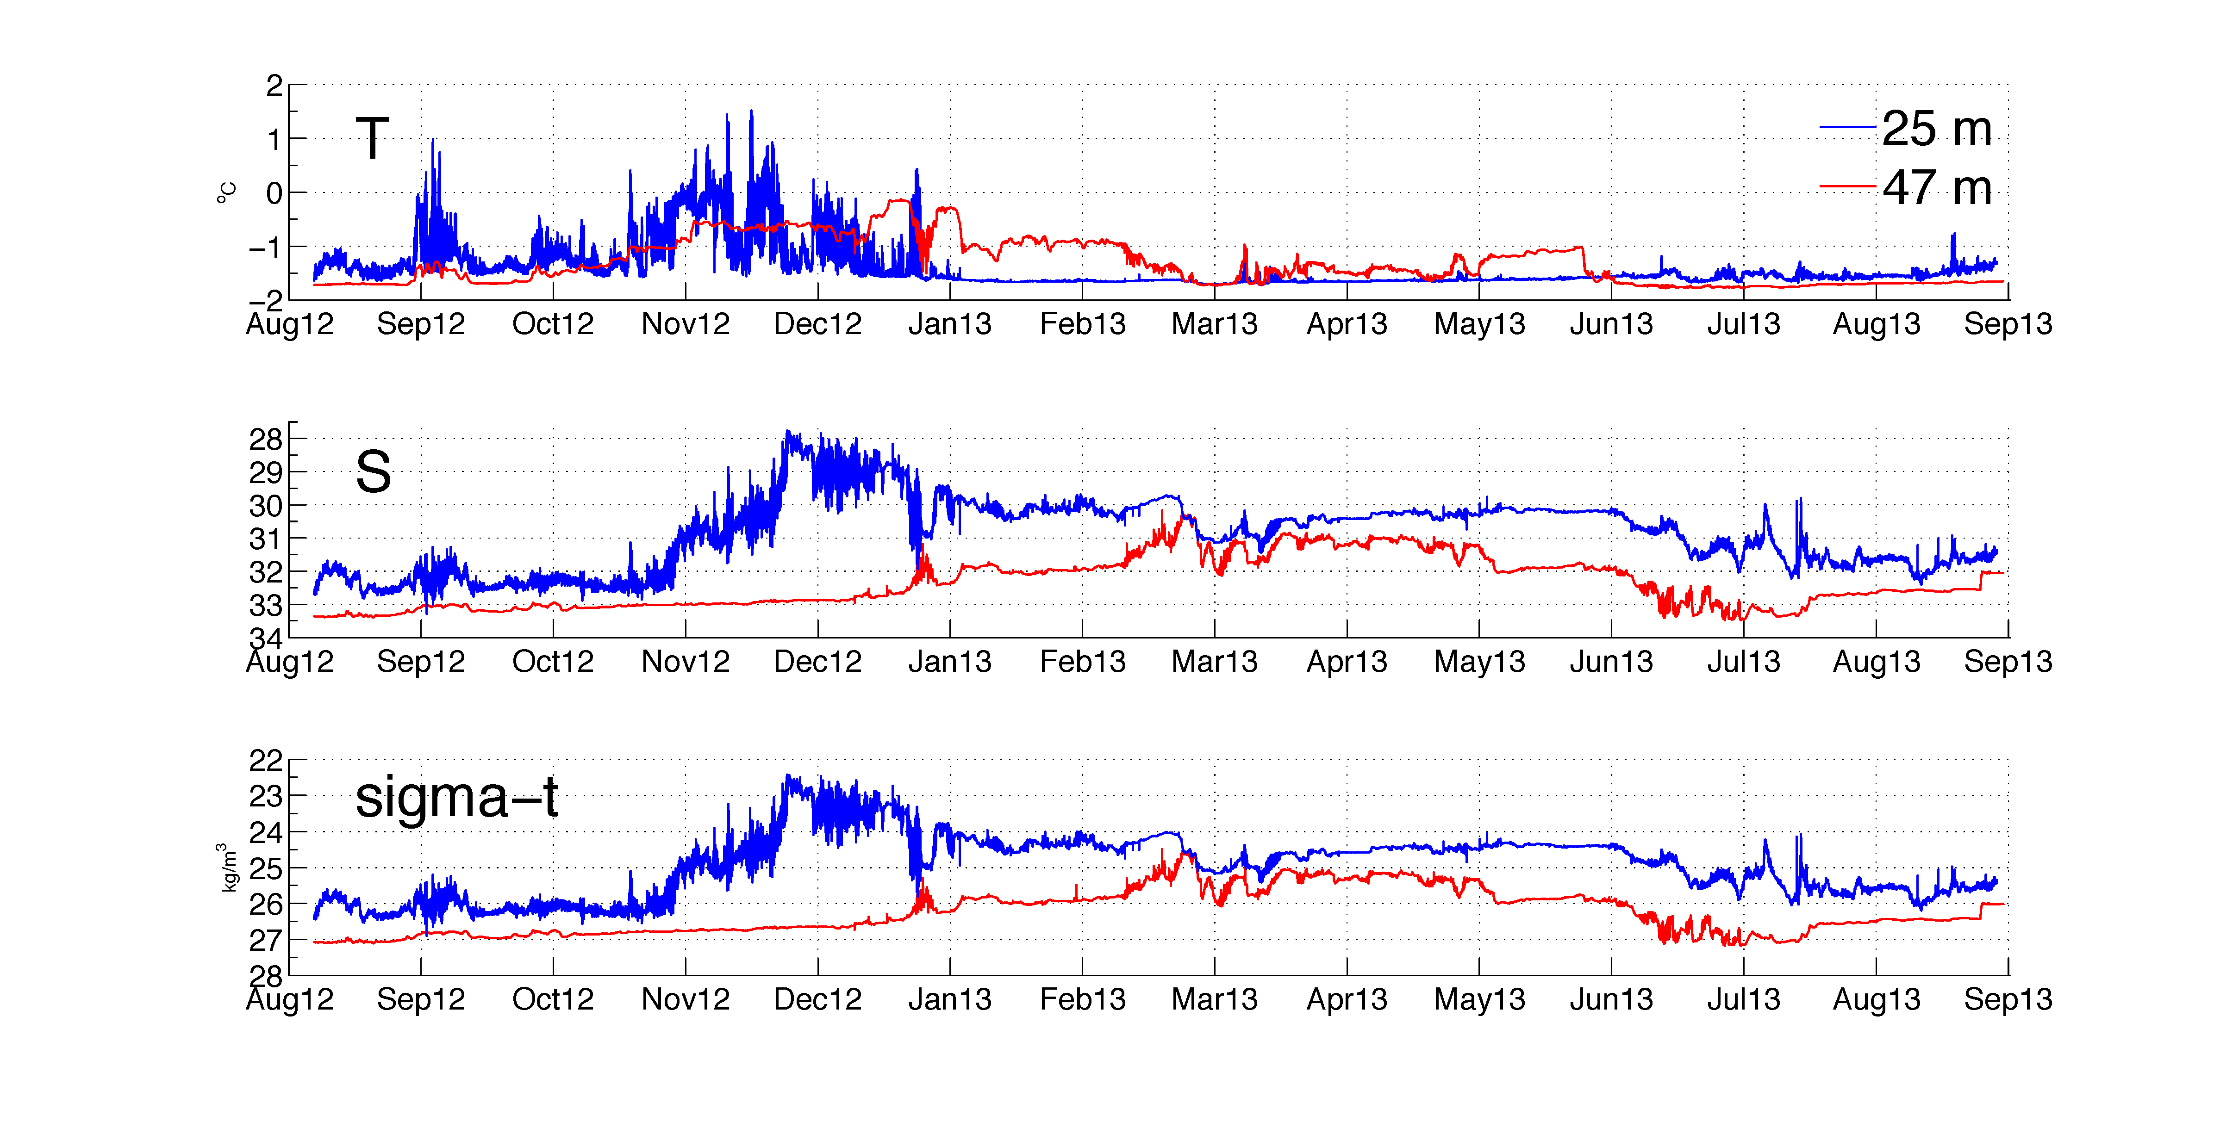
Stratification at NE50
warming
freshening
High frequency motions
freshening
Density less than 26 kg/m³
Why?
Bottom warming and freshening
Notes:
Here is the time series of Iscat at 25 m depth and microcat at the bottom. The upper panel is for temperature, the central one is for salinity and bottom one is for density. The blue line is measurement at 25 m depth, and red line is close to bottom. From this picture, we see that there is a freshening event at 25 m depth after November, and we alsee bottom warming and freshening after December, we also see high frequency signals, I can tell you this is internal waves. From density, we can see that at 25 m depth, the density is is less than 26, this further indicates a downward sloping isopycnal on the eastern side of Hanna Shoal. Then I want to figure out why we have this bottom warming and freshening.

Slide 10
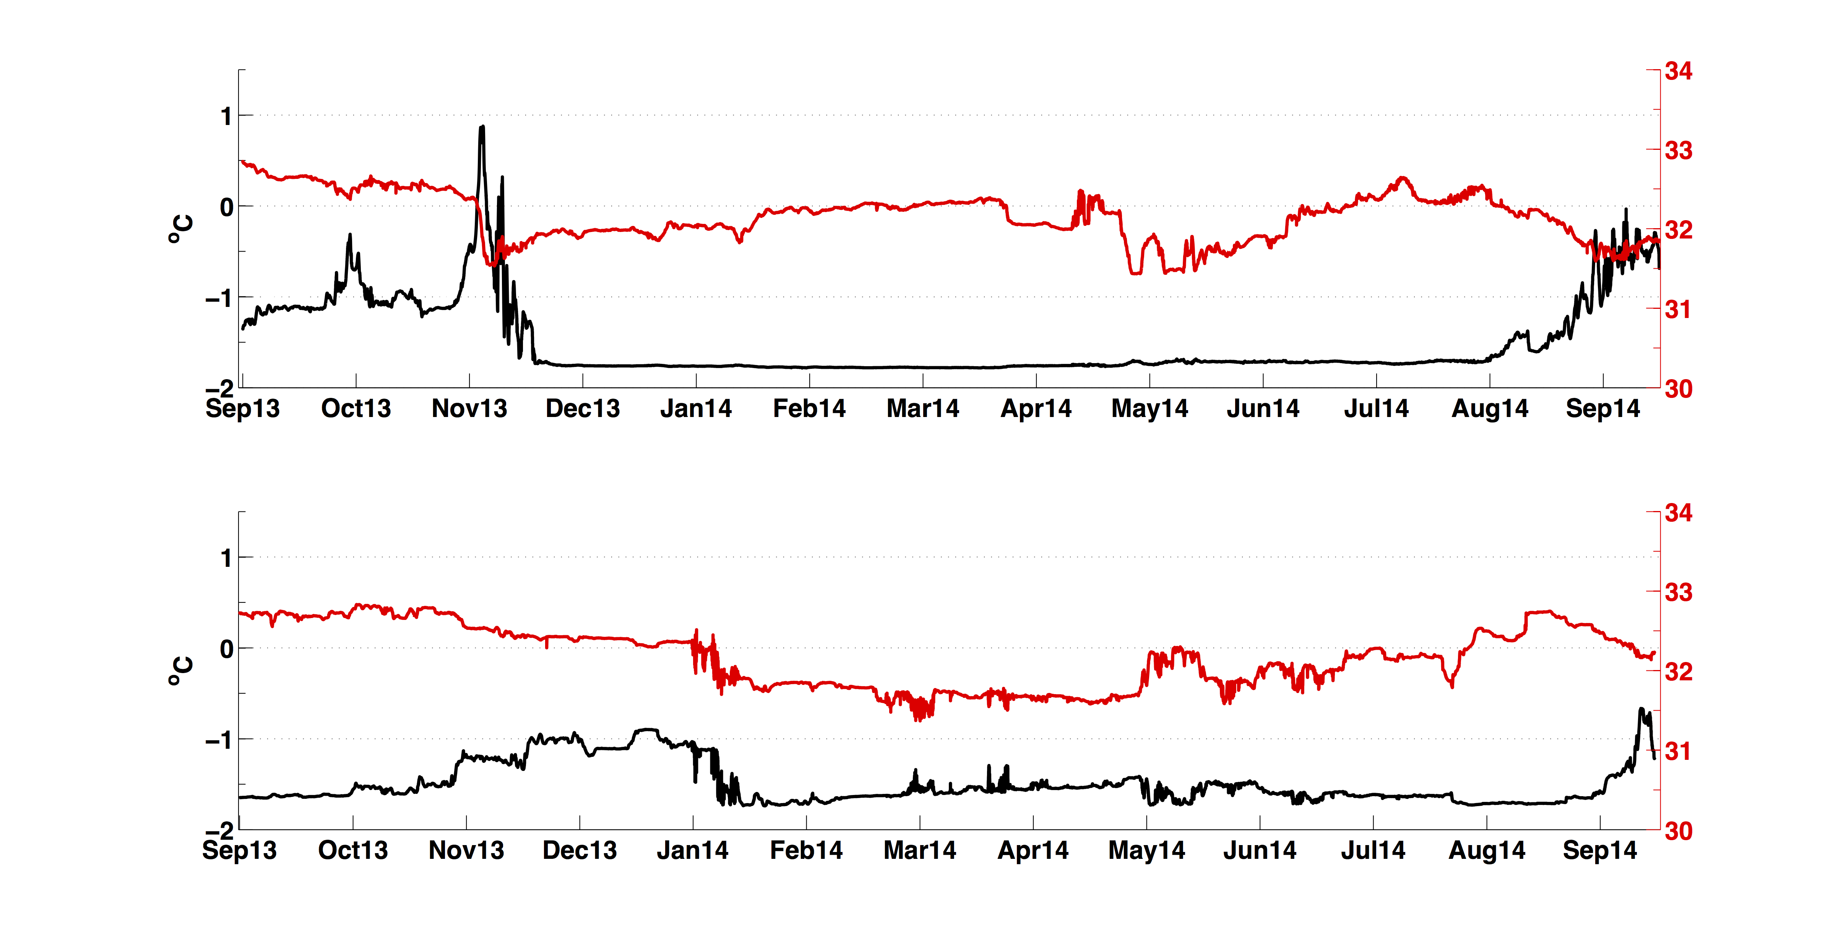
Bottom water variability
West (NW50)
When water reaches the freezing point on the western side, it is warmer on the eastern side of the shoal…
East (NE50)
Notes:
I check bottom microcat from NW50 and NE50, for representatives as west side and east side. Interestingly, when bottom water reached the freezing point after December, it is still warmer on the eastern side. This is weird.

Slide 11
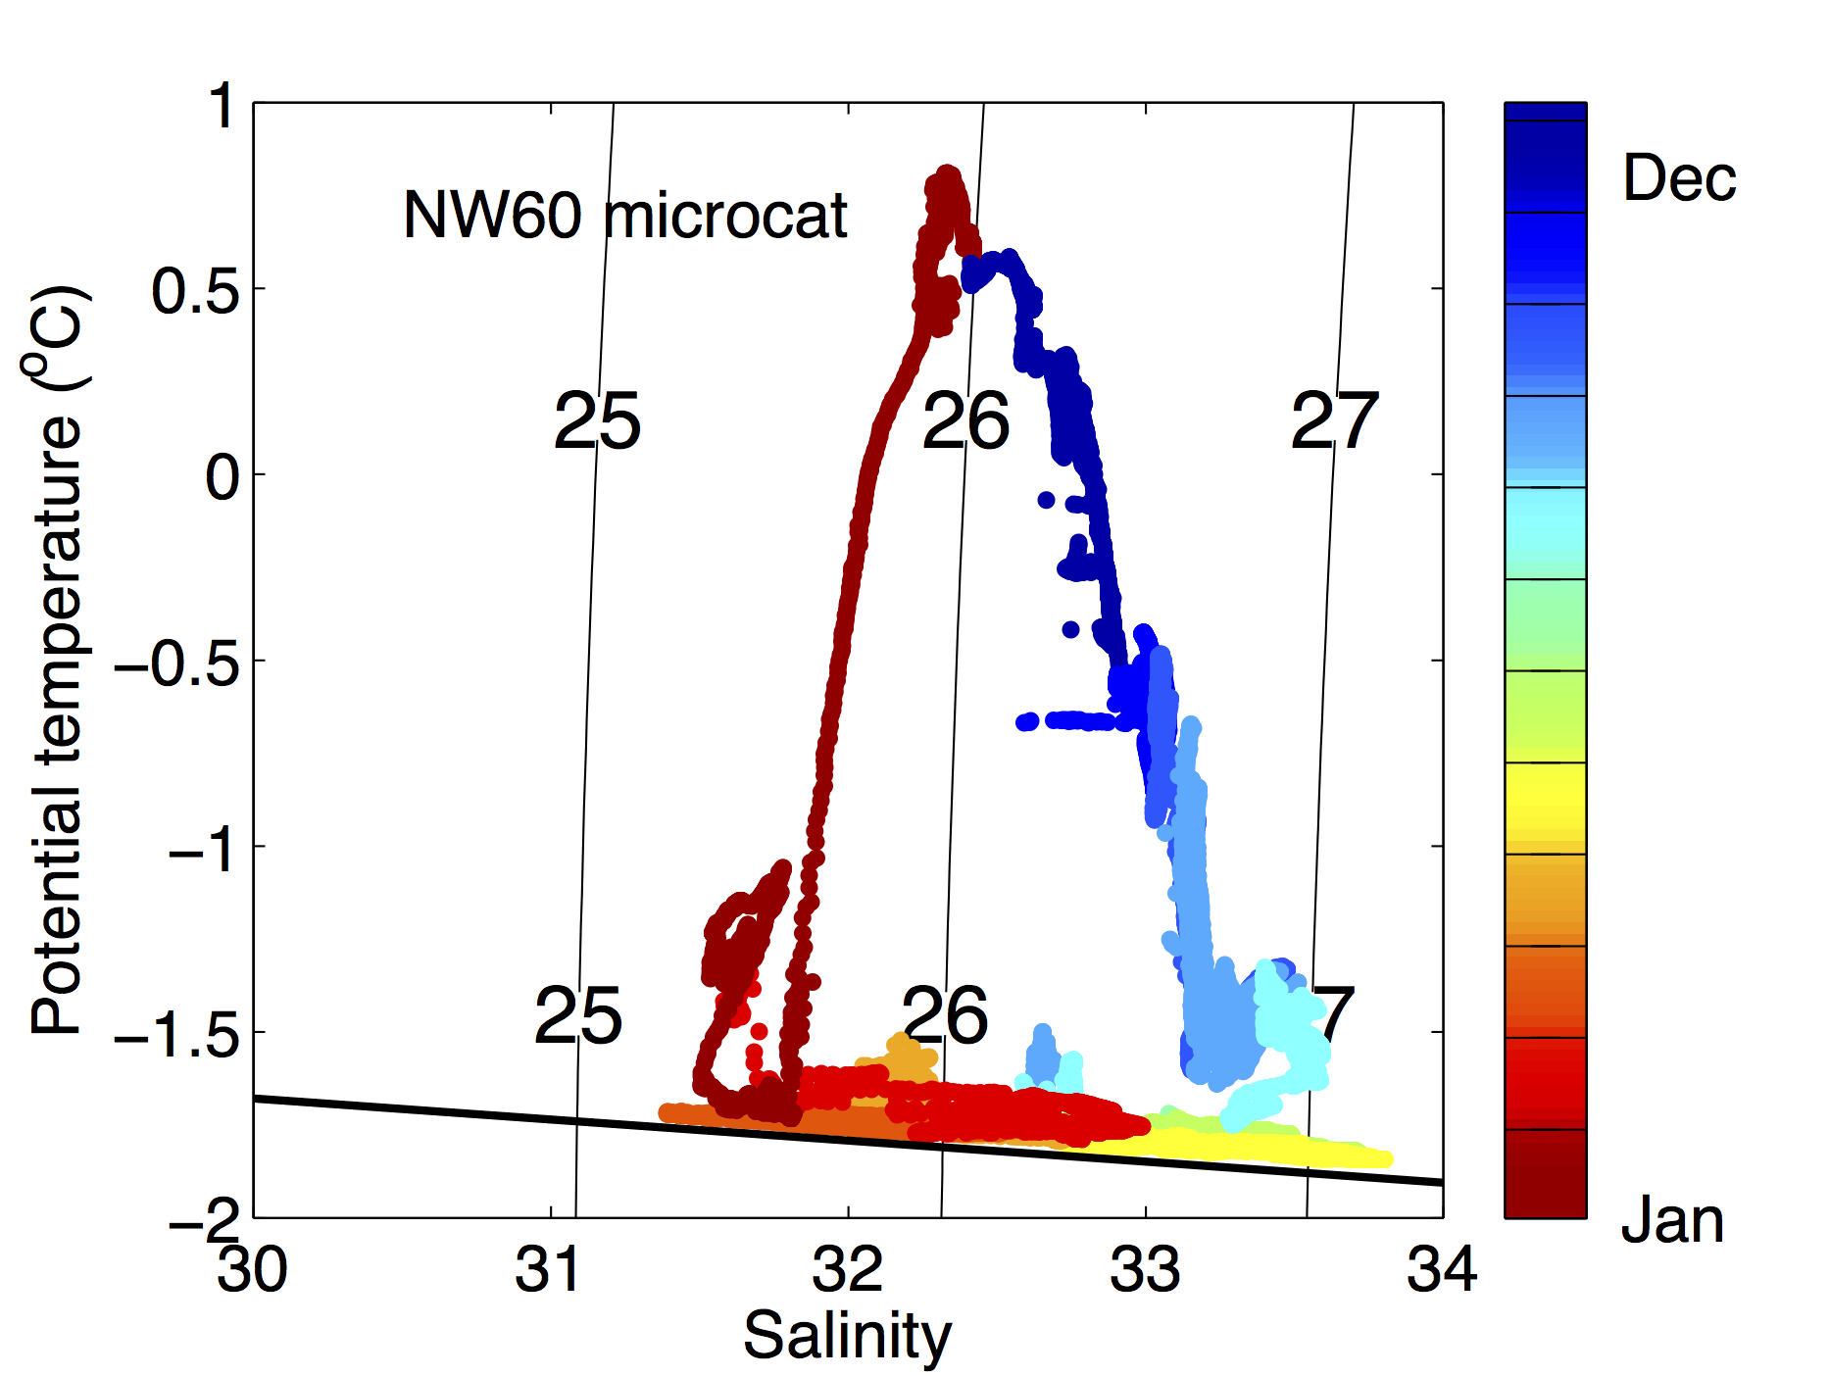
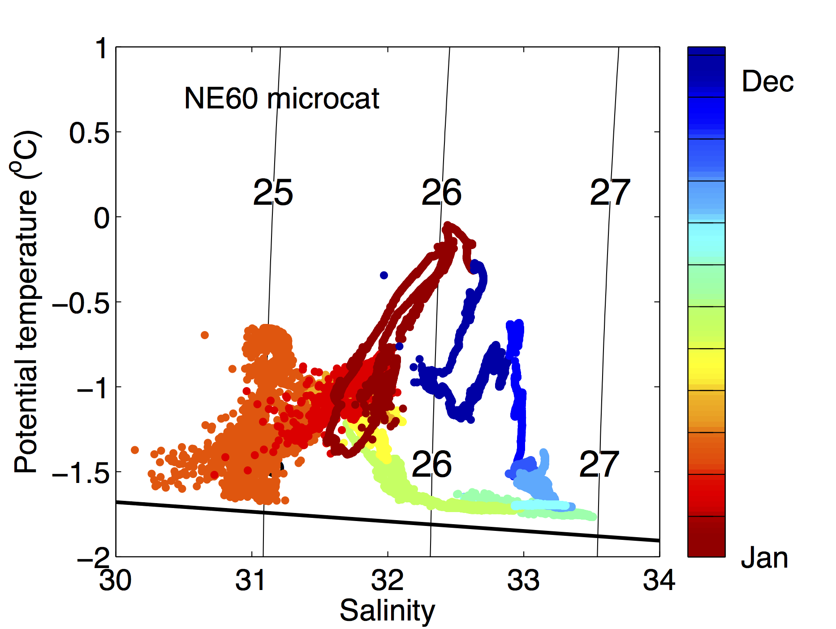
West
East
The arrival of relatively warm and fresh bottom water after January is seen at the eastern moorings
This water may result in downward sloping isopycnals on the eastern side of the shoal
Notes:
So I checked the microcat data again, but this time I chose microcat data at NW60 and NE60 in the first deployment period. Because it has best visualization. I plotted data in the T-S domian and color coded as function of time. So you see, after January, bottom water starts to get coder and saltier, this is during the process of forming winter water. However, on the eastern side, after January, the bottom water is getting warmer and fresher. This is very interesting! Similar patterns are also seen at the eastern moorings.We think this type water is the cause why we have this density gradient on the eastern side of Hanna Shoal.

Slide 12
Concluding remarks
The barotropic component weakens on the eastern side of Hanna Shoal
Deep flow is controlled by the clockwise barotropic pressure around Hanna shoal
Moving toward shallower depths, geostrophic shear becomes important on the eastern side of the shoal due to sloping isopycnals
This baroclinic component creates a counterclockwise pressure against the barotropic component
Mean flow is weaker on the eastern side, so the residence time is longer. How is it related to biology?

